Slide 1
Module 3
How To Use Blockchain Technology Within The Agrifood Sector
This programme has been funded with support from the European Commission. The author is solely responsible for this publication (communication) and the Commission accepts no responsibility for any use that may be made of the information contained therein
Blockchain for AgriFood Open Educational Resources © 2023/2024 by Blockchain for AgriFood Consortium is licensed under CC BY-SA 4.0

Slide 2
SECTION 01 INTRODUCTION
SECTION 02 BLOCKCHAIN AND SUPPLY CHAIN MANAGEMENT
SECTION 03 BLOCKCHAIN AND FARMER-CENTRIC SOLUTIONS
SECTION 04 BLOCKCHAIN AND ENVIRONMENT-CENTRIC SOLUTIONS
SECTION 05 BLOCKCHAIN AND CONSUMER RELATIONS
SECTION 06 LIMITATIONS OF BLOCKCHAIN’S USES IN AGRIFOOD
SECTION 07 CONCLUSIONS
CONTENTS
This programme has been funded with support from the European Commission. The author is solely responsible for this publication (communication) and the Commission accepts no responsibility for any use that may be made of the information contained therein

Slide 3
MODULE DESCRIPTION
Topic: ‘How to use Blockchain technology within the agrifood sector’
Significance: potential to improve the efficiency, profitability, and sustainability of the agrifood sector
Prominent in the academic literature
Address questions about why and how to implement from Blockchain’s use in the agrifood sector, who stands to benefit or lose

Slide 4
LEARNING OUTCOMES
Demonstrate a clear understanding of the major problems facing the agrifood sector today and Blockchain’s relevance as a potential solution to many of these problems
Analyse the role of Blockchain technology in supply chain management and farmer-, environment-, and consumer-centric solutions
Assess the relative advantages and disadvantages of implementing Blockchain technologies in the agrifood supply chain

Slide 5
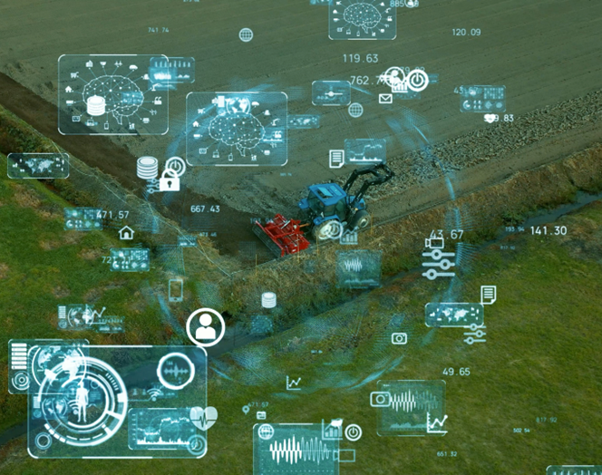
DIGITALISATION IN THE AGRI-FOOD SECTOR
Why digitalise?
Current challenges in the agri-food sector:
Supporting a rapidly growing population: 9.7 billion by 2050
Over a third of all food produced is lost or wasted each year
26% of greenhouse gas emissions globally come from food production
Financial losses associated with food waste (over $230 billion) and food fraud (up to $40 billion)

Slide 6
DIGITALISATION IN THE AGRI-FOOD SECTOR
Why digitalise?
Digitalisation and potential solutions
Increased productivity
Data-driven decision making
More efficient, transparent supply chains
Waste management and reduction
More sustainable, equitable agricultural practices

Slide 7
BLOCKCHAIN AND AGRI-FOOD DIGITALISATION
This module focuses on Blockchain technology, but it is important to remember that Blockchain represents just one useful tool within the wider digitalisation of the agrifood sector
Indeed, a certain level of digitalisation (e.g. level of technical literacy, reliable internet connection) is a prerequisite for the adoption of Blockchain technology
Blockchain is often most effective when used in conjunction with other advanced technologies (e.g. IoT, sensors, cloud computing, machine learning)

Slide 8
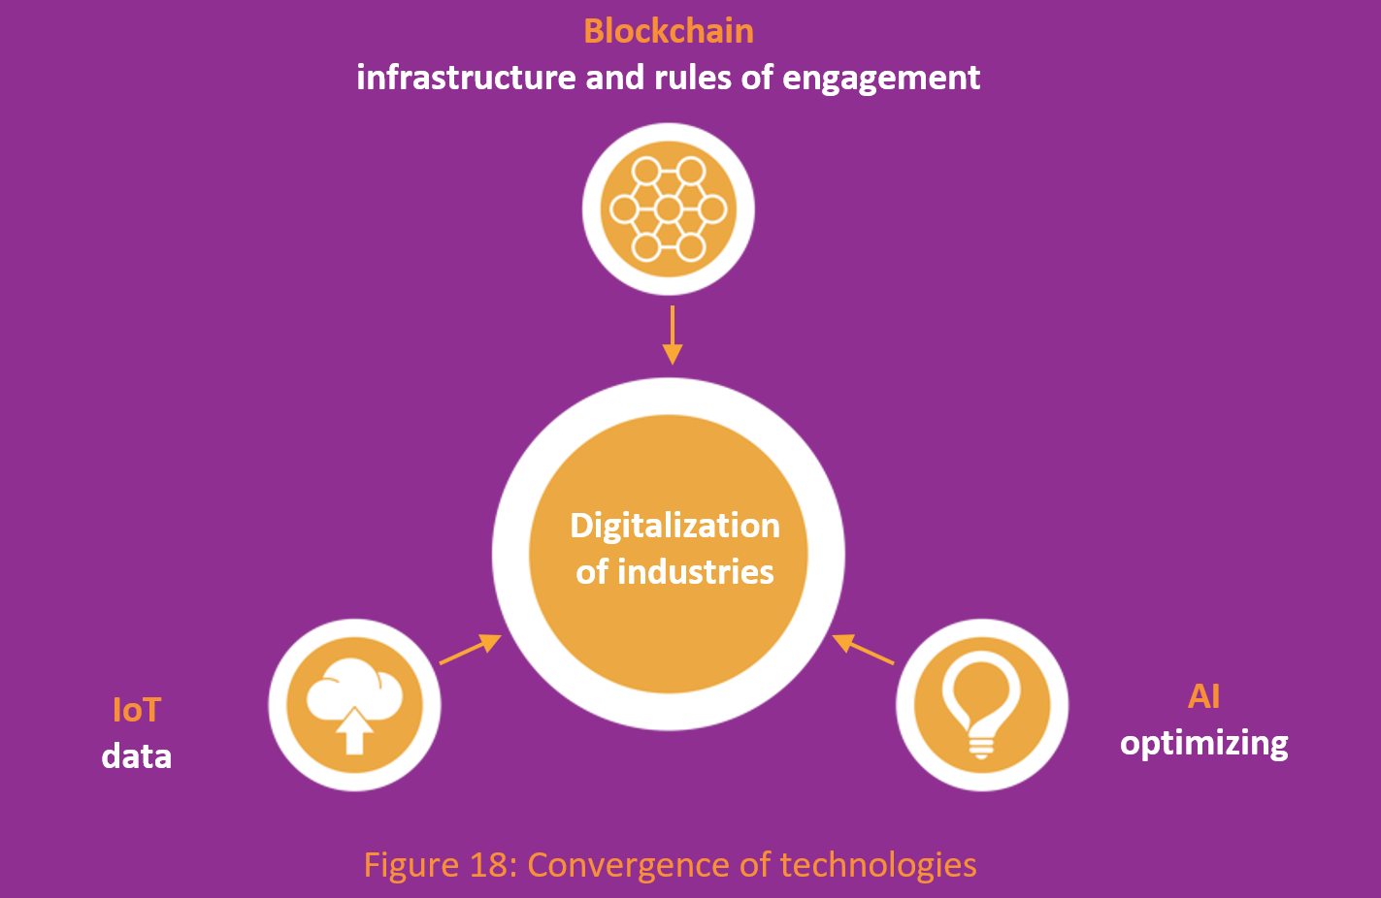
BLOCKCHAIN AND AGRI-FOOD DIGITALISATION
Source: Generation Blockchain

Slide 9
KEY TERMS
Digitalisation: the use of digital technologies to change a business model and provide new revenue and value-producing opportunities.
Internet of Things (IoT): a network of physical devices, vehicles, appliances and other physical objects that are embedded with sensors, software and network connectivity that allows them to collect and share data
Disintermediation: the removal of intermediaries from a supply chain.
Smart contract: a self-executing contract with the terms of the agreement between the two parties being directly written into lines of code.
Greenwashing: the act of providing the public or investors with misleading or outright false information about the environmental impact of a company’s products or operations.

Slide 10
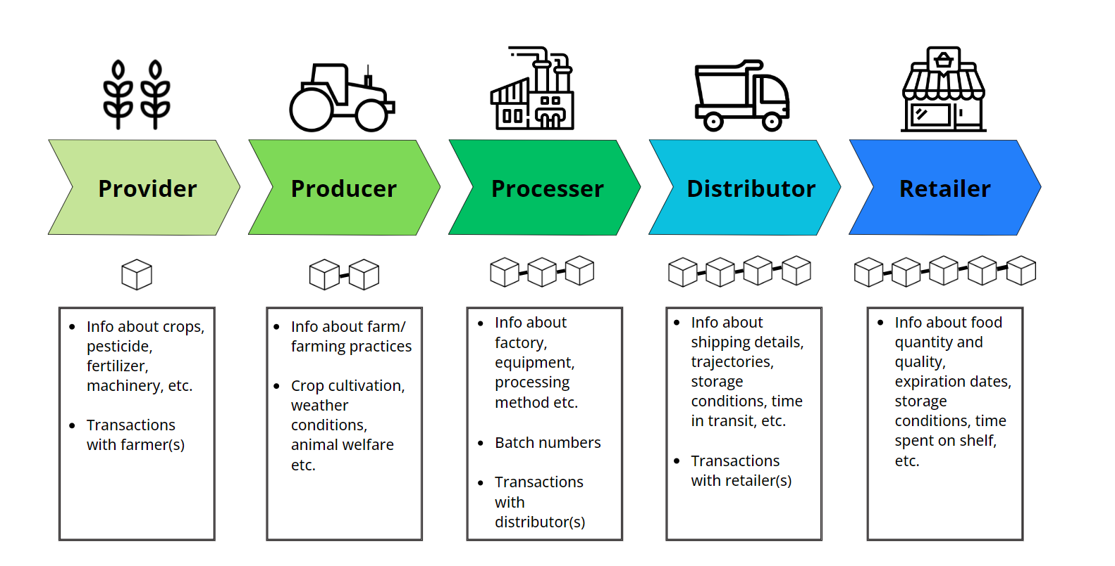
DIGITALISATION OF THE SUPPLY CHAIN USING BLOCKCHAIN
BLOCKCHAIN AND SUPPLY CHAIN MANAGEMENT

Slide 11
DIGITALISATION OF THE SUPPLY CHAIN USING BLOCKCHAIN
Click the video to watch how blockchain can be implemented into the agricultural supply chain

Slide 12
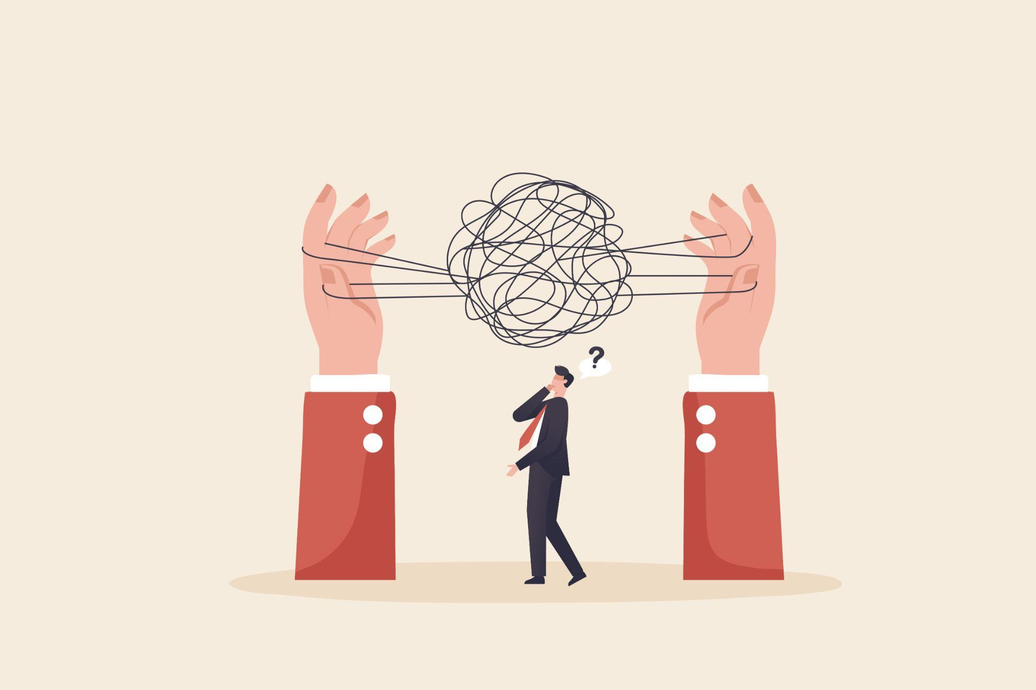
BLOCKCHAIN AND SUPPLY CHAIN MANAGEMENT
Problems in existing supply chains:
Large number of globally distributed stakeholders
Lack of shared information
Low levels of trust - need for third-party intermediaries, resulting in additional costs and delays
Low levels of digitalisation - most compliance data and information stored on paper or in a centralised database
Human error
Data manipulation
Inefficient, costly

Slide 13
Blockchain as a potential solution to many of these problems within the agrifood supply chain
Key: Blockchain as a distributed, decentralised ledger
Everyone on the Blockchain (nodes) receives an identical, synchronised copy of the information on the Blockchain
Data entered into the Blockchain must be verified and validated by all participants (consensus)
Data entered into the Blockchain is immutable
Let’s take a look at the kind of stakeholders and information that should be included in a Blockchain-supported agri-food supply chain
BLOCKCHAIN AND SUPPLY CHAIN MANAGEMENT
See Module 2 for more information on nodes, consensus, and the other building blocks of blockchain

Slide 14
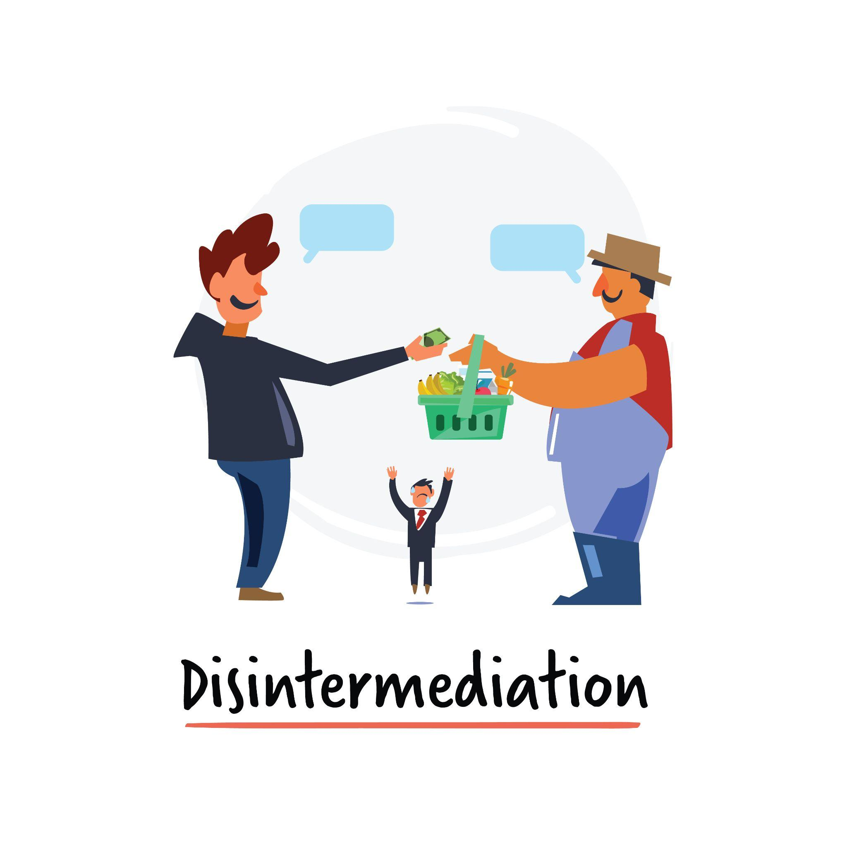
BLOCKCHAIN AND SUPPLY CHAIN MANAGEMENT
ADVANTAGES OF A BLOCKCHAIN-SUPPORTED AGRIFOOD SUPPLY CHAIN
Quicker, more accurate flow of information between supply chain stakeholders
Disintermediation - a distributed, decentralised ledger where information is verified by all stakeholders removes the need for third-party intermediaries to perform this task, thus cutting out the ‘middleman’
Less room for human error, data manipulation or miscommunication
Increased transparency
Increased efficiency
Reduced costs

Slide 15
BLOCKCHAIN AND SUPPLY CHAIN MANAGEMENT
ADVANTAGES OF A BLOCKCHAIN-SUPPORTED AGRIFOOD SUPPLY CHAIN
Increased transparency and traceability thanks to Blockchain can help to reduce the chances of human error and related food waste, but it cannot eliminate all risk of contamination
However, even in instances where Blockchain cannot prevent contamination in the supply chain, it can still help minimize the negative impact
Detailed information about a product’s provenance and journey through the supply-chain can help retailers to identify exactly which products were contaminated, when, and where, in order to conduct a swift and targeted product recall
By increasing supply-chain traceability, Blockchain can help improve food safety and reduce food waste

Slide 16
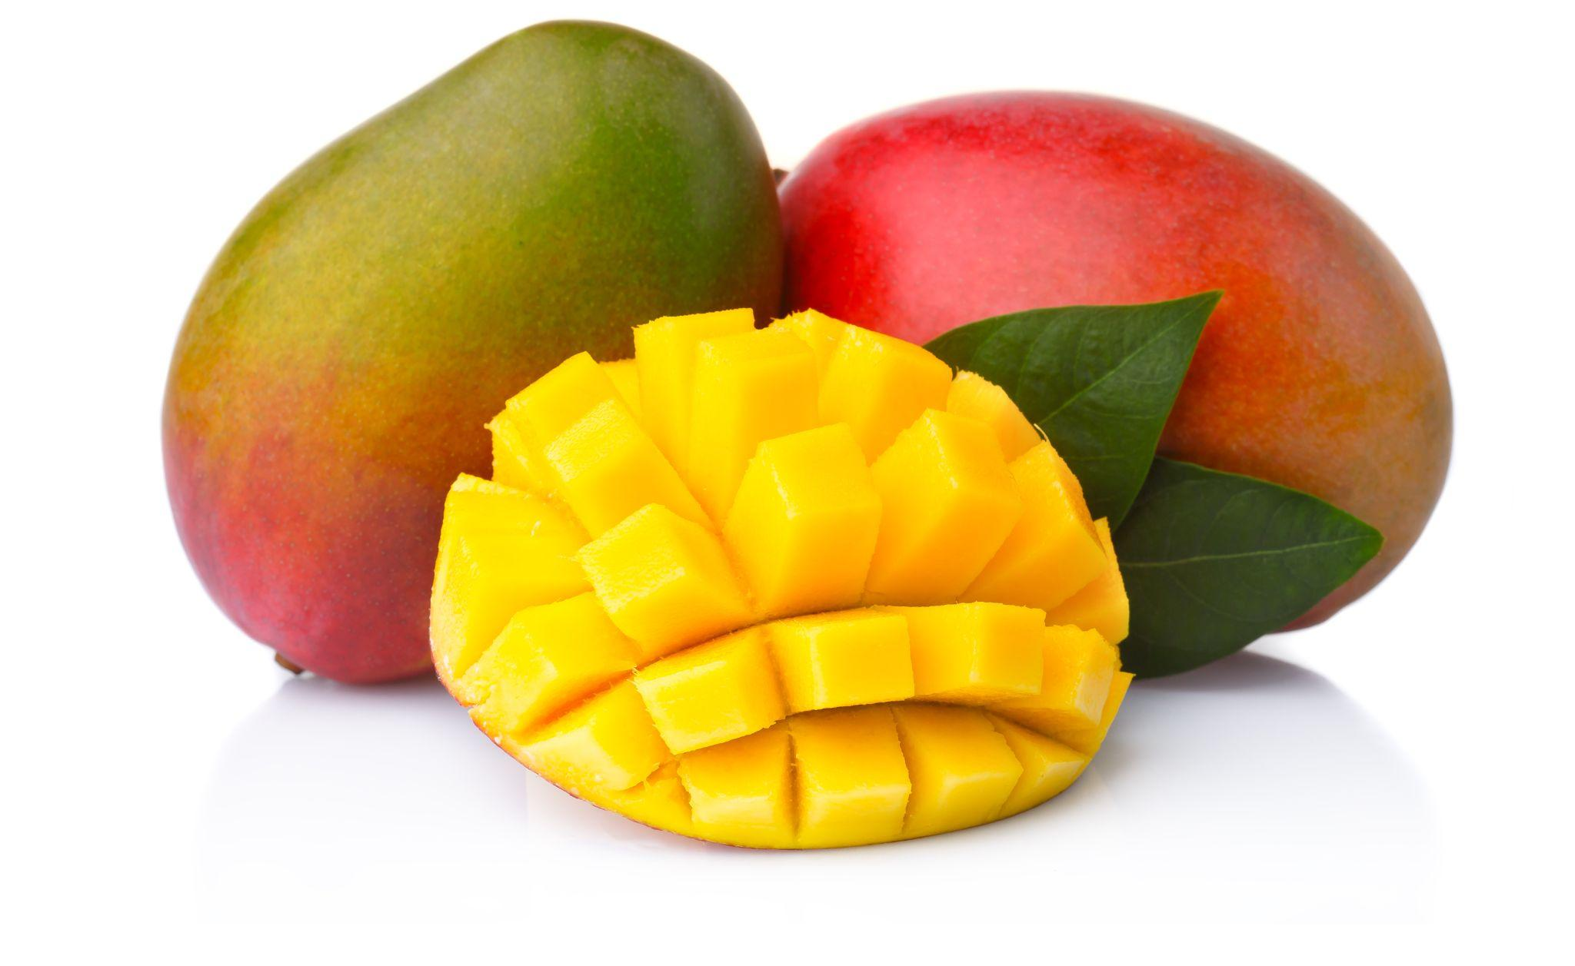
SHORT IN-CLASS EXERCISE: QUIZ
In 2016, Walmart and IBM conducted a case study tracing the provenance of a package of sliced mangoes on sale in one of Walmart’s US stores.
Prior to implementing Blockchain in their supply chain, it took Walmart’s Food Safety team 6 days, 18 hours and 26 minutes to trace the mango’s provenance.
After partnering with IBM to create a Blockchain-based food traceability system (Hyperledger), how long did it take to trace the same mangos?
24-48 hours
12-24 hours
0-12 hours
Under an hour
Using Blockchain, the mangos provenance was traced in just 2.2 seconds!

Slide 17
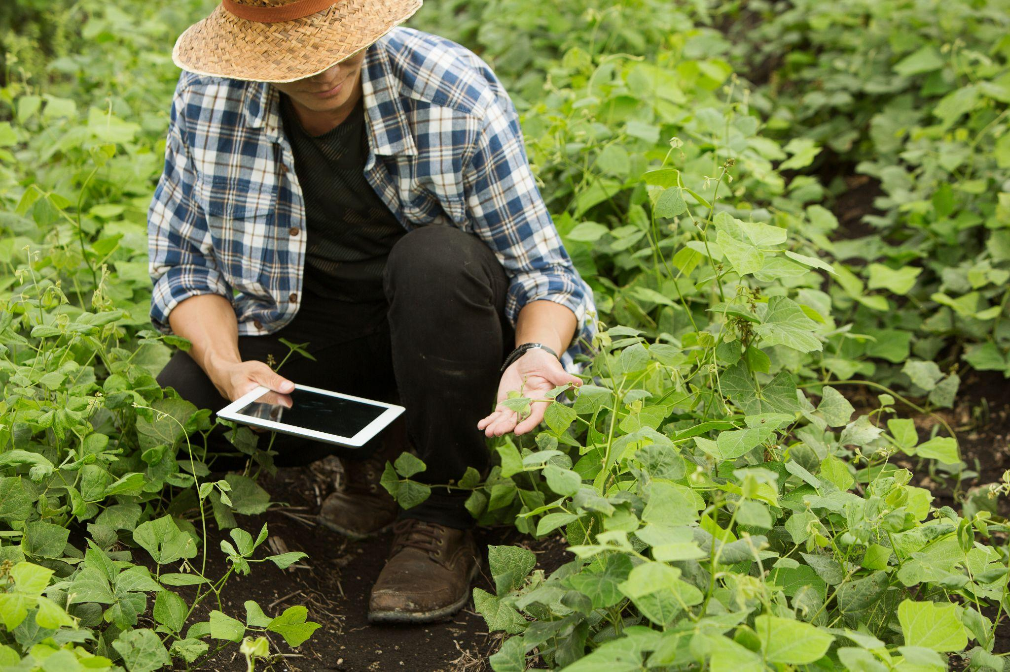
BLOCKCHAIN AND FARMER-CENTRIC SOLUTIONS
ADVANTAGES OF A BLOCKCHAIN-SUPPORTED AGRIFOOD SUPPLY CHAIN
Blockchain implementation has clear advantages in terms of overall supply-chain management, but it can also have more direct benefits for farmers specifically:
Better participation in supply chains
Reduced transaction costs
Support for farmer co-operatives
Support fair labour practices
Prompt payment for services and insurance claims

Slide 18
BLOCKCHAIN AND FARMER-CENTRIC SOLUTIONS
Typically, farmers - particularly small-scale farmers - can be inhibited from participating in supply chains due to costs (e.g. marketing costs, transaction costs, negotiation costs etc) caused by a lack of information transparency
Implementation of Blockchain in the agri-food supply chain can be beneficial to farmers by:
Enabling collaboration between supply chain partners by enhancing trust
Improved market knowledge and understanding of buyers’ requirements
Reduced transaction costs (e.g. due to disintermediation) can enable farmers to access new markets
Increased transparency and more direct contact with consumers can empower farmers in disadvantaged communities to demand fairer wages

Slide 19
BLOCKCHAIN AND SMART CONTRACTS
One way in which Blockchain based solutions can benefit farmers is through the use of smart contracts
Blockchain-based, can be integrated with IoT devices
Advantages: reduced time-delay, foster trust, immutable
Reduce need for intermediaries e.g. lawyers, banks who typically enforce the terms of the contract
Discourage buyers from reneging on payment
Note: stand-alone code-only smart contracts are not legally enforceable; smart contracts are most effective as ancillaries to implement the provisions of a traditional text-based, legally-binding contract

Slide 20
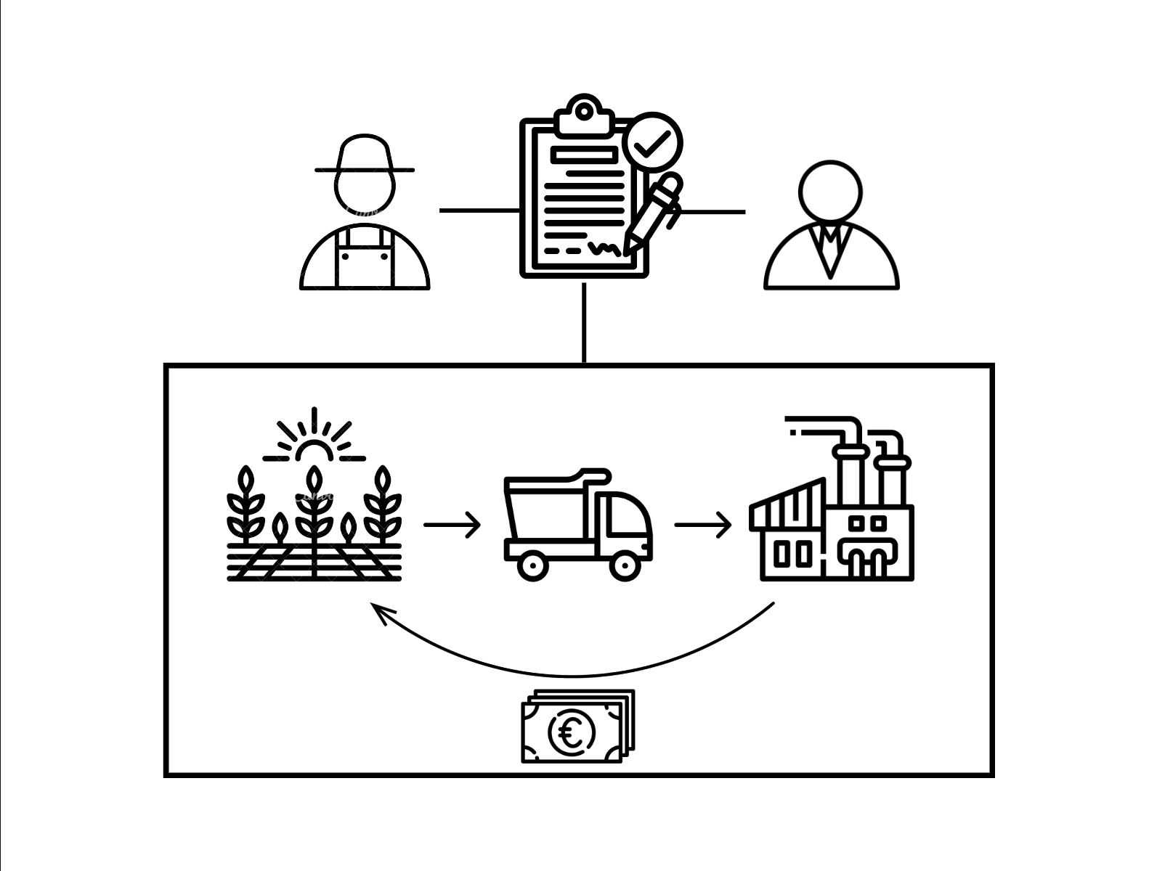
SMART CONTRACTS FOR AGRI-FOOD, an example
A farmer growing wheat wants to sell next year’s harvest to a producer who wants to turn it into flour.
The farmer and the producer create a smart contract according to which the farmer will be paid upon receipt of the wheat.
The following year, the wheat is harvested and delivered to the industrial mill, and the farmer receives his payment automatically via the smart contract upon transfer of asset ownership.
Agri-food smart contract example

Slide 21
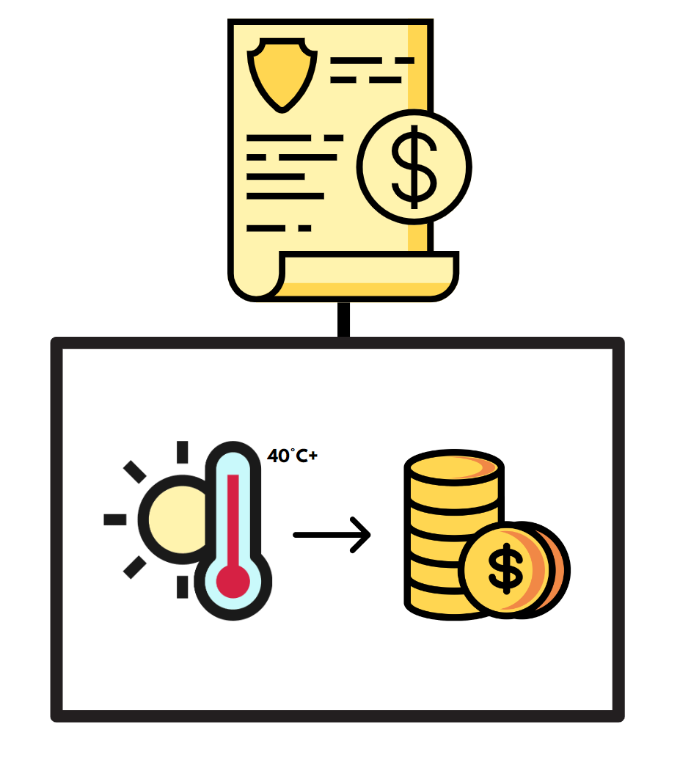
SMART CONTRACTS FOR AGRICULTURAL INSURANCE
Crop insurance is under-utilized globally, in part because the claims process can be complex and/or, in certain countries, corrupt
Smart index-based insurance contracts: payout is triggered by a measurable index rather than the loss itself
Example: an agricultural smart contract might be triggered by weather data, e.g. if it is hotter than 40 degrees for over a week, farmers with this insurance package will automatically receive a payout
Advantages: timely payout, minimal human interaction, symmetrical information between farmer and insurance provider, avoid costly damage assessment

Slide 22
SMART CONTRACTS: PROS AND CONS
PROS
Prompt payment, reduced time-delay
Reduced costs due to disintermediation
Transparency and immutability promotes trust between actors
Reduced likelihood of breach of contract
Promising use in crop insurance
Efficient
CONS
Smart contracts (in and of themselves) are not legally enforceable
Technical expert needed to write smart contract code - a new middleman?
Infrastructure and a high level of digital maturity is necessary for implementation
Inflexible

Slide 23
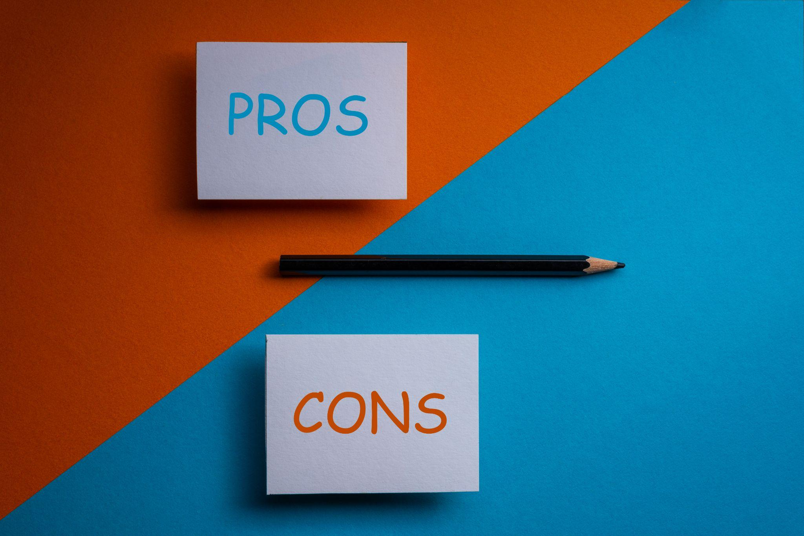
SHORT IN-CLASS EXERCISE
CLASSROOM EXERCISE
So far, we have outlined a number of advantages of smart contracts, but what are the potential disadvantages of smart contracts?
Break out into groups of 4 and discuss for 10 minutes. As part of this exercise, please create a list of pros and cons which you will share with the class.

Slide 24
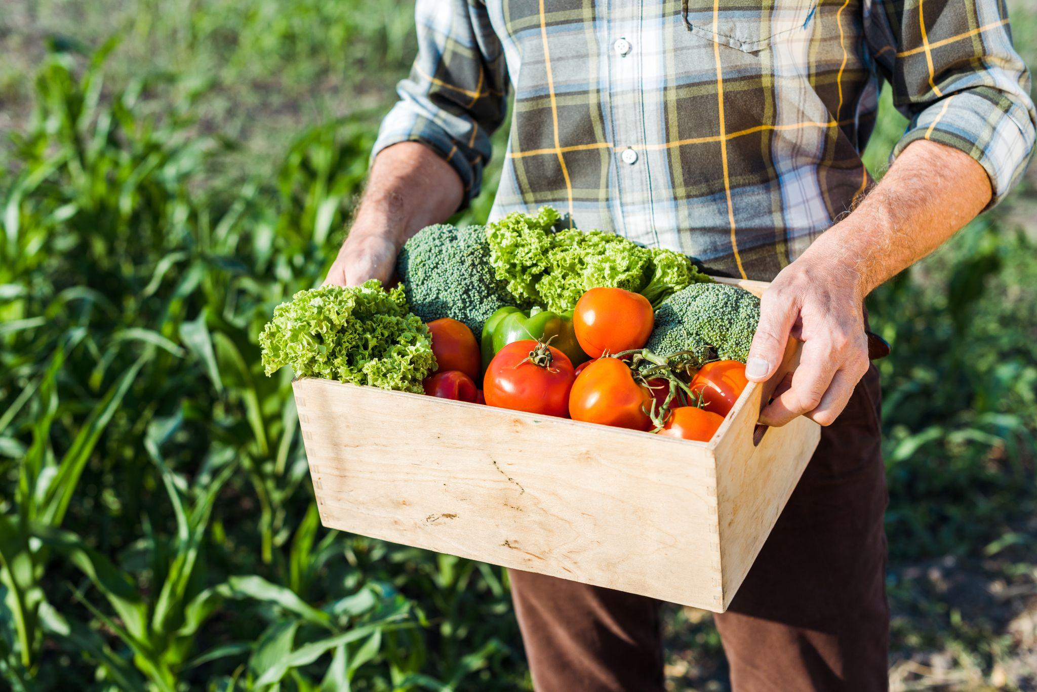
LIMITATIONS OF FARMER-CENTRIC SOLUTIONS
Although the literature has identified many potential advantages of Blockchain implementation for farmers, lack of digital capacity and initial adoption costs remain persistent problems
Low levels of digitalisation, especially in developing countries
Could potentially widen the financial and digital divide between large and small stakeholders, farmers in developed and developing countries
Importance of farmer training and skill development

Slide 25
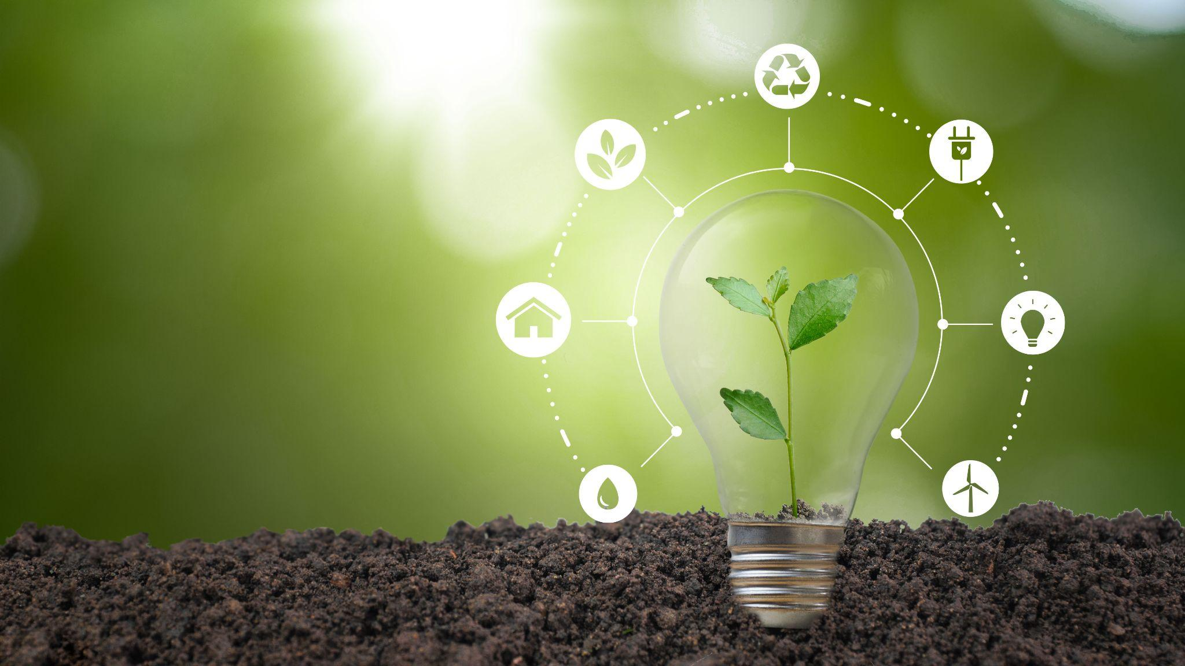
BLOCKCHAIN AND ENVIRONMENT-CENTRIC SOLUTIONS
The negative environmental impact of current agricultural practices necessitates a new sustainability driven approach to agrifood production
New technologies - including Blockchain based solutions - can help to make more effective use of limited resources and reduce food waste

Slide 26
BLOCKCHAIN AND ENVIRONMENTAL-CENTRIC SOLUTIONS
Blockchain’s potential to reduce food waste is also important from an environmental perspective
Approximately ⅓ of food produced globally goes to waste each year due to inefficiencies in the supply chain - this represents a massive waste of resources (e.g. water, energy in greenhouses, fuel for transport) as well as food
By reducing the number of intermediaries and increasing traceability (e.g. track conditions with IoT/RFID with data stored on Blockchain), the introduction of Blockchain in agri-food supply chains can reduce food waste and the associated environmental impact by enabling producers and retailers to more quickly identify and respond to incidences of contamination
Smart food loss management systems and sale of surplus food (e.g. charities, hospitality, compost, biogas etc)

Slide 27
BLOCKCHAIN AND ENVIRONMENT-CENTRIC SOLUTIONS
Pressure from consumers and investors have prompted many agrifood companies to make ambitious public commitments and pledges(e.g. zero deforestation, 100% renewable energy, 100% recycled materials)
However, complex and opaque global supply chains can make it difficult even for companies with good intentions to implement their commitments and demonstrate measurable results
Inability to meet environmental commitments damages a company’s credibility and reputation
Third-party certifications as a solution? 1) Confusing proliferation, 2) Greenwashing, 3) Audit fraud, 4) Expensive
Blockchain as a way to demonstrate fulfilled commitments/an alternative to third-party certification: transparency, verifiable supply chains, and trust
Note: role of governments and regulatory bodies key to holding companies accountable - consumer demand may be an insufficient motivator on its own

Slide 28
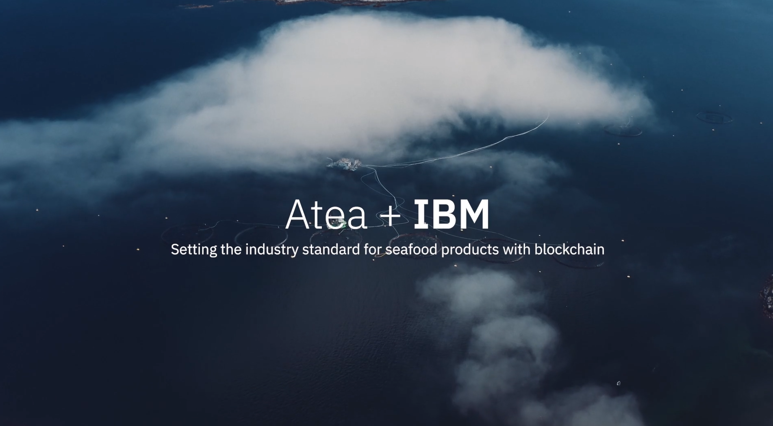
CASE STUDY: FISHING INDUSTRY
The fishing industry is often associated with unsustainable practices such as overfishing which pose a serious threat to marine conservation
Use of Blockchain technology to support more sustainable fishing practices
Example: Atea and IBM Food Trust
Video: Atea + IBM Food Trust

Slide 29
CASE STUDY: FISHING INDUSTRY
Other examples of Blockchain uses for sustainable fishing:
World Wildlife Fund (WWF)
2018 pilot programme, blockchain in the Pacific Islands’ tuna industry
Aim to stamp out illegal, unregulated and unreported tuna fishing, as well as unfair labour practices
Result: launch of online platform, OpenSC, which uses blockchain to verify sustainable production, track food along the supply chain and help people to avoid illegal, environmentally-damaging or unethical products
Source: Wikimedia

Slide 30
CASE STUDY: FISHING INDUSTRY
FishCoin
Open-source, decentralised Blockchain platform designed to incentivize data sharing
Fishcoin app: enables fishers to sell information about their catch to potential buyers. When a buyer decides to purchase the data, the fisher is immediately rewarded with cryptocurrency tokens (FishCoins), which can be redeemed for e-vouchers, mobile plan minutes, credit towards utility bills, or direct remuneration where applicable on a country by country basis
Source: fishcoin.co

Slide 31
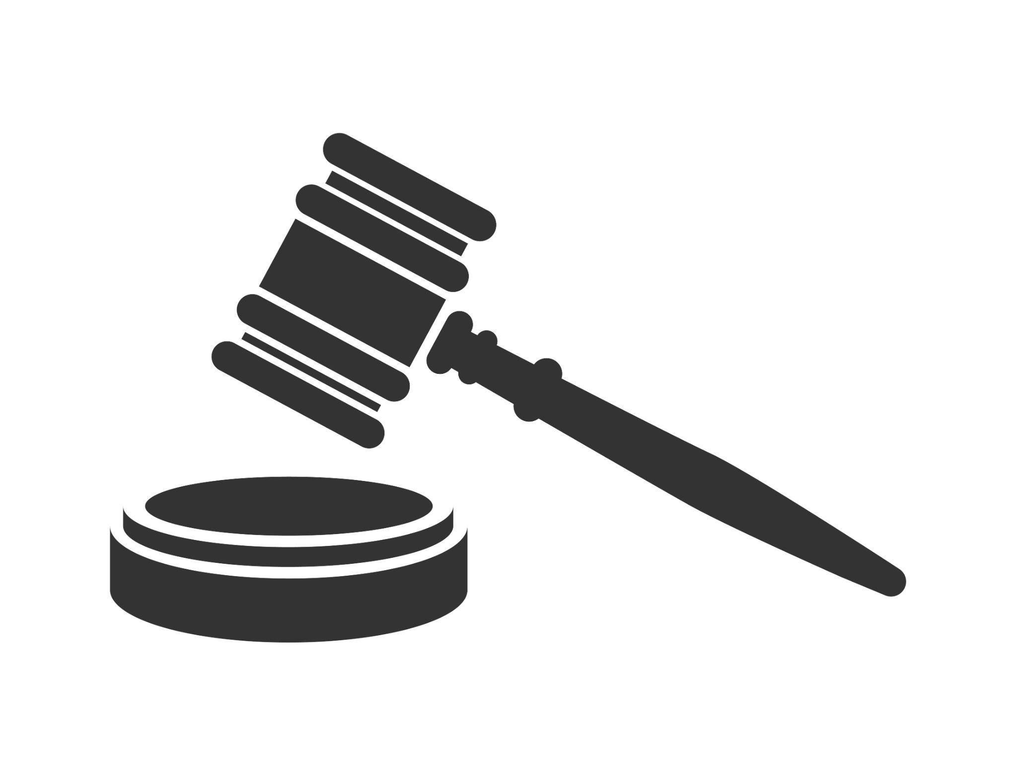
LIMITATIONS OF ENVIRONMENT-CENTRIC SOLUTIONS
Blockchain can offer radical environmental transparency - but not all agrifood actors may want this
Producers also have incentives not to disclose information - current lack of regulation, high expenditure, competition, reputational damage
Selective information sharing - disclose only positive aspects while ignoring the negatives
To encourage greater transparency (using Blockchain or otherwise), governmental and societal pressure is crucial

Slide 32
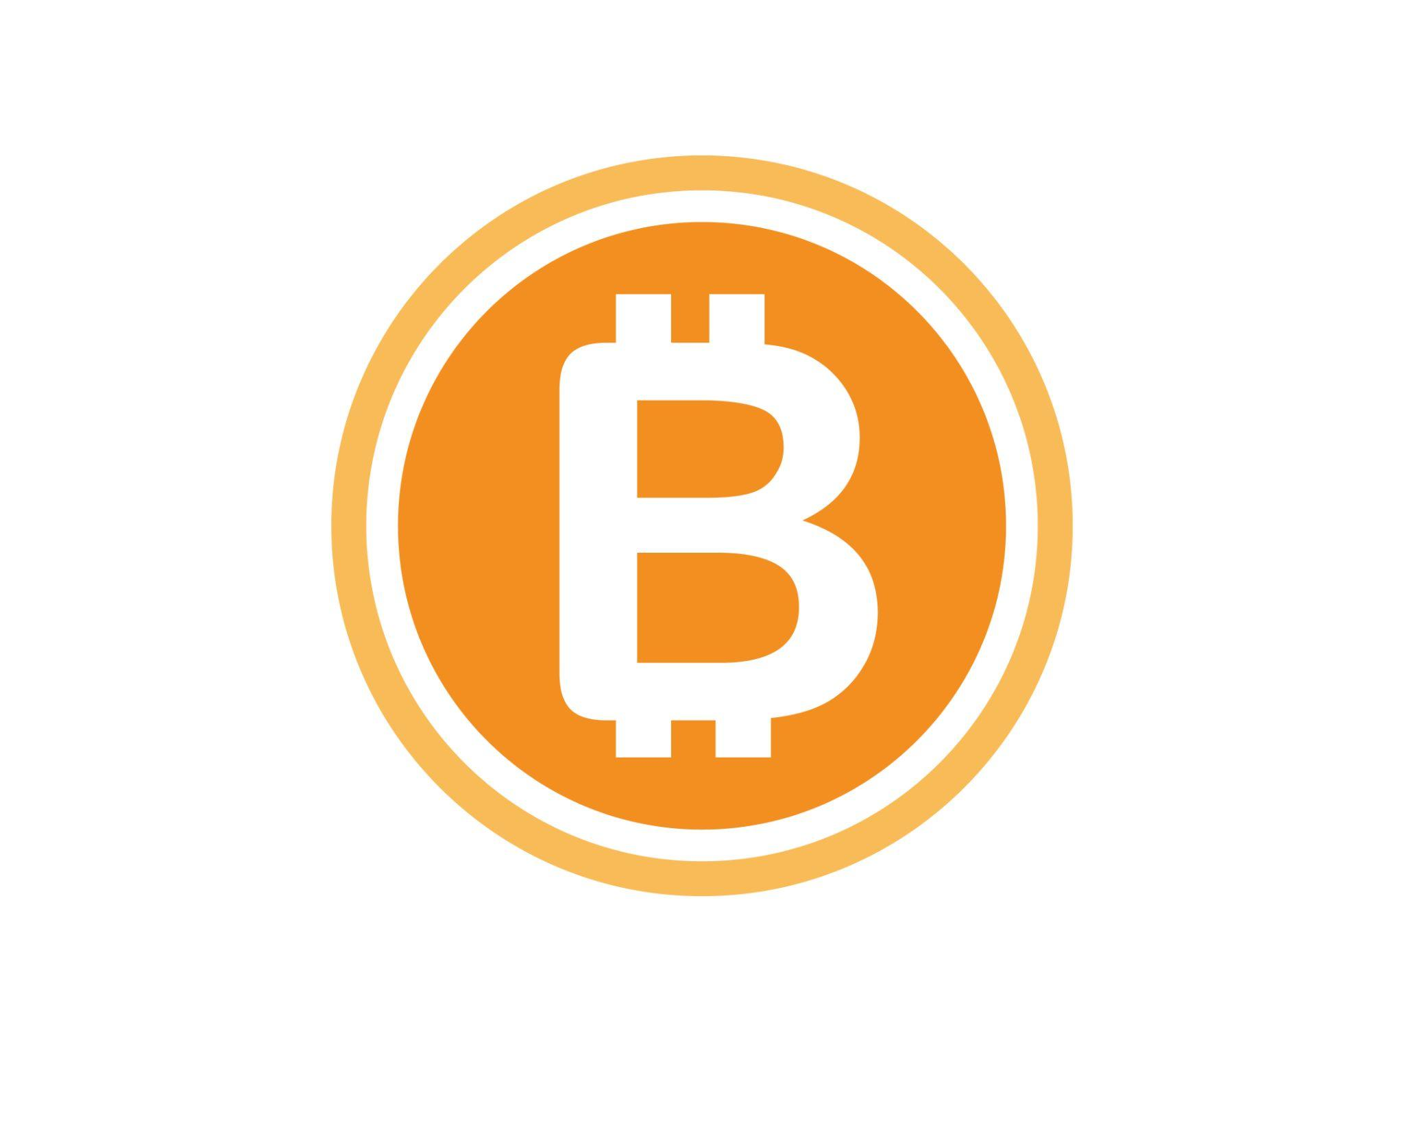
LIMITATIONS OF ENVIRONMENT-CENTRIC SOLUTIONS
Question surrounding the sustainability of Blockchain technology itself?
Most well-known Blockchain consensus mechanism: Proof of Work (PoW)
PoW often requires high levels of computational power and, consequently, high levels of energy consumption
In 2022, Bitcoin’s estimated carbon footprint was comparable to country-level emissions of Greece

Slide 33
LIMITATIONS OF ENVIRONMENT-CENTRIC SOLUTIONS
Possible solution: alternatives to PoW? Many alternatives have been developed, here are two of the most commonly used:
Proof of Stake (PoS) - rather than solving computational problems to verify transactions, validators are selected to verify transactions = lower energy consumption than PoW
Validators chosen based on the amount of stake they have in the network
Disadvantage: potential problem of monopolisation
Proof of Authority (PoA) - like PoS, transactions are verified by validators who are chosen based on their trustworthiness = lower energy consumption than either PoW or PoS
Disadvantage: centralised consensus mechanism

Slide 34
SHORT IN-CLASS SUSTAINABILITY EXERCISE
The sustainability of Blockchain technology is a complex issue, and no version of Blockchain so far is without its drawbacks, though the technology is continuously evolving
What do you think? (30 mins)
Divide the class into three groups, those who consider Blockchain a sustainable technology (YES), those who don’t (NO), and those who are unsure (DON’T KNOW).
The YES and NO groups should stand on opposite sides of the room with the DON’T KNOWs in the middle.
The teacher will alternately ask random members of each group to explain their stance.
Throughout the debate, students who are persuaded by the arguments of others have the chance to leave their group and join another (‘voting with your feet’). Students who switch groups will be asked to explain what argument most convinced them to change their stance.

Slide 35
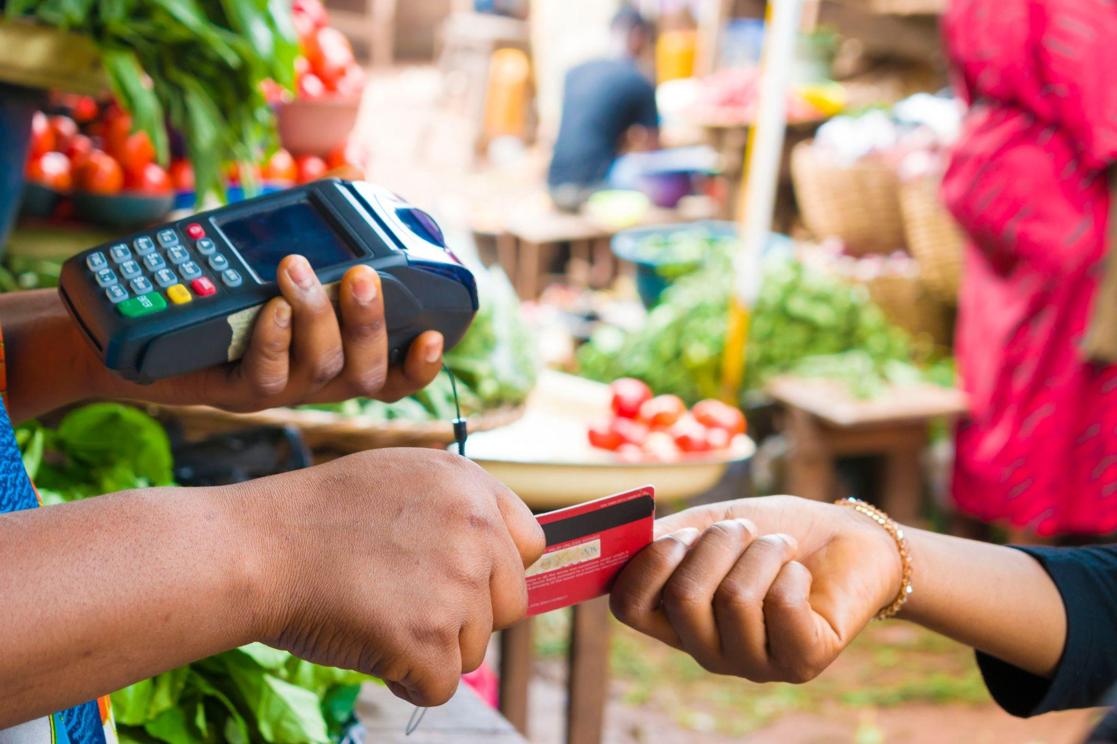
BLOCKCHAIN AND CONSUMER RELATIONS
Shifting consumer preferences - quality, safety, sustainability, responsibility
Over 70% willing to pay higher price for transparency
Blockchain as an opportunity to increase consumer confidence and attract new customers
Transparency as a unique selling point: a new competitive advantage

Slide 36
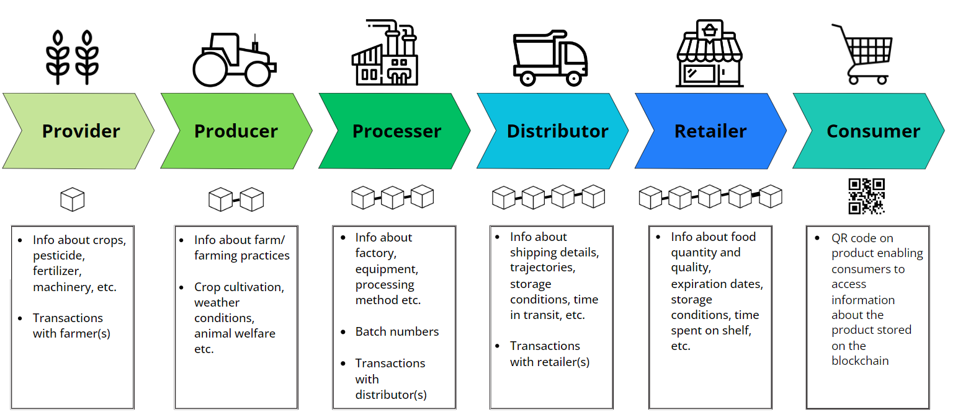
BLOCKCHAIN AND CONSUMER RELATIONS
Mechanism: QR codes on products

Slide 37
BLOCKCHAIN AND QUALITY ASSURANCE
Certain products where price and provenance are closely linked e.g. PDO products, wine, organic foods
Consumers are willing to pay a premium but need assurance the product is genuine
Incidences of food fraud
Blockchain solution: track product on Blockchain from source and make this information available to the consumer

Slide 38
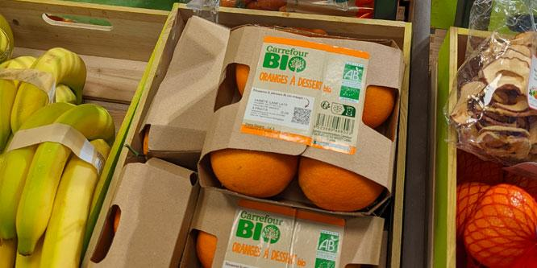
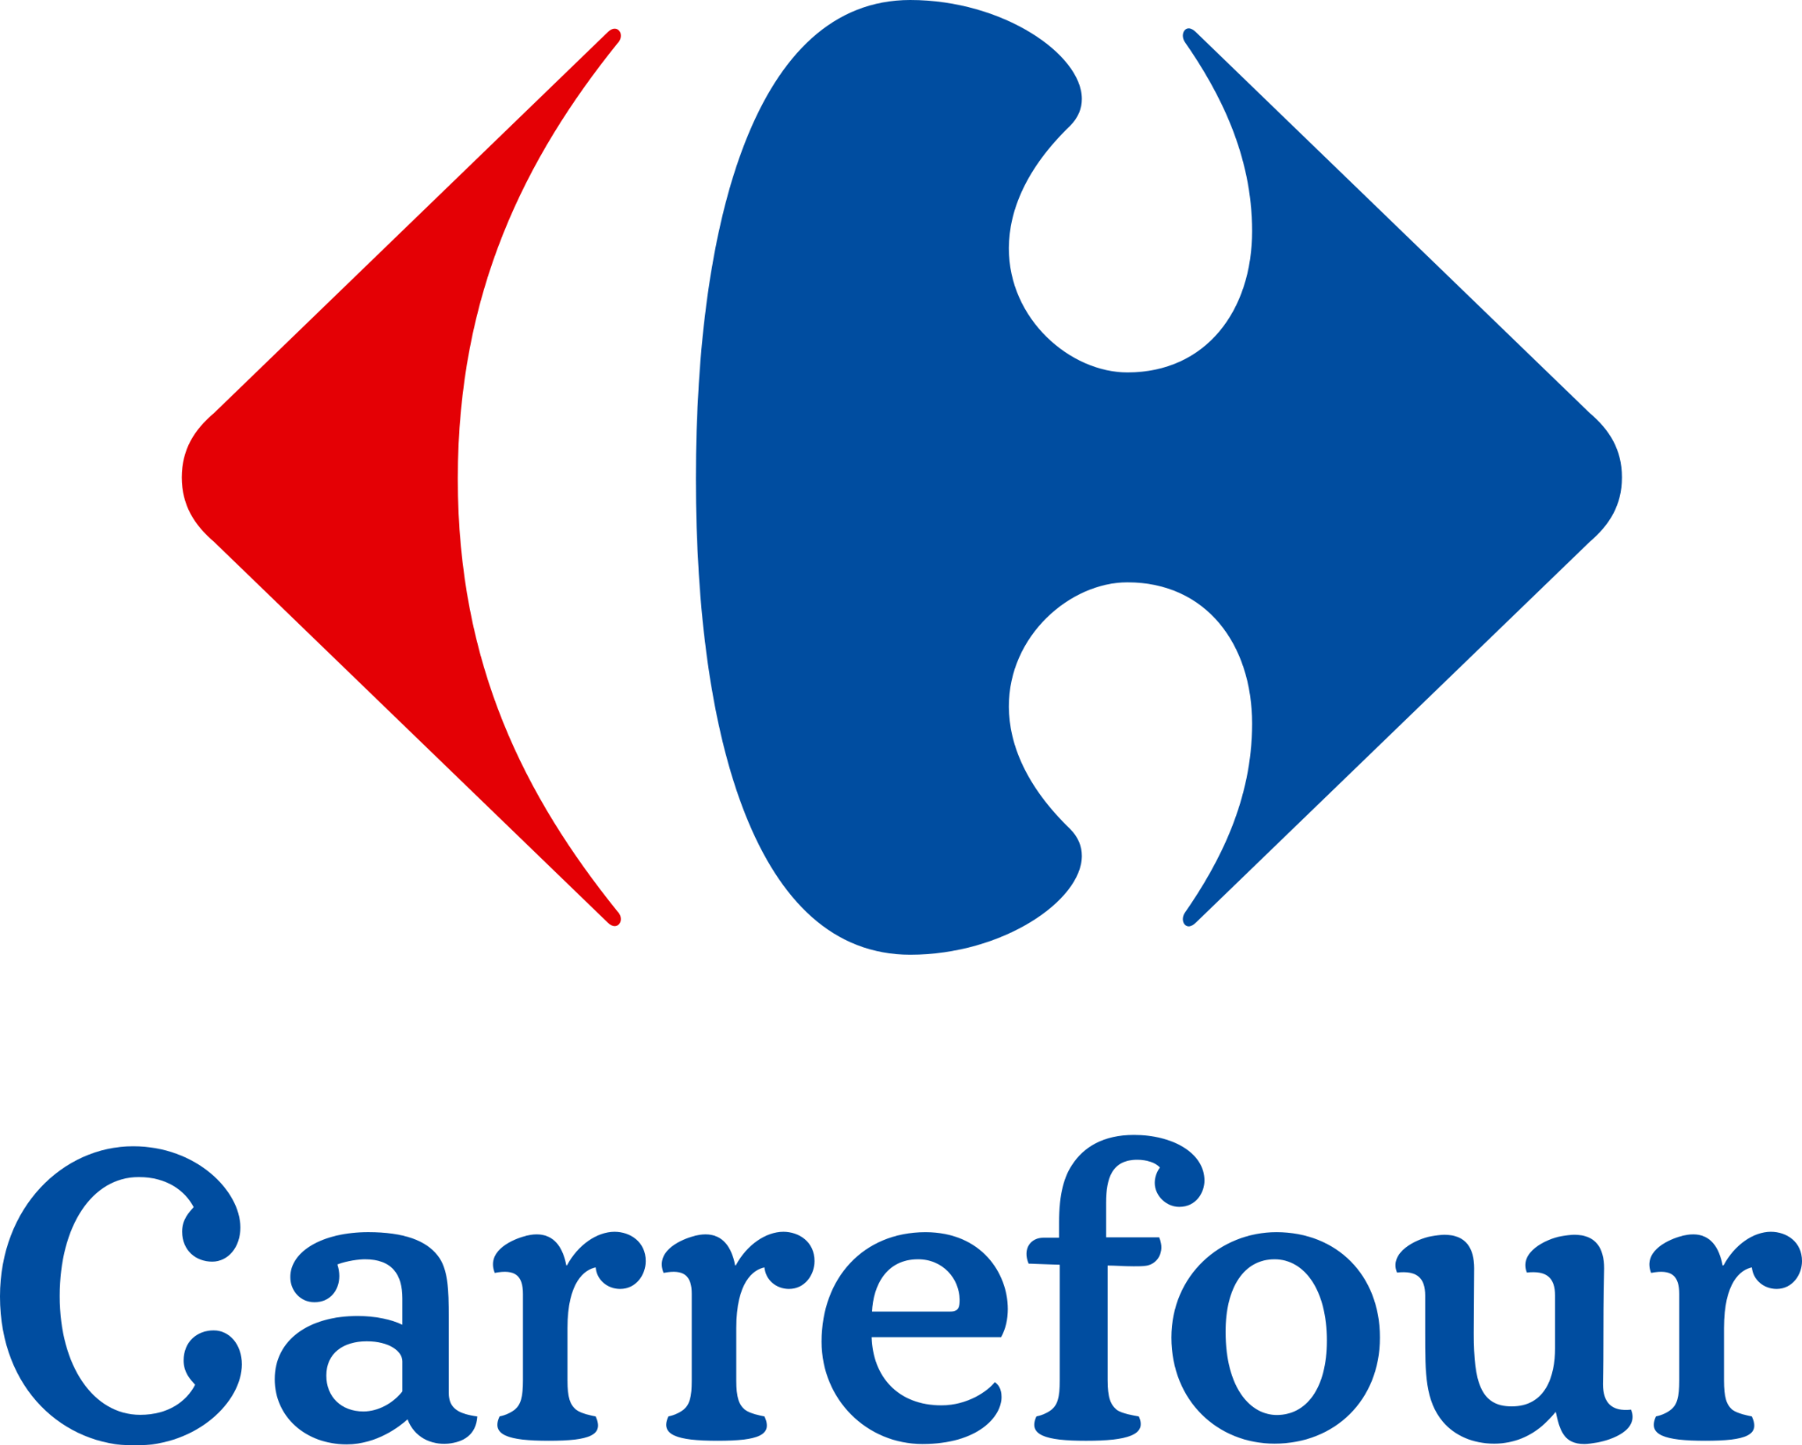
EXAMPLE: CARREFOUR BIO
2022 press release: ‘Carrefour is the first retailer to use blockchain technology with its own-brand organic products, providing consumers with more transparency’
Pilot product: organic dessert oranges
‘A QR code for retracing the itinerary of each batch’:
Its origin and the pathway it has taken: producer name, field location, packaging location, transport means
Its quality: harvest date, analysis results, variety and seasonality
Its organic certification: conversion date, official certificate, additional initiatives implemented by the producer.
Source credits: Carrefour Group

Slide 39
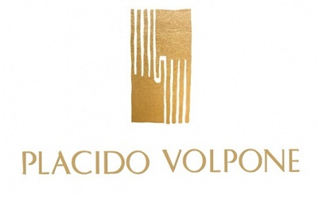
EXAMPLE: PLACIDO VOLPONE
Source credits: Placido Volpone

Slide 40
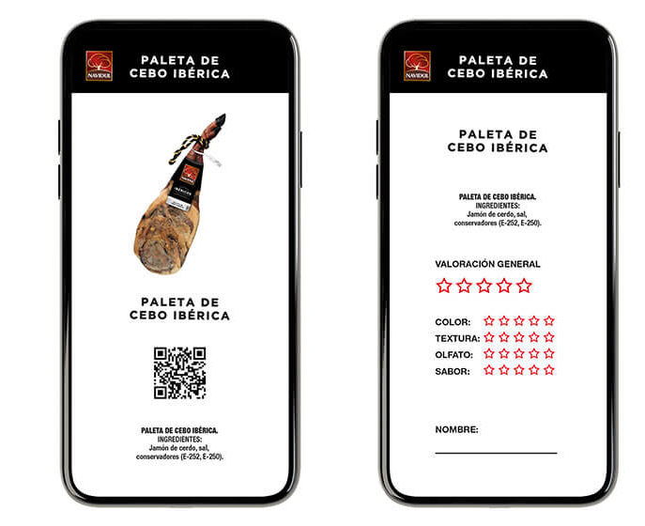
EXAMPLE: NAVIDUL
Iberian ham shoulders (DO)
Coloured-coded labels and Blockchain
Information about the animal’s diet weight, curing process etc.
“True, complete, and immutable” information

Slide 41
BLOCKCHAIN AND QUALITY ASSURANCE
Another way Blockchain solutions could be useful in terms of consumer relations is in the event of a product recall
Product recalls represent a loss for the company in terms of unsold products, but an even greater loss can be damage to the company’s reputation and losing consumers’ trust
Integrated Blockchain and IoT/RFID technologies can help reduce the likelihood of product recall by closely monitoring product quality throughout the supply chain - but even in instances where contamination is not successfully avoided, Blockchain- enabled traceability can help companies mitigate the reputational damage of a product recall
Knowing exactly which products were contaminated, how, when and where can help companies to conduct a swift and targeted product recall that can help to avoid a potential scandal

Slide 42
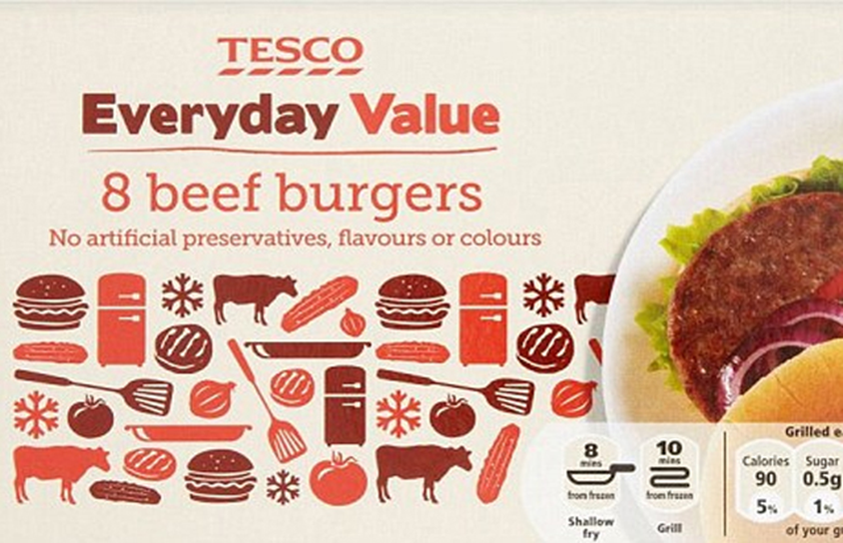
SHORT IN-CLASS EXERCISE: TESCO BURGER HORSE MEAT SCANDAL, 2013
Read the 2013 Guardian article on the Tesco burger horse meat scandal
Break into groups of 4 and discuss how the use of modern Blockchain technology could have helped to prevent and/or mitigate the scandal
‘Horsemeat scandal: where did the 29% horse in your Tesco burger come from?’, The Guardian, 2013

Slide 43
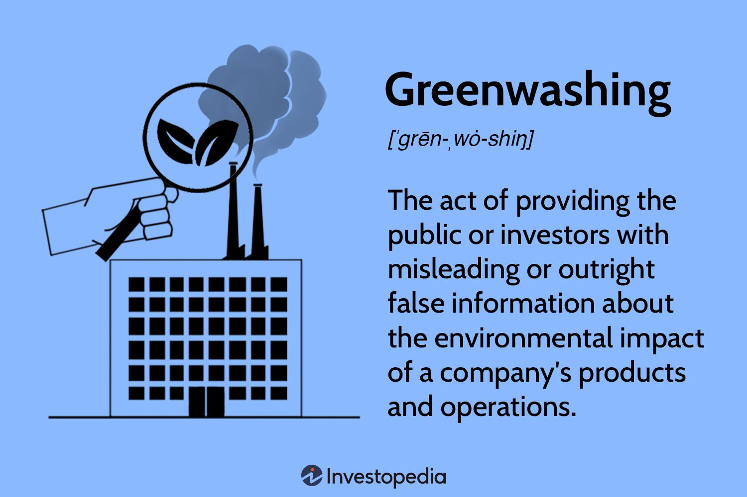
BLOCKCHAIN AND SUSTAINABILITY
Consumers are concerned about environmental sustainability - carbon footprint, deforestation, depletion of natural resources
Proliferation of certificates - a source of clarity or confusion?
Consumer wariness of ‘greenwashing’
Potential solution: include information on the blockchain about water usage, pesticide, travel miles, energy sources etc.
Informed consumer decision-making

Slide 44
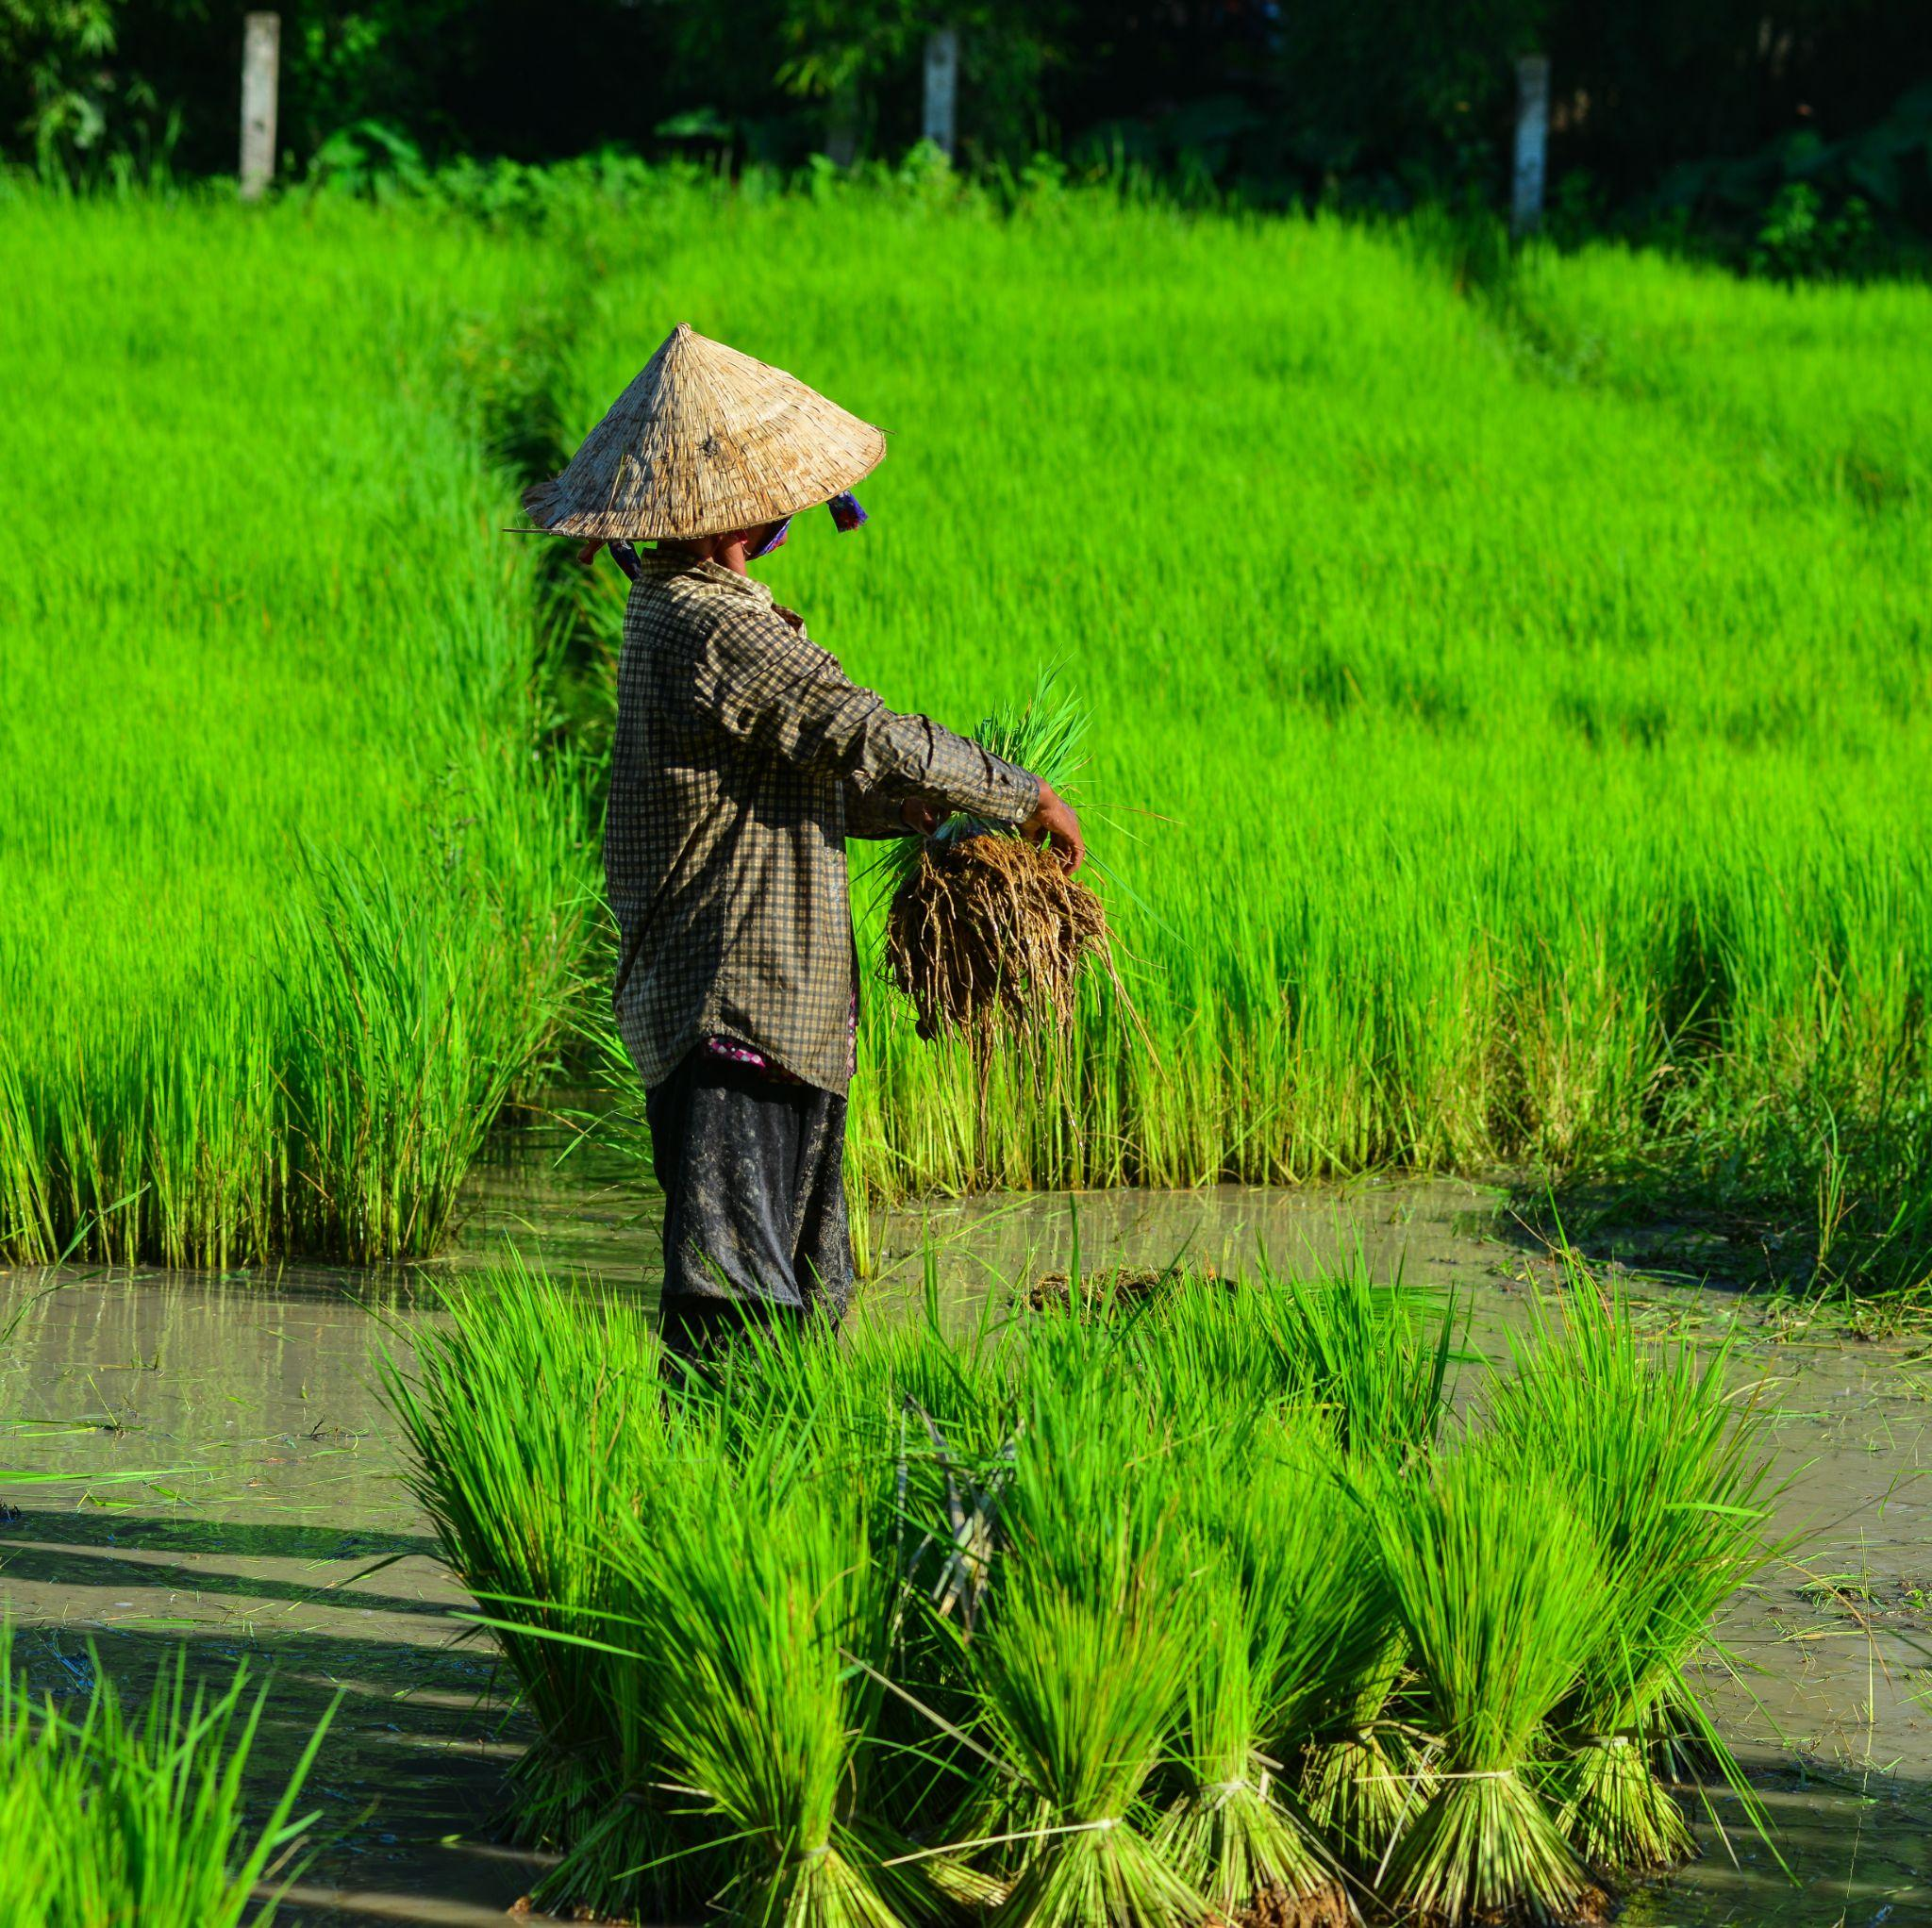
BLOCKCHAIN AND SUSTAINABILITY
Consumers are also concerned about the social side of sustainability - modern slavery, poor working conditions, exploitative business models, gender inequality
Demand for fairtrade products
Potential solution: include information on the individual farmers/producers on the Blockchain, including wages, percentage of profit, working conditions
Providing this information on the Blockchain is not only beneficial to the consumer, the transparency can allow local farmers to better negotiate a fair deal for themselves

Slide 45
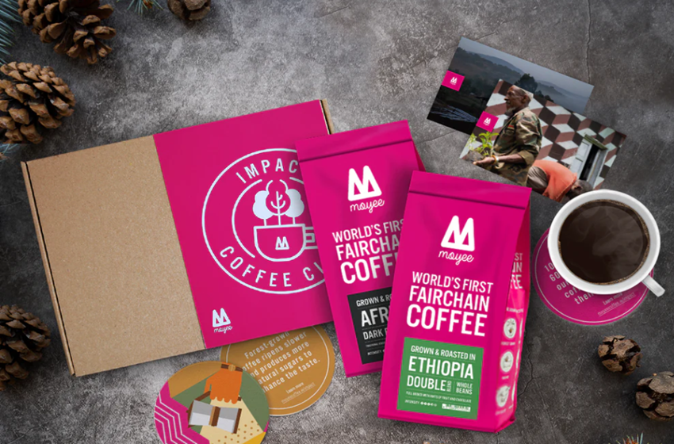
Challenges in the coffee industry:
‘Big Coffee’, uneven distribution of profits - only 10% of coffee value remains in country of origin
Poverty - 90% of coffee farmers earn less than €2 a day
Environmental impact - habitat destruction and deforestation
Moyee’s approach: “Radically good coffee with a radical impact”
‘FairChain’ business model: share more of the value from coffee with coffee growing countries
Key: roasting, packaging and branding coffee in country of origin
Focus on social and environmental sustainability - helping coffee farmers earn a liveable wage and contribute to reforestation in coffee producing countries
Blockchain technology is central to Moyer’s business model and brand identity
CASE STUDY: MOYEE COFFEE
Source: Moyee Coffee

Slide 46
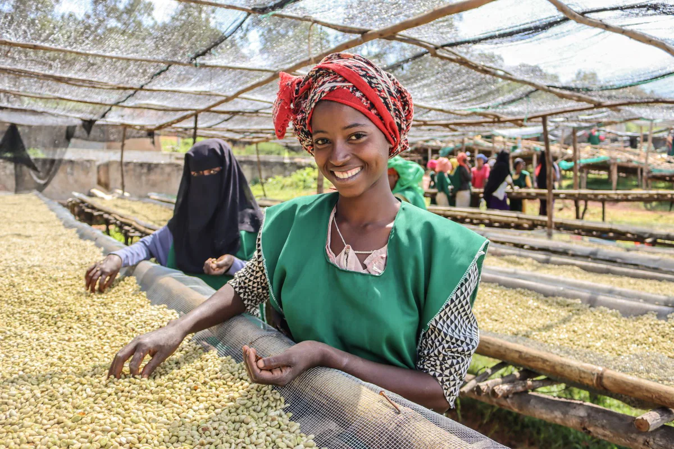
CASE STUDY: MOYEE COFFEE
CASE STUDY: MOYEE COFFEE
Uses of Blockchain within Moyee Coffee:
End to end digitalised coffee value chain - 100% transparency
Moyee’s farmers are given mobile wallets, tap cards, unique ID numbers and barcodes - paid digitally
Geo-tagging farms and washing station to prove location
QR codes on the side coffee bags - consumers can scan with mobile phones and access information about the farmers and other supply chain actors, including who gets paid what
Source: Moyee Coffee

Slide 47
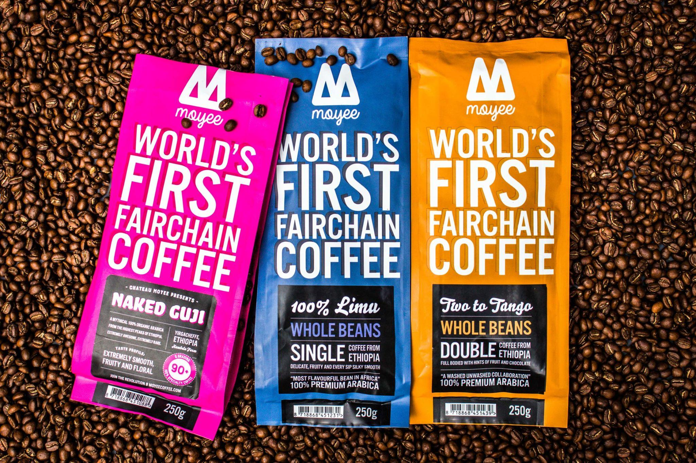
Additionally, consumers receive a digital token worth 50c upon purchasing Moyee Coffee
Consumers can either:
Keep the token and get money back off their next purchase
Use the token to tip the farmer
Help fund social projects in coffee-growing communities
Digital payments are traceable - Blockchain helps to make farmers bankable, access Blockchain-powered microloans
CASE STUDY: MOYEE COFFEE
Source: Moyee Coffee

Slide 48
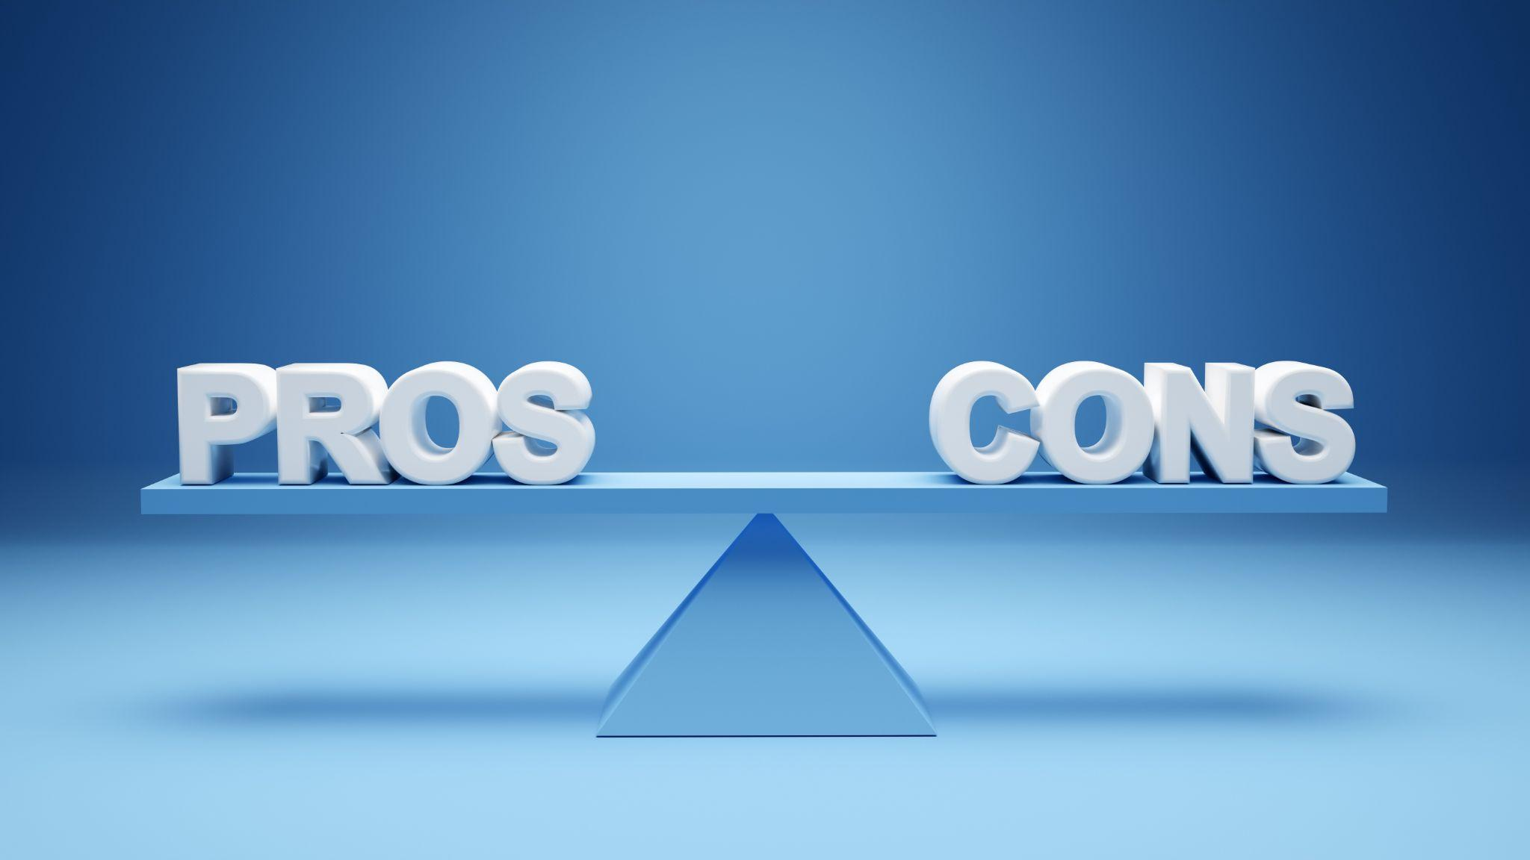
So far, this module has focused primarily on how to use Blockchain technology within the agrifood sector and the potential advantages associated with this technology
However, it is also important to bear in mind that Blockchain technology also has certain limitations and disadvantages - crucially, Blockchain is not a universally applicable solution
LIMITATIONS OF BLOCKCHAIN’S USES IN AGRI-FOOD

Slide 49
SHORT IN-CLASS EXERCISE
Each student should select a random agrifood product, a supply chain actor persona (provider, producer, processor, distributor or retailer) and a problem this persona might have.
Example: Imagine you are the manager of a meat processing plant trying to reduce instances of contamination.
Using the World Economic Forum’s decision tree, answer these 11 questions to determine whether blockchain is the right solution to the problem you are facing.
Once all the students have finished answering the questions, do a show of hands for how many problems could/could not be solved by Blockchain. Randomly select a few students to explain their product/persona/problem and their results.

Slide 50
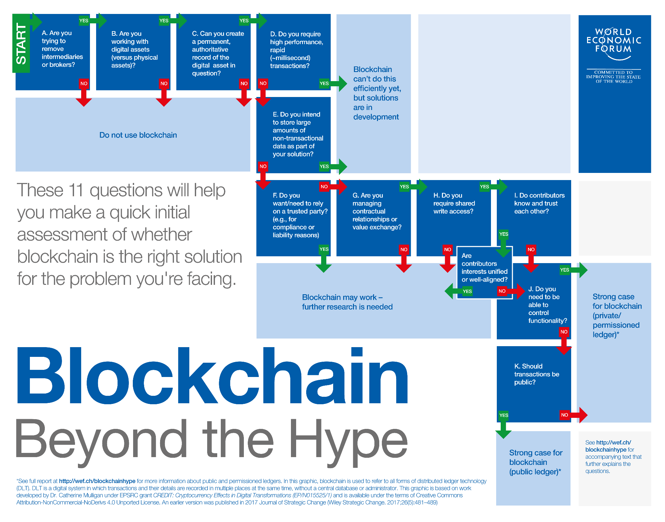
SHORT IN-CLASS EXERCISE

Slide 51
LIMITATIONS OF BLOCKCHAIN’S USES IN AGRI-FOOD
Adoption challenges
Complex blockchain ledger interfaces - not user friendly for mainstream adoption
Relatively high levels of digitalization and digital infrastructure (e.g. reliable internet connection, mobile network coverage) as a prerequisite for successful blockchain adoption; particularly problematic for farmers in the developing world
Lack of technical expertise/digital literacy among farmers; potential distrust, reluctance or resistance
Infrastructure and upskilling requirements = high upfront costs
Current examples of Blockchain in agrifood are still in the early stages of implementation, making it difficult to assess the long-term profitability

Slide 52
LIMITATIONS OF BLOCKCHAIN’S USES IN AGRI-FOOD
Potential for error and manipulation
Information on the Blockchain is immutable but not infallible: Blockchain does not have a way of verifying whether the information initially inputted is accurate - room for fraud and error
Past errors entered into the Blockchain cannot be corrected due to Blockchain’s immutability
Blockchain itself is not capable of ensuring the security of products during transit - e.g. genuine products being swapped out during transit for inferior products - solution: use Blockchain in conjunction with IoT/sensor monitoring
Disadvantage: Blockchain data may be encrypted, but IoT devices are more vulnerable to tampering, hacking or malfunction - this can undermine the integrity and accuracy of the Blockchain data

Slide 53
LIMITATIONS OF BLOCKCHAIN’S USES IN AGRI-FOOD
Lack of regulation
Blockchain as a new technology - legislation has yet to catch up with technological developments
E.g. code-only smart contracts are not legally enforceable
Cross-border blockchain transactions and question surrounding jurisdiction
Blockchain and data privacy?

Slide 54
LIMITATIONS OF BLOCKCHAIN’S USES IN AGRI-FOOD
Limited interoperability
Different Blockchain systems created by different companies may not be interoperable
Blockchains and other IT systems may also not be interoperable
Particularly problematic in the context of the agrifood sector - many different actors in global supply chain all using potentially different management systems
Integration may be costly and complex
Need for a unified technology standard

Slide 55
LIMITATIONS OF BLOCKCHAIN’S USES IN AGRI-FOOD
Environmental concerns
High computational power required = high levels of energy usage
Lack of motivation?
Producers may not want full transparency - loss of competitive edge, reputational damage
Consumer demand alone may be insufficient as a driver for change
Lack of policy-based motivations e.g. taxation
Benefits for farmers may vary depending on farm size - disincentivize smallholder farmers
Blockchain associated with cryptocurrency, volatile reputation

Slide 56
CONCLUSIONS
Blockchain technology has many potential applications within the agrifood sector
Most notably, advantages of blockchain include transparency, traceability and trust
Blockchain offers potential advantages to many actors in the supply chain, from farmers to producers to consumers, but these advantages may not be evenly distributed
However, Blockchain is also surrounded by ‘hype’ and has distinct limitations and disadvantages too. Any decision to implement Blockchain in a given supply chain should be based on research and careful consideration.

Slide 57
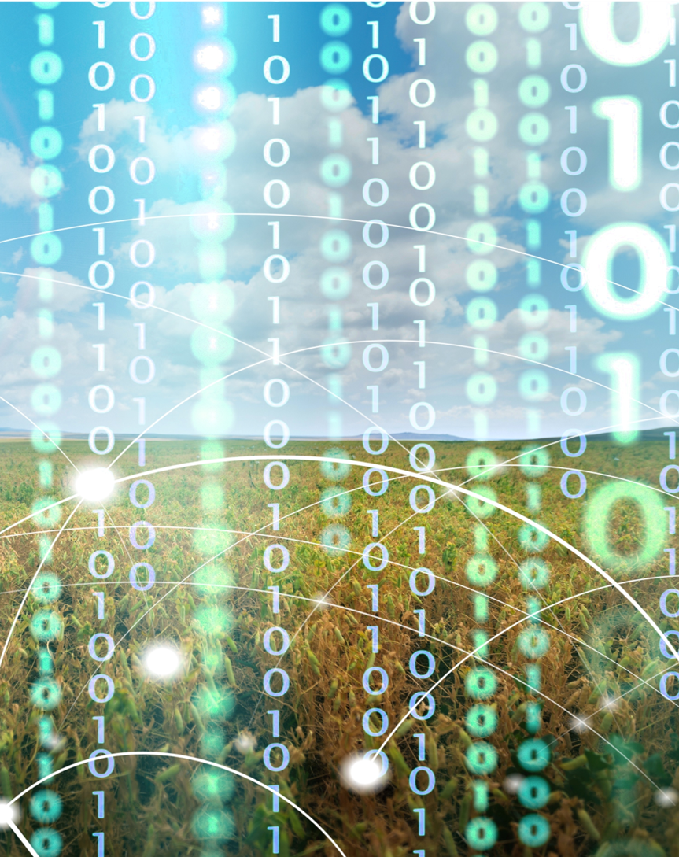
CONCLUSIONS
Blockchain as a relatively new technology only recently introduced in the agrifood sector - difficult to assess the full extent of its strengths and limitations, but initial results suggest great potential
Realising this potential will require increased overall levels of digitalisation and technical upskilling within the agrifood sector
Blockchain technology as a tool rather than a goal - achieving social and environmental sustainability requires a shift in attitude and outlook as well as the adoption of new technologies
A quickly developing technology - keep up to date with ongoing developments

Slide 58
LINKS TO FURTHER MATERIALS
UNDP, ‘Blockchain for Agri-food Traceability’, 2021
Saurabh and Dey, ‘Blockchain technology adoption, architecture, and sustainable agrifood supply chains’, 2020
Okorie et al, ‘Removing barriers to Blockchain use in circular food supply chains: Practitioner views on achieving operational effectiveness’, 2022
Tyagi, ‘A global blockchain-based agro-food value chain to facilitate trade and sustainable blocks of healthy lives and food for all’, 2023
Kumarathunga, ‘Improving Farmers’ Participation in Agri Supply Chains with Blockchain and Smart Contracts’, 2020
Kim and Laskowski, ‘Agriculture on the Blockchain: Sustainable Solutions for Food, Farmers, and Financing’, 2017
Yadav and Singh, ‘A Systematic Literature Review of Blockchain Technology in Agriculture’, 2019
Mattila, Dwivedi, Gauri, and Ahbab, ‘The Role of Blockchain in Sustainable Development Goals (SDGs) ‘, 2022
Yogarajan et al, ‘Exploring the Hype of Blockchain Adoption in Agri-Food Supply Chain: A Systematic Literature Review’, 2023
Bhat, Huang, Sofi, and Sultan, ‘Agriculture-Food Supply Chain Management Based on Blockchain and IoT: A Narrative on Enterprise Blockchain Interoperability’, 2022
Xiong, Dalhous, Wang, and Huang, ‘Blockchain Technology for Agriculture: Applications and Rationale’, 2020
PwC, ‘Building block(chain)s for a better planet’, 2018
Varavallo et al, ‘Traceability Platform Based on Green Blockchain: An Application Case Study in Dairy Supply Chain, 2022
Kamilaris, Fonts, and Prenafeta-Boldu, ‘The Rise of Blockchain Technology in Agriculture and Food Supply Chains’, 2019

Slide 59
LINKS TO FURTHER MATERIALS
Parmentola, Petrillo, Tutore, and De Felice, ‘Is blockchain able to enhance environmental sustainability? A systematic review and research agenda from the perspective of Sustainable Development Goals (SDGs)’, 2021
Van Wassenaer, Verdouw, and Wolfert, ‘What Blockchain Are We Talking About? An Analytical Framework for Understanding Blockchain Applications in Agriculture and Food’, 2021
Bosona and Gebresenbet, ‘The Role of Blockchain Technology in Promoting Traceability Systems in Agri-Food Production and Supply Chains’, 2023
Parra-Lopez et al, ‘Digital transformation of the agrifood system: Quantifying the conditioning factors to inform policy planning in the olive sector’, 2021
Cuellar and Johnson, ‘Barriers to implementation of blockchain technology in agricultural supply chain’, 2022
Food and Agriculture Association of the United Nations, ‘Exploring blockchain technology to transform agrifood systems’, 2022
Knowledgehut, ‘Blockchain Technology in Agriculture: Application Techniques’, 2023

Slide 60
SELF-TEST QUIZ
Q1. What percentage of food produced is currently lost or wasted each year?
Over 15%
Over 25%
Over 30%
Over 45%

Slide 61
SELF-TEST QUIZ
Q2. Supply chain information stored on the blockchain is simultaneously shared between members, subject to consensus, and immutable. For these reasons, blockchain technology is sometimes described as a:
Distributed centralised ledger
Distributed decentralised ledger
Distinct deregulated ledger
Disruptive decommissioned ledger

Slide 62
SELF-TEST QUIZ
Q3. Which of these is a common problem in global food supply chains?
Low levels of trust
Lack of shared information
Low levels of digitalisation
All of the above

Slide 63
SELF-TEST QUIZ
Q4. What is a smart contract?
A self-executing contract with the terms of the agreement between buyer and seller written directly into lines of code
A legally binding contract between two intelligent individuals
A self-correcting contract that automatically updates to reflect changing circumstances between buyer and seller in real-time
A digital contract incorporating data collected by smart devices such as RFID sensors and Internet of Things (IoT)

Slide 64
SELF-TEST QUIZ
Q5. In the context of agri-food supply chains, what is "disintermediation"?
The involvement of more intermediaries in the agri-food supply chain
The encryption of sensitive supply chain data by third parties
The removal of non-essential 'middle-men' from the agri-food supply chain
The need to hire third-party mediators to resolve disputes between farmers and producers

Slide 65
SELF-TEST QUIZ
Q6. How might the implementation of a product recall differ between a regular food supply chain and a blockchain-enabled food supply chain?
Product recall is likely to be more expensive for the supplier if the affected products are recorded on the blockchain
Product recall is likely to be swifter and more targeted if the affected products are recorded on the blockchain
A regular food supply chain is better able to limit contamination in the event of a product recall than a blockchain-enabled supply chain
Blockchain completely eliminates the possibility of contamination along the food supply chain, meaning product recall is never necessary

Slide 66
SELF-TEST QUIZ
Q7. What is "greenwashing"?
Greenwashing is when companies commit to reducing their water use for environmental reasons
Greenwashing is when companies take meaningful steps to improve their sustainability in response to consumer pressure
Greenwashing is when companies lie to their shareholders to create the appearance of financial success
Greenwashing is when companies provide false or misleading information to the public or investors about the environmental impact of their products and operations

Slide 67
SELF-TEST QUIZ
Q8. Adding QR codes to product packaging can help improve customer relations by:
Increasing transparency
Reducing incidences of food fraud
Building brand loyalty
All of the above

Slide 68
SELF-TEST QUIZ
Q9. Which of the following blockchain consensus mechanisms is most often criticised for requiring unsustainable levels of energy consumption?
Proof of Authority (PoA)
Proof of Stake (PoS)
Proof of Burn (PoB)
Proof of Work (PoW)

Slide 69
SELF-TEST QUIZ
Q10. Which of the following statements is false?
"Information stored on the blockchain is immutable and encrypted"
"Blockchain has a built-in mechanism to automatically verify the accuracy of information inputted"
"Successful adoption of blockchain technology is significantly more likely in agri-food systems where there are relatively high levels of digitalisation and good digital infrastructure already in place"
"To date, there is a lack of regulation regarding blockchain, as legislation has yet to catch up with recent technological developments"

Slide 70
SELF-TEST QUIZ
Answers:
Q1. C
Q2. B
Q3. D
Q4. A
Q5. C
Q6. B
Q7. D
Q8. D
Q9. D
Q10. C

Slide 71
This programme has been funded with support from the European Commission. The author is solely responsible for this publication (communication) and the Commission accepts no responsibility for any use that may be made of the information contained therein

