Slide 1
Module 4
Blockchain in Practice - series of case studies
This programme has been funded with support from the European Commission. The author is solely responsible for this publication (communication) and the Commission accepts no responsibility for any use that may be made of the information contained therein
Blockchain for AgriFood Open Educational Resources © 2023/2024 by Blockchain for AgriFood Consortium is licensed under CC BY-SA 4.0

Slide 2
contents
01
The Power of Case Studies, a Module Introduction
02
Blockchain in Agri Supply Chains
03
The Rise of Intermediary Platforms
04
Retailers Are On Board
05
Learning Exercise and Conclusions
This programme has been funded with support from the European Commission. The author is solely responsible for this publication (communication) and the Commission accepts no responsibility for any use that may be made of the information contained therein

Slide 3
Module Description
Welcome to Blockchain in Practice, a module dedicated to understanding the real-world application of blockchain within the agrifood sector through the lens of case studies.
This module takes you through a practical journey of blockchain applications in agrifood. We begin with an insightful introduction to the power of case studies in learning. The module then explores the role of blockchain in agricultural supply chains, highlighting the emergence of intermediary platforms and the involvement of retailers.
These sections are designed to showcase how blockchain is being adopted across the agrifood industry, from production to point-of-sale, and the impact this technology is having on the sector. Join us to discover through real-life examples how blockchain is revolutionising the agrifood ecosystem.

Slide 4
Learning Outcomes
By the end of Module 4, participants will be able to:
Grasp the key principles and mechanisms that underpin blockchain technology in applied ways in the agrifood sector.
Recognise the role of blockchain in agrifood supply chains and identify the benefits and challenges of implementing blockchain in agricultural supply chains.
Analyse the impact of intermediary platforms. Evaluate the emergence and influence of intermediary platforms in the agrifood market.
Assess retailer integration of blockchain. Understand the motivations and strategies behind retailer adoption of blockchain technologies and the implications for the supply chain and end consumers.
Apply knowledge gained to real-world contexts by analysing case studies that demonstrate the practical application and outcomes of blockchain in the agrifood industry.
Critically reflect on blockchain's potential to assess the transformative potential of blockchain for future developments in the agrifood sector.

Slide 5
01
The Power of Case Studies, a Module Introduction

Slide 6
The Power of Case Studies
Case studies are a powerful educational tool. They provide the following benefits:
1. Real-world Context: Through case studies, theoretical knowledge finds practical grounding. We're not just discussing concepts; we're looking at how they play out in real scenarios.
2. Problem-Solving: Each case study presents a unique set of challenges. By diving into these situations, you're actively engaging in problem-solving, fostering critical thinking and analytical skills.

Slide 7
The Power of Case Studies
3. Relatable Learning: By seeing blockchain in action within familiar agrifood settings, the knowledge becomes more relatable and easier to grasp.
4. Diverse Perspectives: Case studies often showcase a variety of stakeholder viewpoints, from farmers to distributors, thus enriching our understanding of the topic.
As we delve into these case studies, keep in mind the broader impact and potential of blockchain within the agrifood sector. Consider the challenges faced, the solutions proposed, and the outcomes achieved.
We hope this module offers you a comprehensive understanding of the practical uses and benefits of blockchain in the agrifood domain. Let's begin our exploration.

Slide 8
02
Blockchain in Agri Supply Chains

Slide 9
Watch and learn
Before we learn about excellent examples of blockchain in action in agri supply chains, please take 4.5 minutes which shows how Infosys blockchain can help to create a trusted network and enable stakeholders' transactions through smart contracts.
Agricultural supply chain involves complex interconnected processes between various stakeholders. The typical challenges include tracking provenance and Place of origin, tracing custodian information, lack of trust & transparency between stakeholders leading to potential delays in downstream decision making.
Click the arrow to play.

Slide 10
2.1 Let’s meet Iberchain
IMPLEMENTATION OF Blockchain Technology in the meat value chain labelled as Iberian 100% Autochthonous Breed

Slide 11
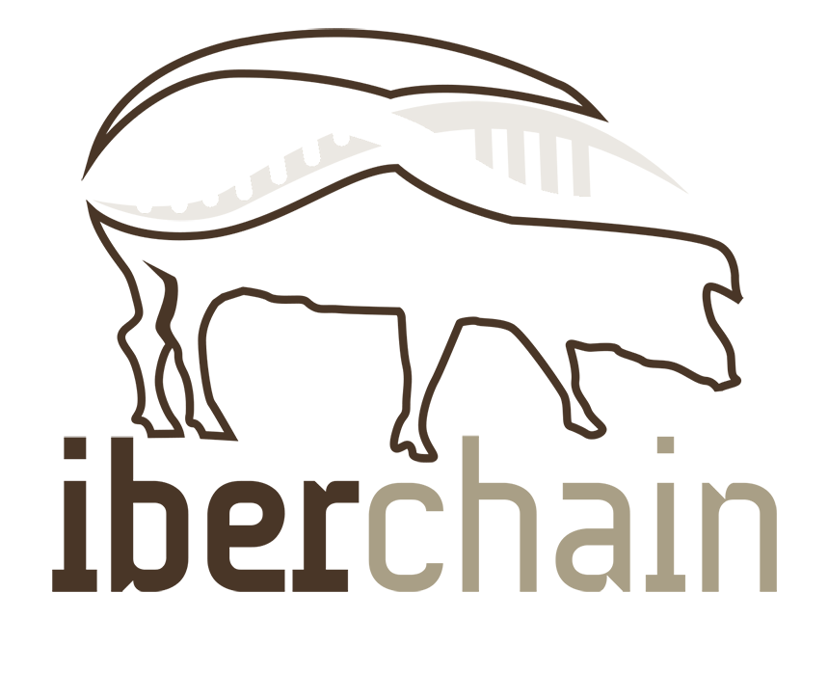
Spotlight on Iberchain, Spain
The agri-food industry is the largest industrial subsector in the Spanish economy² (Ministerio de Agricultura, Pesca y Alimentación, 2021). According to key reports, it is in need of renewal and requires a thorough digital transformation. Additionally, the firms in the sector are small compared to its European counterparts, which increases their difficulty to compete on a larger scale.
The IBERCHAIN Operational Group | Grupo Operativo IBERCHAIN was founded to tackle to food fraud and the need to improve the traceability of meat. With the implementation of a differentiated quality brand (100% native Iberian breed), and the technology that has established itself as the most reliable and effective today: the Blockchain, it is now possible to identify 100% Iberian pig without margin of error.
CASE STUDY Iberchain – Blockchain for 100% Iberian traceability – Grupo Operativo
IMPLEMENTATION OF Blockchain Technology
in the meat value chain labelled as Iberian 100% Autochthonous Breed

Slide 12
Spotlight on Iberchain, Spain
The Problem that affected the consumer and the producer to the same extent: fraud. Only 13% of the total Iberian pigs produced in Spain correspond to 100% Iberian pigs. The rest are pigs crossed with another non-Iberian breed although they are called Iberian.
High-precision verification controls
Verification controls are made on the slaughter line from an intelligent measurement system that integrates two technologies:
the microelectronic bioimpedance which through a non-destructive function obtains a pattern of the electrical properties of the meat tissue
NIRS technology which acts through a beam of light that is scattered by the meat piece and is collected again by the device. The difference between the emitted and reflected image generates a unique spectrum that makes it possible to distinguish the purity of the sample.

Slide 13
Spotlight on Iberchain, Spain
Blockchain as an anti-fraud technology
Once this double check has been carried out, it is the turn of the blockchain technology implemented by Cedesa Digital. The data collected in the production chain is recorded and validated to create an anti-fraud database of maximum security and total independence. This guarantees the traceability of the meats, an essential requirement to incorporate a new quality brand, 100% native Iberian breed.
This process serves to strengthen the reliability of the production chain and restore consumer confidence. It will also consolidate the prestige of Iberian in Spain and in the world. This is a giant step for the sector that opens the door to any producer and other food sectors. The Operational Group also pays special attention to demanding livestock practices that are more respectful of the natural environment, the Dehesa, counting on internal advice from the scientific community and private companies specialized in the matter.

Slide 14
2.2 Let’s meet Alpha Estate Winery, Greece
A blockchain message in a bottle

Slide 15
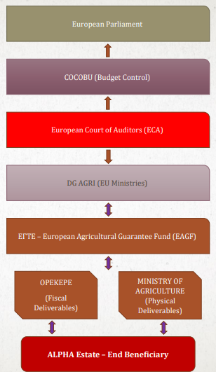
(a Blockchain) Message in a bottle (of wine)
Since 1997, Alpha Estate has operated as a state-of-the-art wine making experience and 220 ha privately owned vineyard in Greece, exporting to more than 30 countries around the globe. It is a vertically integrated 45-person SME, implementing cutting-edge sustainable viticulture.
It’s first experience of blockchain was an ECA Blockchain Event in Luxembourg in November 2018, leading to receiving EU support.
Source: EU Blockchain Observatory | Online Workshop | November 23th 2020

Slide 16
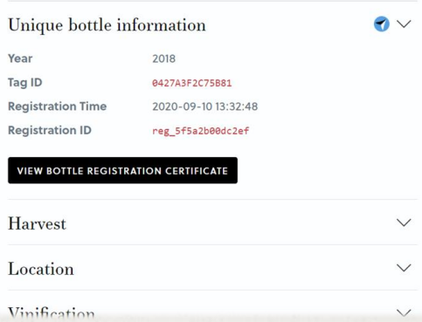
(a Blockchain) Message in a bottle (of wine)
A bottle of unique wine is:
A “primary information” (from the ecosystem and the grapes of an area)
“secured” into a bottle that can last through time
More appealing to new ages/markets (gen Y and Z)
Truth Certified
Finally provide to the “end beneficiary” the “pleasure” and “utility” of this “preservation
Source: EU Blockchain Observatory | Online Workshop | November 23th 2020

Slide 17
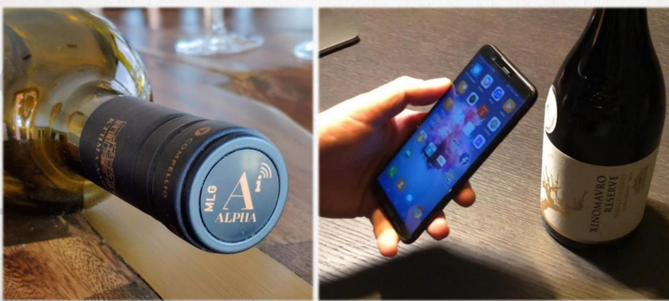
(a Blockchain) Message in a bottle (of wine)
For Alpha Estate, the advantages of blockchain are
Direct 1 to 1 connection between winemaker and final consumer
Advanced loyalty
opportunities (traceability,
geolocation)
Mediator-free markets
Real-time market survey
“Securely” interconnected
customers
From vineyard-to-shelf intact info provided
Not just for consumers but
evangelists of the experience
Source: EU Blockchain Observatory | Online Workshop | November 23th 2020

Slide 18
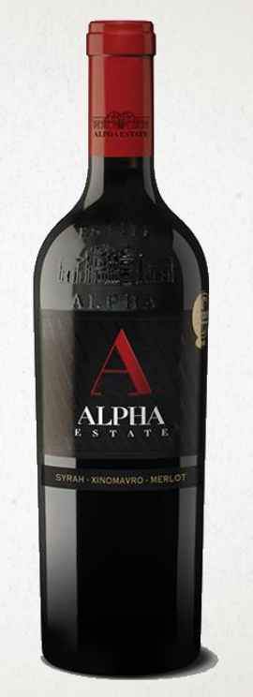
(a Blockchain) Message in a bottle (of wine)
And the Challenges/Bottlenecks
• No ready-to-use (out of the box) machinery
• «Hand-made» solutions – Increased initial costs
• Issues when trying to scale up the approach to all products
• Difficult capacity building inside the company
• Lack of Blockchain providers (with proven expertise)
Source: EU Blockchain Observatory | Online Workshop | November 23th 2020

Slide 19
2.3 Let’s meet Polish Premium Beef and other examples

Slide 20
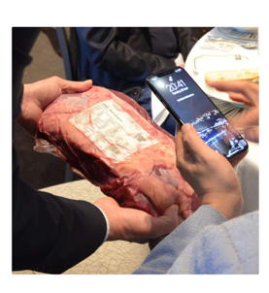
Pilot Project on use of Blockchain and IoT Technologies
Polish Premium Beef was a pilot project on the use of blockchain and IoT technologies in cooperation between farmers, processors and advisers in high quality beef production.
Polish Premium Bief Pilot Project - Agreco | PDF | Sustainability | Foods (scribd.com)
www.agrego.pl

Slide 21
From Oranges to Juice
In Brazil, Albert Heijn works with the orange groves of LDC Juice where the fruit is harvested. The oranges are picked by hand on the plantations and collected in large nets. In this step, the following certificates, controls and data are verified and added to the blockchain
Harvest period
Location and name of plantation
Rainforest Alliance Certificate
Responsible and ethical working conditions
Read more Juicy details: Albert Heijn uses blockchain to make orange juice production transparent | Ahold Delhaize

Slide 22
03
The Rise of Intermediary Platforms

Slide 23
3.1 Let’s meet Provenance
UK company Revolutionizing Transparency
https://www.provenance.org/

Slide 24
PROVENANCE https://www.provenance.org/
Founded in 2013 by Jessi Baker.
Mission: Empower brands to take steps toward greater transparency.
Tool: Blockchain-powered platform to trace products' origins.
Jessi Baker recognized the disconnect between products and their origins. With a a Master’s in Engineering (Cambridge University) and Design (Royal College of Art), she founded Provenance whilst doing a PhD in Computer Science (UCL).
Provenance is a digital platform enabling producers, manufacturers and retailers to track the journey of people, places and ingredients behind their products. They use blockchain and smart tagging technologies to revolutionise supply chain transparency. With Provenance, businesses can drastically reduce risk in their supply chain and foster a new form of consumer trust.

Slide 25
PROVENANCE, a Pioneering Company
As a proud social enterprise and B Corp, they are committed to making business a force for good. The first to apply blockchain technology to supply chain in 2013, Provenance are now working with businesses in the UK and across global supply chains, including The Co-op supermarket, Sainsbury’s, Unilever, The World Bank, Greenpeace, organic certified farms across Europe and luxury brands in the food and fashion industry.
They are a member of the Ellen MacArthur foundation CE100 – pioneering open traceability systems for a circular economy and were featured in over 100 news titles in 2017.
FURTHER READING
TechCrunch – Provenance’s Story https://techcrunch.com/2015/09/21/provenance-aims-to-use-blockchain-technology-to-prove-authenticity/

Slide 26
PROVENANCE Roadblocks and Hurdles
Initial skepticism about blockchain’s application outside of finance.
Bringing brands on board with the concept.
Integrating with diverse and complex supply chains.
Let’s look deeper into the founder story and meet Jessi Baker, click play on the screen

Slide 27
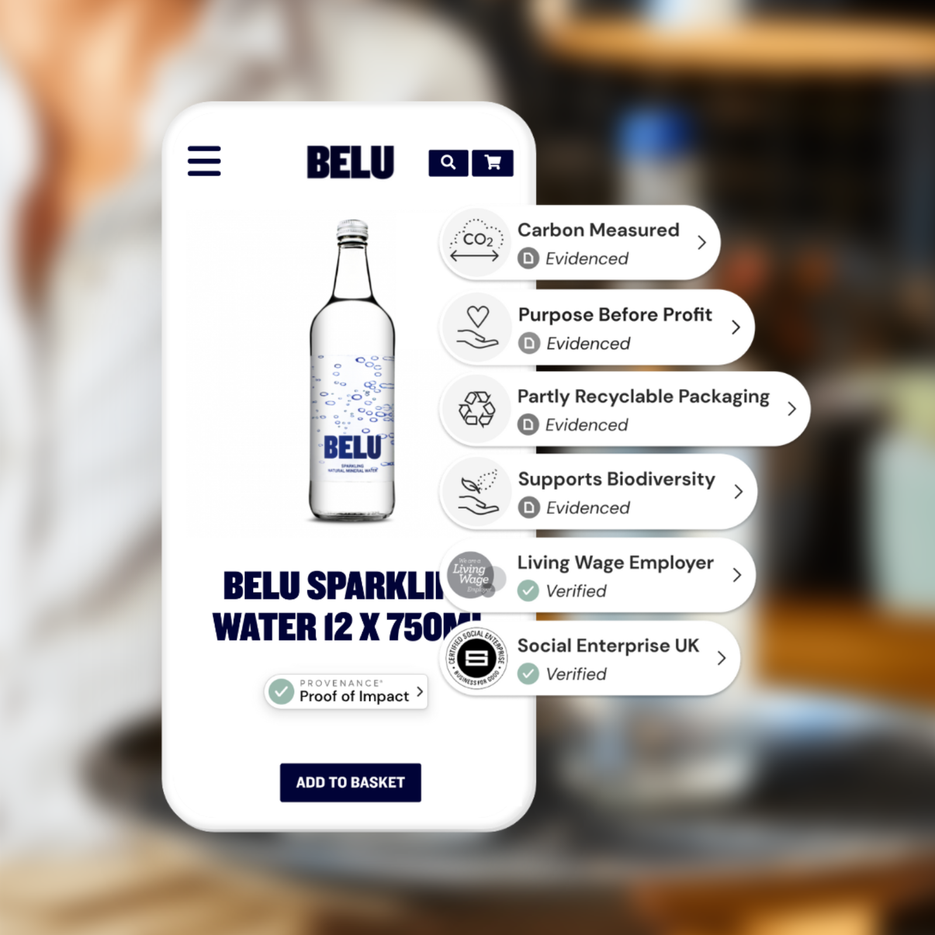
PROVENANCE BELU Water Brand
Launched in 2007, the Belu Homepage - Belu purpose is to change the way the world sees water. They invest profits into saving carbon emissions from entering the atmosphere, championing a circular economy and ending water poverty.
Since 2011, social enterprise Belu has committed to directing all of its net profit to WaterAid, a partnership that aims to bring clean water, decent toilets and good hygiene to everyone, everywhere. To date, they’ve sent over £5.5m. But, BELU faced a challenge in translating its high-level brand purpose, and alignment with the UN’s Sustainable Development Goals, into tangible facts and claims that customers could easily understand and trust. It partnered with PROVENANCE.

Slide 28
BELU publish a remarkable Impact Report – Belu, an easy overview of their impact initiatives, and allowing us to click through to see more information and proof.

Slide 29
PROVENANCE BELU Water Brand
Where they once articulated their brand purpose at a more abstract level, they are now communicating their impact in a way that their customers can easily pin down. BELU’s Proof Points also provide a useful asset in pitches to hospitality stockists, many of whom are increasingly focused on sustainable sourcing.
READ MORE ABOUT PROVENANCE EMPOWERING BELU TRANSPARENCY
BELU sustainability and transparency food & drink case study | Provenance | Provenance
Green credentials, not greenwash - Belu

Slide 30
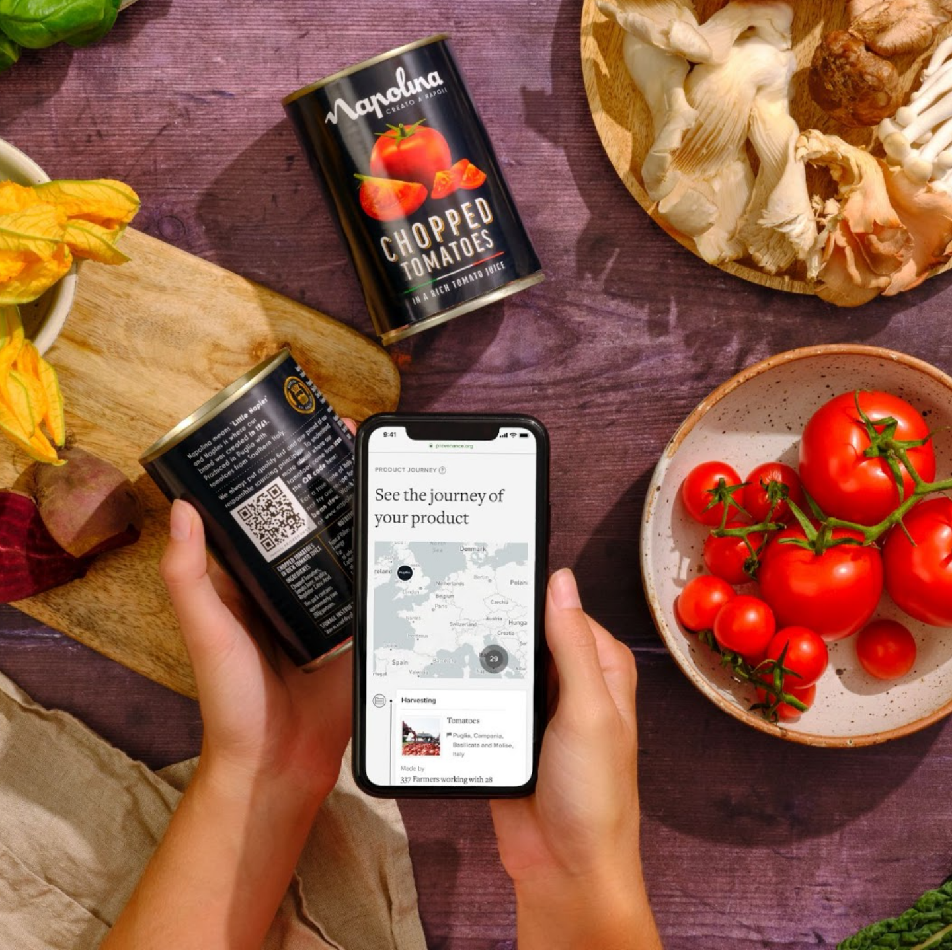
PROVENANCE + NAPOLINA
Napolina is protecting long-term brand value with proof-backed communications
With Provenance, Napolina is sharing proof of its progress on tackling illegal labour with shoppers and industry stakeholders.
With Provenance, Napolina turned its supply chain data into a shopper-facing digital experience showing the sourcing and impact of its tomatoes. This experience was made accessible via a QR code on more than 3 million cans of tomatoes and via integrated Proof Points on Napolina’s corporate Responsible Sourcing webpage. To protect Napolina and its customers from greenwashing, every claim was connected to evidence or third-party verification.
Napolina: A Supply Chain Transparency Case Study | Provenance | Provenance

Slide 31
PROVENANCE Notable Successes
Provenance showcases the potential of blockchain beyond finance.
Pioneering the movement towards transparency and ethical consumption.
A testament to the value of authentic brand storytelling
Supported by significant investors, including Humanity United
-

Slide 32
3.2 Let’s meet The Rice Exchange
How industry is bringing
transparency to the
agri-food sector
using Fujitsu Blockchain
solutions

Slide 33
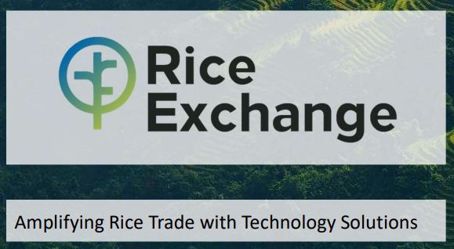
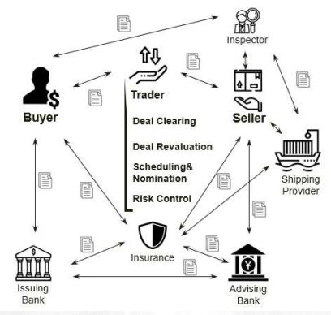
Key challenge -rice market dysfunction
Highly fragmented
Low trust
Reliance on hardcopy paperwork
Under-financed
Scarcity of market data
Lack of price transparency
Fraud
Limited futures and hedging

Slide 34
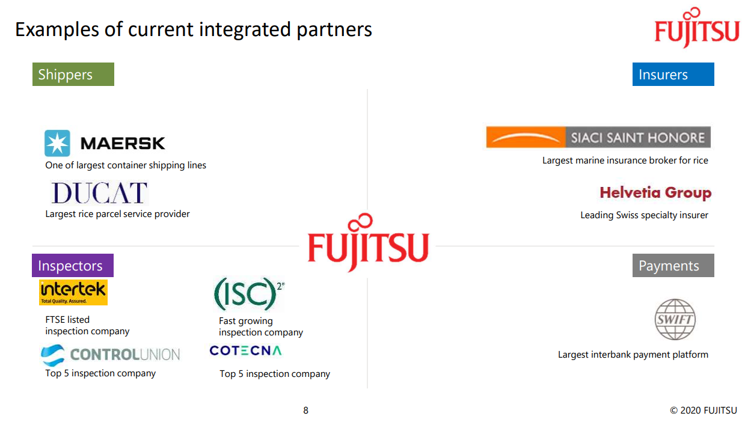
Rice Exchange is a digital rice marketplace with an integrated supply chain solution.
It is not just about using technology, but using it to bring security, transparency, traceability and finality to a complex trade and commercialization of an eco-system with multiple stakeholders.
In Rice Exchange, blockchain ensures all involved stakeholders are looking at the same verifiable data, in real-time whilst accelerating the removal of friction and delays in the supply chain.
The primary question driving Blockchain is ‘do I trust the data I am using, and can I rely on it to assess my risk?’ In Rice Exchange, uncertainty is replaced by transparency and stakeholders can better manage their risk
SOURCE Fujitsu and Rice Exchange Bring to Market First Global Blockchain Rice Trading Platform - Fujitsu EMEIA

Slide 35
Rice Exchange is opening new possibilities for actors in the rice trading sector
Immediate benefits | Valuable metrics | In production
Open new business possibilities Farmers can get more out of their production Secure settlement - all information is verified with a document matching tool | Cost of trade significantly reduced (20%) 90% of trades are completed in less than 6 minutes In 2020, used by 300+ organizations, handling over $250m in trades per quarter within a year | Up and running since September 2020

Slide 36
3.3. Let’s meet TE-FOOD: End-to-End Food Traceability

Slide 37
TE-FOOD https://www.te-food.com/
Founded in 2016 with operations in Germany and Vietnam as a response to the global need for food safety. It claims to the largest farm-to-table traceability solution globally with over 6,000 business customers, tracking 400,000+ operations daily.
Goal:
Reduce epidemic outbreaks & fraud in the food industry and leveraging blockchain for immutable data and trust.
Key Challenges:
Educating a traditional sector about modern blockchain technology.
Towards a Safer Food Future: Set global standards for food traceability.

Slide 38
TE-FOOD Collaboration in Action
TE-Food has enabled Auchan, the French multinational retail group, to implement the traceability of prunes products.
Auchan works together with Maison Roucadil, a 130-year-old farming and agricultural processing company. Roucadil has been IFS (International Food Standard) certified, as well as Zero Pesticide Residue and HVE (High Environmental Value) certified.
Their products are Protected Geographical Indication certified as well, which guarantees that Agen prunes are exclusively obtained from Ente plum orchards planted in the delimited production area and that they are dried, conditioned and processed by companies established in a designated territory in France.
-

Slide 39
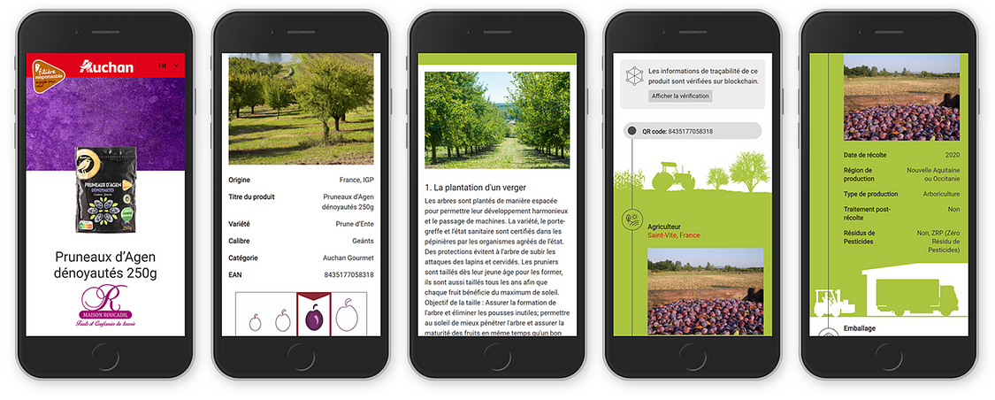
TE-FOOD Collaboration in Action
Source

Slide 40
TE-FOOD Collaboration in Action
Consumers can follow the history of each production lot from the harvest to the packaging and distribution.
Maison Roucadil provides insights of the agricultural approach they follow, from the planting methodologies, plant protection protocols, to the processing activities from drying, sorting, calibration, rehydration and pitting.
-

Slide 41
3.4 Let’s meet @OriginChain, Irish Agritech Company

Slide 42
@OriginChain, Irish Agritech Company
@OriginChain is committed to forging a future of food we trust. The Irish company are engineering a multi-party, DLT-based system with a credential-focussed agri-trust layer. They
help farmers to report with pride on the origins and sustainability of the food they produce.
use autonomous processes to help reporting bodies to certify environmental KPIs and sustainable farming practises that protect biodiverse habitats, enhance water quality and promote a blend of commercial and environmental farming objectives.
Interestingly, they highlight they use tech that 86% of farmers already have to hand – their own smart phones.
Read more Irish agri-food blockchain pioneer takes home the European 'Standards+Innovation' Award | NSAI

Slide 43
Spotlight on @OriginChain
We can learn from @OriginChain CEO, Fiona Delaney, who contributes to John G. Keogh’s 2020 Future of Food 10×10 Blockchain Series

Slide 44
3.5 Let’s meet EIT Food Unfolded

Slide 45
Spotlight on EIT’s Food Unfolded
The EIT Food Trust Tracker® Results show:
The OPENNESS of food system actors is of primary importance in establishing consumer trust. Their activities, the information they offer and their honesty.
A community of people engaged in dialogue around the origins and future of our food
www.foodunfolded.com
@food.unfolded

Slide 46
04
Retailers are on Board

Slide 47
4.1 Let’s meet Carrefour
Launched Europe’s first food blockchain for its free-range Auvergne chicken

Slide 48
CARREFOUR Food blockchain | Carrefour Group
In 2018, leading French-based retailer Carrefour has launched Europe’s first food blockchain through its free-range Auvergne chicken, one million of which were sold every year. The company has since extended the technology to many more animal and vegetable product lines, including eggs.
Traceability
Carrefour is using blockchain in the food sector so that each and every party along the length of the supply chain, including producers, processors and distributors, to provide traceability information about their particular role. For example, each batch – dates, places, farm buildings, distributed channels, potential treatments – can be traced and added to the database.
As a result, it can provide consumers a guarantee of complete product traceability, meets the growing desire for transparency from farm to fork.
Carrefour said it would be able to use it to share a secure database with all of its partners as well as guaranteeing higher levels of food safety for its customers.

Slide 49
CARREFOUR Food blockchain | Carrefour Group
QR code
So how does it work? In concrete terms, each product’s label features a QR code which consumers will be able to scan using their smartphones. This will provide them with information about the product and the journey it has taken – from where it was reared right up to when it was placed on the shelves: for example, for free-range Carrefour Quality Line Auvergne chicken, consumers were able to find out the following information:
Where the bird was reared
The name of the farmer
What feed was used (whether or not they were fed on French cereals and soya beans, on GMO products etc)
Any quality labels
Where the bird was slaughtered

Slide 50
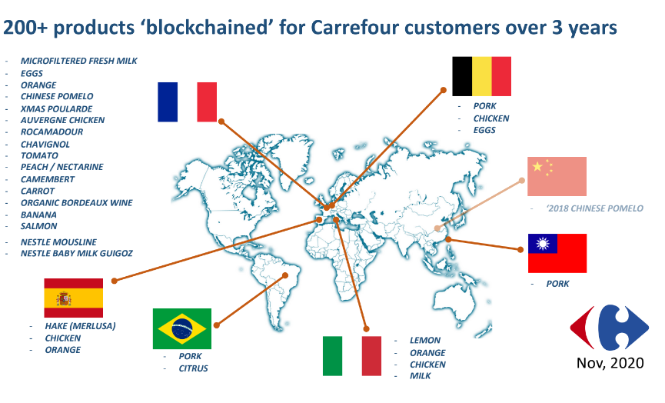
CARREFOUR Food blockchain | Carrefour Group
Read more Carrefour uses blockchain to offer consumers greater supply chain transparency - RetailWire

Slide 51
CARREFOUR Food blockchain | Carrefour Group
The trend for accurate and broader information is surging
73% of customers willing to pay for more quality / information
(2016). “Driving Long Term Trust and Loyalty Through Transparency”. Accessed 22nd June 2020.
Labels and certification are numerous
Demand for local provenance
« free of » segments rising
Customers are shifting from abundance to quality & trust
DOWNLOAD
THE CARREFOUR BLOCKCHAIN PRESENTATION ON Trust through traceability - Carrefour.pdf - Google Drive

Slide 52
4.2 Let’s meet IBM Food Trust™ Platform

Slide 53
IBM Food Trust™ Platform
In 2018, Carrefour joined other participants in building the IBM Food Trust ™ platform. The objective of the collaboration between Carrefour and IBM Food Trust is to implement a global food traceability standard across all of the links in the chain – from producers through to sales channels, including:
Growers: The people who cultivate the food.
Processors: The entities that convert raw food materials into consumable food items.
Wholesalers: The businesses that buy large quantities of goods from producers or vendors and resell them to retailers.
Distributors: The intermediaries that deliver goods from producers to retailers.
Manufacturers: The companies that produce finished goods from raw materials.
Retailers: The businesses that sell goods directly to consumers¹.

Slide 54
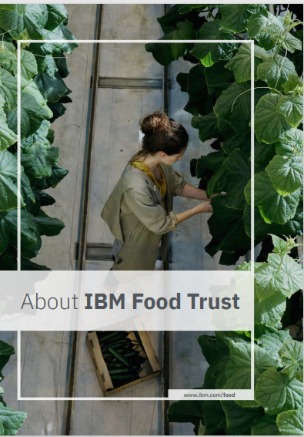
IBM Food Trust Platform
Click here to DOWNLOAD the GUIDE TO FOOD TRUST
These participants work together to enhance visibility and accountability across the food supply chain. They connect through a permissioned, immutable, and shared record of food provenance, transaction data, processing details, and more. This helps ensure safety, quality, and sustainability in our food ecosystem.
IBM Food Trust is a software-as-a-service (SaaS) food-safety solution that is powered by the IBM Blockchain Platform.
https://www.ibm.com/products/supply-chain-intelligence-suite/food-trust
How to use IBM App Connect with IBM Food Trust - IBM Documentation

Slide 55
IBM Food Trust Platform
The seafood watchdog, Oceana.org, stated in a study that one in three seafood products is mislabeled nationwide. Revealed: seafood fraud happening on a vast global scale | Fish | The Guardian
Kvarøy Arctic, a large producer of Norwegian-farmed salmon for stores like Whole Foods, joined IBM’s blockchain-based Food Trust. Blockchain Technology — Kvaroy Arctic
They KvaroyArctic-Tech-Blockchain.pdf (squarespace.com)

Slide 56
Interactive Learning Activity (classroom)
Activity Title: Blockchain Decision-Making Simulation
This simulation game places students in the role of a Supply Chain Manager for an agrifood company that is considering adopting blockchain technology. Best delivered in a classroom setting.
Meet the Company: The Organic F&V Co. Dilemma
Welcome to The Organic F&V Co., a mid-sized company known for sourcing and distributing organic fruits and vegetables. Despite a strong ethos of quality and integrity, The Organic F&V Co. has recently been troubled by incidents of food fraud within their supply chain, involving the mislabelling of non-organic produce as organic. Additionally, their manual tracking methods have led to bottlenecks and losses, with delays in identifying the origins of produce during food safety recalls. Transparency is also a concern, as consumers are demanding more information about the sourcing and handling of their food.

Slide 57
Interactive Learning Activity (classroom)
The Challenge
The company is in need of a robust solution to restore The Organic F&V Co reputation for quality and trust in the market. Blockchain technology might just be the answer to their problems, offering a way to track their produce journey transparently and efficiently.
Our Exercise
Through a series of decisions, students must implement blockchain technology to improve the supply chain while balancing budget, stakeholder interests, and regulatory requirements. Use template.
Gameplay Mechanics
Students are presented with a series of decision points for The Organic F&V Co (e.g., choosing a blockchain platform, deciding which parts of the supply chain to integrate first, etc.). Each decision affects the company's budget, trust level with consumers, and operational efficiency. Students must also navigate unexpected challenges such as food recalls or changes in regulation.
Double click to download

Slide 58
Interactive Learning Activity (classroom)
After completing the simulation, students discuss in groups how their choices impacted the overall supply chain and compare outcomes. They should also consider what they might do differently and how their decisions would scale in a real-world environment.
Learning Acquired:
Students learn the complexities of integrating blockchain into existing systems.
They understand the trade-offs and decision-making processes involved in adopting new technologies.
They get to reflect on the importance of blockchain for transparency and efficiency in the agrifood supply chain.
This simulation encourages active learning and helps solidify the theoretical knowledge gained from the module through practical application.

Slide 59
Conclusions
The transformative potential of blockchain in the agrifood sector is shared via diverse international case studies which help us understand how different agricultural and retail players are applying blockchain in agrifood.
The case studies have provided us with real-world insights into how this technology enhances transparency, efficiency, and trust from farm to table.
We have seen how blockchain can combat food fraud, streamline supply chains, and bring retailers closer to the source. We have seen sustainability and ethics in action and cases where blockchain is a major marketing advantage.
The future of food security and supply chain management is here, and it is deeply entwined with the advancements in blockchain technology.
As the industry continues to evolve, so too will the opportunities for blockchain to address its complex challenges.

Slide 60
In the next Module, you will learn
Click to type

Slide 61
https://blockchainforagrifood.eu/
Thank you
Any questions?

