Slide 1



Module 5
Trustworthy Blockchain Resources in the Agrifood Sector – Who to Trust?
Blockchain for AgriFood Open Educational Resources © 2023/2024 by Blockchain for AgriFood Consortium is licensed under CC BY-SA 4.0
The European Commission support for the production of this publication does not constitute an endorsement of the contents which reflects the views only of the authors, and the Commission cannot be held responsible for any use which may be made of the information contained therein.

Slide 2
contents
01
Module 5 Introduction
02
Key terms
03
Blockchain Use In The Agrifood Sector
04
Exercises and Case Studies
05
What Are The Current Limits Of Blockchain?
06
Conclusions

Slide 3
Module Introduction
Topic of the module: ‘Trustworthy Blockchain Resources in the Agrifood Sector – Who to Trust?’​
Significance:
Potential to illustrate to what extent blockchain can be viewed as a trustworthy technology.
Prominent in the academic literature.
Answering the questions to what extent the use of blockchain in the agri-food sector is trustworthy.

Slide 4
Learning Outcomes
By the end of Module 5, participants will be able to:
Define key terms related to the topic of blockchain in the agrifood sector.
Describe how blockchain is used in the agrifood sector.
Demonstrate a clear understanding of the key features of blockchain technology and its trustworthiness as a potential solution to many of these problems.
Analyse the role of blockchain technology as a trusted technology.
Assess the trustworthiness of blockchain technologies in the agri-food supply chain.

Slide 5
02
Key Terms

Slide 6
KEY TERMS
Trust: Trust is a complex concept which can be defined as a firm belief or confidence in the reliability
“Computers-as-a-social actor”: (CSA) paradigm is based on the observation that people view computers as teammates and assign them personality traits like helpfulness or dominance (Reeves & Nass, 1996).
Information systems (IS): Information systems (IS) research describe the trustworthiness of IT artifacts (Benbasat and Wang, 2005)
A rigid tamper-proof chain : Both the content of the blocks within the blockchain and their order are tamper-proof. This relies on the decentralised architecture and the consensus principle.
Effective risk management: Effective risk management strategies, including the identification and mitigation of potential risks associated with blockchain implementation, contribute to the overall trustworthiness of the technology

Slide 7
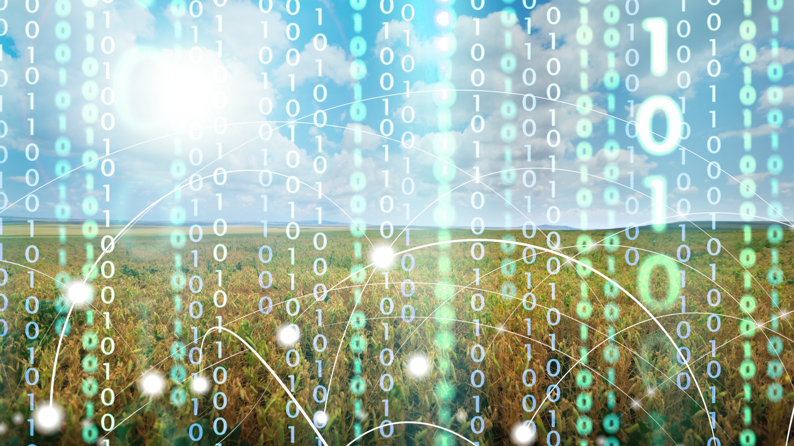
TRUST
Trust is a complex concept which can be defined as a firm belief or confidence in the reliability, integrity, and ability of a person, institution, system, or process.
(O’Hara, 2012, p. 19).

Slide 8

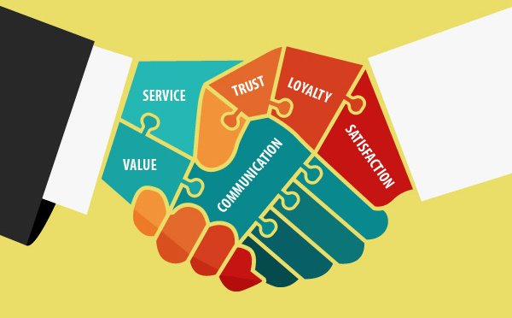
Trust
Trust is particularly important in business transactions as it serves like the foundation that makes people feel confident that the other party will do what they say and creates more successful exchanges.​
​Trust in the business-consumer relationship is foundational, fostering security that the business will act with integrity, provide reliable products or services, and prioritize the customer's interests (Pennington et al., 2003).

Slide 9
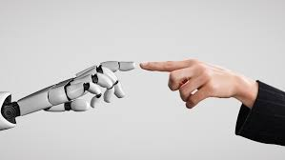
Human-like Trust In Technology
The “computers-as-a-social actor” (CSA) paradigm is based on the observation that people view computers as teammates and assign them personality traits like helpfulness or dominance (Reeves & Nass, 1996).​
In information systems (IS) research, the notion of a “human-to-technology trust relationship” was developed (Lankton, McKnight, & Tripp, 2015, p. 882).
Users perceive IT artifacts as “social actors” in terms of virtual providers possessing human character traits (Benbasat and Wang, 2005).
​Human treating computers as a social actor (Fussell et al., 2008)​
This kind of trust is also called human-like trust in technology (Lankton et al., 2015). ​
Information systems (IS) research describe the trustworthiness of IT artifacts (Benbasat and Wang, 2005)​

Slide 10

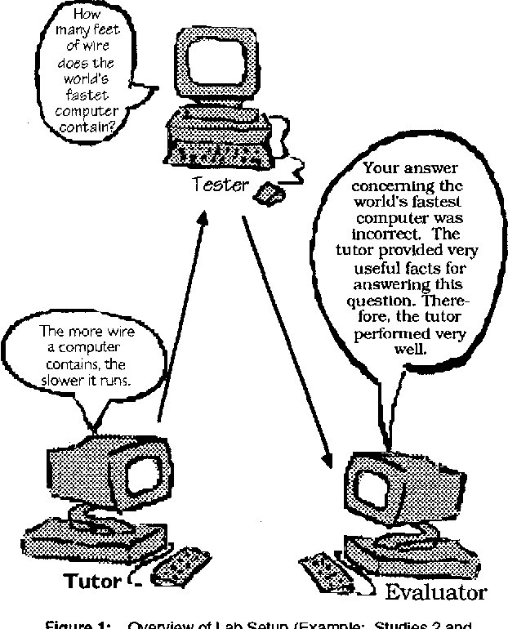

Human-like Trust In Technology
As a result, it could be even harder to build trust with blockchain because users need to trust the technology as well as their business partners and given the fact that it is a new unfamiliar technology, there’s a chance of it being more complicated.
Notes:
Provide introduction/overview of key concept(s), history/development to date, core problem/challenge as relevant.
Rename slide with relevant title
Make sure to incorporate images and visual aids to engage students.

Slide 11
A blockchain consists of several features that can induce trust, however not complete trust

Slide 12
03
Blockchain Use In The Agrifood Sector

Slide 13

Decentralization​
Definition: Trust in blockchain in the agrifood sector involves confidence in the decentralized nature of the technology. Participants trust that there is no central authority controlling the entire network, reducing the risk of manipulation or single points of failure.​
Role in Trust: Decentralized blockchain networks enhance transparency. All participants have equal access to the distributed ledger, fostering trust in the accuracy and authenticity of information. Decentralization also promotes accountability, as no single party has unchecked control over the entire system.​
Trust also relies on transparency.​

Slide 14

Transparency
Definition: Trust is established through the transparency offered by blockchain. Participants in the network can access a shared, transparent ledger that allows them to trace the journey of agricultural products from the farm to the consumer. This transparency reduces information asymmetry and enhances trust among stakeholders.​
Role in Trust: Transparent recording and sharing of information across the supply chain build trust among participants. The ability to access and verify data in real-time fosters confidence in the accuracy and authenticity of the information.​

Slide 15

Smart Contracts and Automation
Definition: Trust is facilitated by the use of smart contracts, self-executing code that automates and enforces predefined rules in agreements, reducing the need for intermediaries. ​
​Role in Trust: Participants trust that these contracts will execute as programmed, reducing the need for intermediaries and streamlining processes. Trust is built through the execution of predefined rules, ensuring that contractual conditions are met without the possibility of manipulation.​
​

Slide 16
Blockchains enable good
digital risk management.​
Blockchains enable good
digital risk management.​

Slide 17

Digital Security
A rigid tamper-proof chain : Both the content of the blocks within the blockchain and their order are tamper-proof. This relies on the decentralised architecture and the consensus principle. On top of this, there can be a mechanism incentivising positive behaviour, disincentivising negative behaviour, and a cryptographic system supporting strong technical guarantees. ​
​The PoW relies on consensus and a cryptographic proof that is costly in terms of computing power, while the PoS relies on consensus and an incentive structure and has not yet proven it could be trusted at a large scale.​

Slide 18

Risk Management
Definition: Trust in the context of risk management involves the confidence that the technology is designed to identify, assess, mitigate, and respond to potential risks effectively.​
Role in Trust: Effective risk management strategies, including the identification and mitigation of potential risks associated with blockchain implementation, contribute to the overall trustworthiness of the technology. It is integral to building and maintaining trust in blockchain technology within the agrifood sector.​

Slide 19

Security Measures
Definition: Trust in blockchain includes confidence in the security measures implemented, such as cryptographic techniques, encryption, and access controls.​
Role in Trust: Participants trust that the technology is designed to protect against unauthorized access, tampering, and data breaches.​

Slide 20
Digital Security
A rigid tamper-proof chain: The content and order of the blocks within the blockchain are tamper-proof. This relies on the decentralised architecture and the consensus principle. In addition, a mechanism incentivising positive behaviour, disincentivising negative behaviour, and a cryptographic system supporting strong technical guarantees can be used. ​
​The PoW relies on consensus and cryptographic proof that is costly in terms of computing power, while the PoS relies on consensus and an incentive structure and has not yet proven it could be trusted at a large scale.

Slide 21
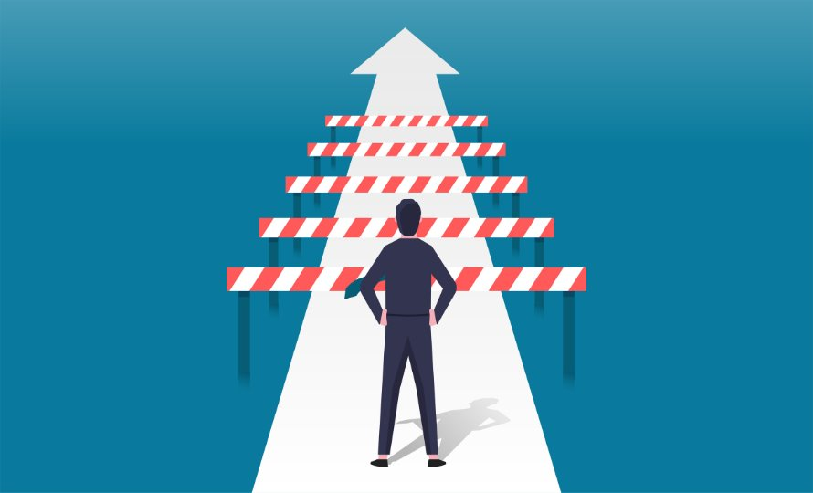
Further Elements Challenging the Complete Trust
While blockchain technology holds great promise for enhancing trust in the agrifood sector, certain elements and challenges have questioned or may question the complete trust in its implementation. ​
​Some of these elements include:​
Technology complexity,​
Integration challenges,​
Scalability concerns,​
Data Privacy Concerns
Notes:
Provide introduction/overview of key concept(s), history/development to date, core problem/challenge as relevant.
Rename slide with relevant title
Make sure to incorporate images and visual aids to engage students.

Slide 22
How Can Blockchain Improve Trust In The Agrifood Sector​
We have seen that in the agrifood sector, blockchain technology can improve trust among supply chain actors and between producers and consumers through the following specific mechanisms:​
Traceability: By allowing the creation of a transparent ledger that traces the journey of agricultural products from the farm to the table. This visibility enhances trust by providing consumers and supply chain participants with accurate and real-time information about the origin and handling of food products.​
Immutable Records: The immutability of blockchain records ensures that information about the origin and characteristics of food products cannot be altered. This reduces the risk of food fraud and counterfeiting, contributing to increased trust among consumers and supply chain participants.​
Real-Time Updates: Utilizing IoT devices and sensors connected to the blockchain allows for real-time monitoring of the supply chain. This transparency enables stakeholders to track the status and location of products at every stage, ensuring authenticity and reducing the risk of counterfeiting.
Notes:
Provide introduction/overview of key concept(s), history/development to date, core problem/challenge as relevant.
Rename slide with relevant title
Make sure to incorporate images and visual aids to engage students.

Slide 23
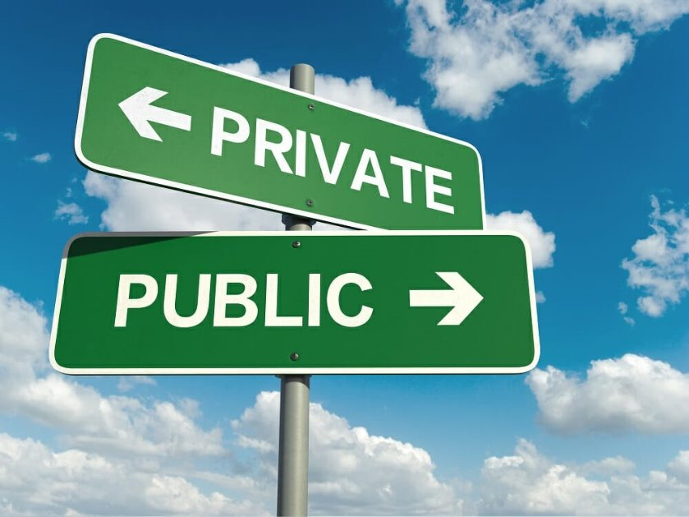
Types of Blockchain – public vs private
The choice of blockchain type can impact the transparency and, consequently, trust in the agrifood sector.​
Public blockchain: highly transparent; all transactions visible to anyone on the network​.
Enhance trust between businesses and consumers by providing a transparent and tamper-proof record of transactions
Consumers can independently verify the authenticity and origin of products.
​
​
Notes:
Provide introduction/overview of key concept(s), history/development to date, core problem/challenge as relevant.
Rename slide with relevant title
Make sure to incorporate images and visual aids to engage students.

Slide 24
Types of Blockchain – public vs private
Private blockchain: restricted access to a set of participants, reduced transparency in comparison to public blockchains; participants can see transactions, but the broader public doesn’t have access​
While a private blockchain may increase trust within a company or the players in the agrifood sector, it may not enhance trust between businesses and consumers because the level of transparency is limited.​
Notes:
Provide introduction/overview of key concept(s), history/development to date, core problem/challenge as relevant.
Rename slide with relevant title
Make sure to incorporate images and visual aids to engage students.

Slide 25
Types Of Blockchains –Permissioned Vs. Permissionless​
Permissioned blockchain:
Control who can participate in the network and validate transactions; participants have visibility; external entities may not have the same level of transparency​
Permissioned blockchains can improve trust within a closed ecosystem of businesses as participants are known and accountable. However, transparency might be limited when interacting with external stakeholders.
Permissionless blockchain:
Allows anyone to participate; often associated with public blockchains; high level of transparency​
Permissionless blockchains can be effective in building trust, especially in scenarios where inclusivity and openness are essential. Consumers may trust a system more when they know it is not controlled by a single entity.​
Notes:
Provide introduction/overview of key concept(s), history/development to date, core problem/challenge as relevant.
Rename slide with relevant title
Make sure to incorporate images and visual aids to engage students.

Slide 26


Pros vs. Cons
Transparency:​ Blockchain enhances transparency by providing a tamper-proof and publicly accessible ledger, allowing consumers and stakeholders to track the entire supply chain, from farm to table.​
Traceability:​ Blockchain's immutability ensures accurate traceability, making it highly effective in quickly identifying the origin and journey of products, instilling confidence in the supply chain.​
​Smart Contracts:​ Implementing smart contracts automates and enforces agreements, streamlining processes, reducing the risk of disputes, and enhancing trust by ensuring that predefined conditions are met.​
​Reduced Fraud:​ Blockchain's decentralized and secure nature reduces the risk of fraud and counterfeiting, creating a more trustworthy environment for consumers and supply chain actors.
Scalability Challenges:​ Blockchain networks may face scalability issues, which, if not addressed, could impact the speed and efficiency of transactions within the supply chain in the agrifood sector.​
​Data Privacy Concerns:​ Despite security features, concerns about data privacy on a decentralized ledger may arise, necessitating careful consideration of data protection regulations​
​Regulatory Uncertainty:​ The evolving regulatory landscape for blockchain in the agrifood sector may lead to uncertainty and potential compliance issues as regulations are developed and implemented.​
​Integration with Existing Systems:​ Integrating blockchain with existing agrifood systems and technologies may pose challenges, requiring careful planning and potential modifications to current processes.
Notes:
Provide introduction/overview of key concept(s), history/development to date, core problem/challenge as relevant.
Rename slide with relevant title
Make sure to incorporate images and visual aids to engage students.

Slide 27
04
Exercises and Case Studies

Slide 28
Opportunism is effectively constrained in the management of the agri-food supply chain based on blockchain​.

Slide 29

ACTIVITY: Blockchain Brainstorm
What are the potential applications of blockchain in the agrifood sector?​
Divide into small groups or pairs and for 5 minutes try to brainstorm as many applications as possible, writing them down on the provided sticky notes.​

Slide 30
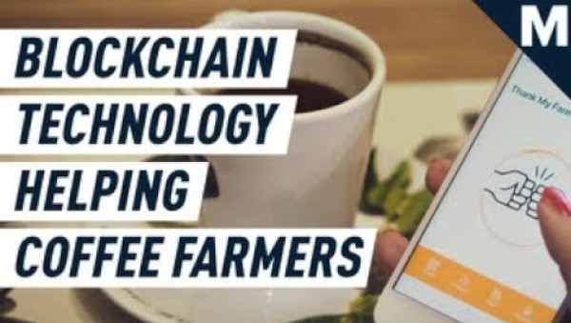
Blockchain Technology Is Helping Farmers Be More Sustainable​
WATCH
Mashable. “Blockchain Technology Is Helping Farmers Be More Sustainable”.
Online video clip. YouTube. https://www.youtube.com/watch?v=P2izCyFt_d0​
​

Slide 31
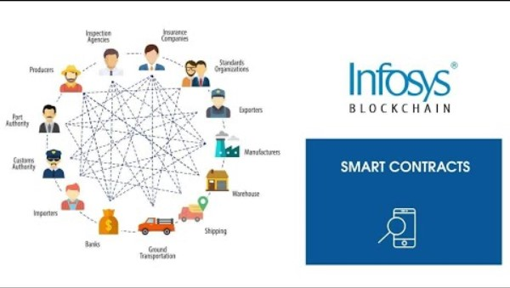
Smart Contracts​
WATCH
Infosys. “Blockchain for agricultural supply chain”. Online video clip. YouTube. https://www.youtube.com/watch?v=6ImFBrRuGG0
​

Slide 32
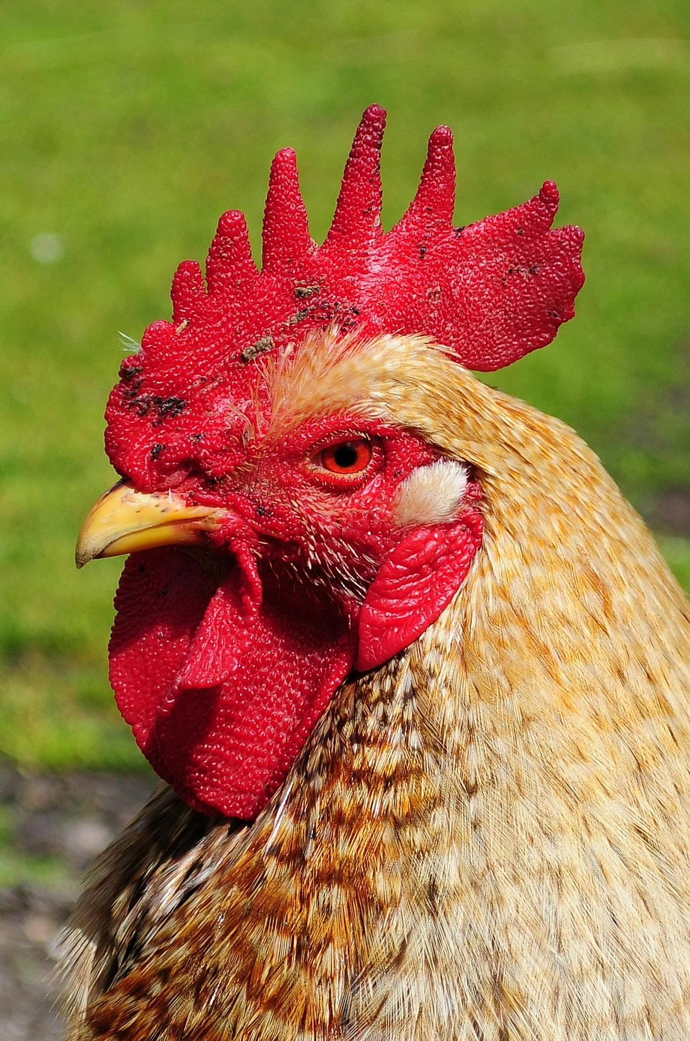
Case 1: blockchain-based poultry farming ecosystem – ‘Bu Bu Chicken’ project​
The Bu Bu Chicken project by Zhong An Technology utilizes special technology like sensors and a secure database called 'An Chain Cloud' to track the chicken's journey from the farm to the consumer's plate.​
​
Sensors placed on the chicken collect data about its location and the conditions it's raised in, which is then stored securely in a database.​
Consumers can access this data through a mobile app, which provides detailed information about the chicken's origin, handling, and transportation.​
​
To ensure the reliability of the information, multiple parties agree on it using a special system, increasing trust among consumers.
Blockchain-based agri-food supply chain management: case study in China (wageningenacademic.com)
​

Slide 33
Case 1: blockchain-based poultry farming ecosystem – ‘Bu Bu Chicken’ project​
Zhong An Technology collaborates with farmers, delivery companies like SF EXPRESS, processing plants, and online stores such as JD.com to implement the project.​
Blockchain technology helps track the chicken's journey from birth to sale, facilitating transparency and reliability.​
​Zhong An Technology works with over 200 farms across China and aims to expand to 2,500 farms
​Zhong An also offers financial services such as insurance and loans to farmers and businesses involved in the project, leveraging data from the blockchain system to ensure affordability and accessibility.​
​(Fu et al., 2020)
​

Slide 34
Case 2: ‘Shan Liang Taste’ – the agri-food supply chain system under the blockchain environment​
Shan Liang Taste combines Internet of Things (IoT), blockchain, and big data to develop an agri-food supply chain management platform.​
They digitize the assets of Beidahuang Farm Group, breaking down its grain supply chain into 1,639 business nodes across 3 farms, 9 management districts, and 33 workstations.​
By adopting standardized, large-scale, and mechanized production methods, Shan Liang Taste creates an autonomous agricultural system powered by intelligent equipment and blockchain.​
Various IoT devices installed on equipment automatically collect data such as time, location, planting details, and management data, which is uploaded to the blockchain system to ensure authenticity.​
Participants in the grain supply chain record transaction information on the blockchain system, ensuring transaction security and comprehensive data mapping.​
​

Slide 35
Case 2: ‘Shan Liang Taste’ – the agri-food supply chain system under the blockchain environment​
Shan Liang Taste develops various apps within the blockchain platform to manage the grain supply chain effectively:​
Shan Liang Blockchain Food Tickets app issues tradable and collateralized digital planting orders corresponding to land.​
​Shan Liang Blockchain Order via WeChat allows customers to book land for rice production, with orders costing $1,150 for 1 mu land.​
​Shan Liang Smart Contract app provides supply chain order contracts, effectively solving trust issues.​
​Shan Liang Steward app standardizes production services including breeding, procurement of agricultural materials, and production planning.​
​Shan Liang Finance app, in collaboration with financial institutions, offers new financial services to supply chain partners based on blockchain data assets and trading data.​​
(Fu et al., 2020)

Slide 36
05
What are the Current Limits of Blockchain?​

Slide 37
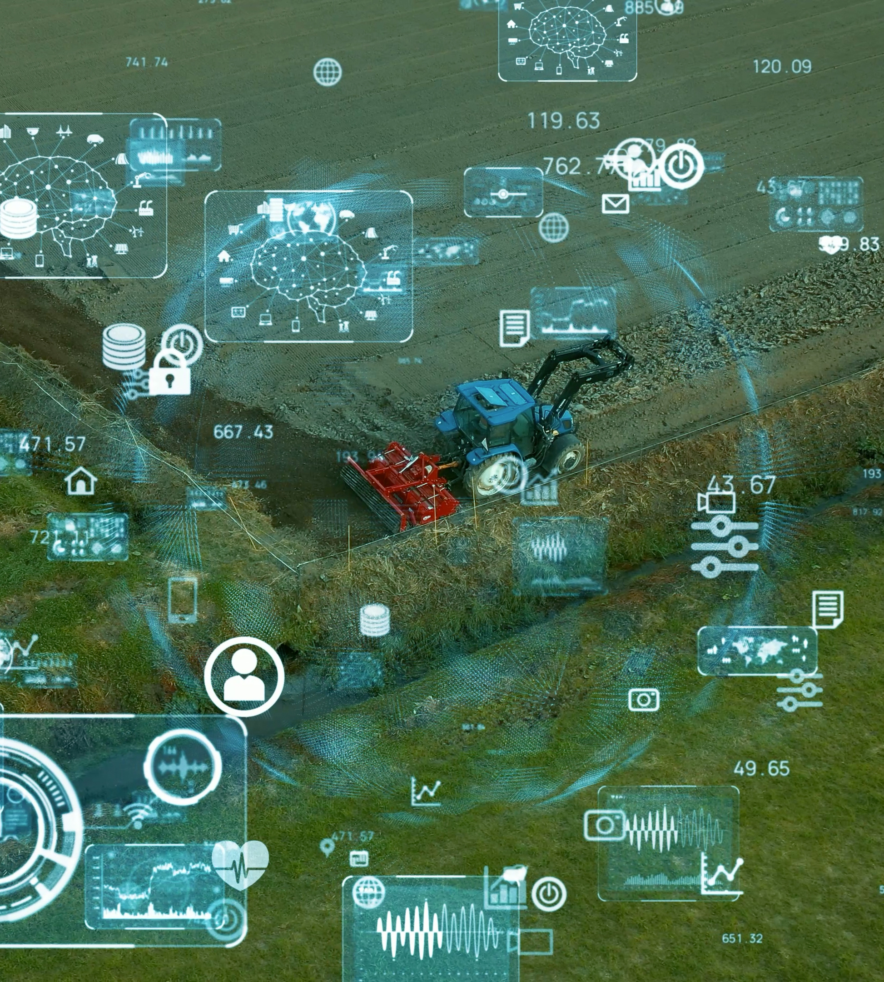
Blockchain technologies have structural limits.​

Slide 38
Current Limits
We have seen that blockchain technologies have structural limits. They cannot be considered as a basis for complete trust and confidence, even narrowed down to trust. Indeed, organizational issues relating to power dynamics between actors and user appropriation as well as technical factors make studying the actual scope of this technology very complex.
However, they indicate once more that mere transparency does not necessarily come with complete trust and an adequate protection of personal data​.
Let us finally remind here that Public Key Infrastructures (PKI) were once similarly presented as a revolutionary, trust-inducing technology, before we came to share an understanding of its limits.​ Therefore, and as is the case with labels in a broader sense, using a blockchain is a guarantee of certain properties, but should be considered as a way to induce or suggest user trust by emphasizing the appropriate features of this technology.​
​

Slide 39
06
Conclusions

Slide 40
Assessing the Trustworthiness Of Blockchain Technologies in the Agri-food Supply Chain​
Implementation Quality:​
Assessment: The trustworthiness of blockchain in the agrifood sector depends on the quality of its implementation. A well-designed and rigorously implemented blockchain system is more likely to be trustworthy.​
​Transparency and Traceability:​
Assessment: Blockchain's impact on transparency and traceability is a key factor. If the blockchain implementation provides a transparent and traceable record of the supply chain, it contributes to trustworthiness.
Data Integrity:​
Assessment: The immutability of data on the blockchain ensures data integrity. If the technology is effectively preventing unauthorized modifications to the data, it enhances trust in the accuracy of information.​

Slide 41
Assessing the Trustworthiness Of Blockchain Technologies in the Agri-food Supply Chain​
Security Measures:
Assessment: The security features of the blockchain system play a crucial role. Robust encryption, secure consensus mechanisms, and access controls contribute to the overall security of the technology, impacting its trustworthiness.​
Scalability:​
Assessment: The ability of the blockchain to scale and accommodate a growing volume of transactions is crucial. A scalable solution ensures continued performance and reliability, impacting its trustworthiness.​
​Continuous Improvement:​
Assessment: Ongoing development, updates, and a commitment to continuous improvement indicate a dynamic and responsive blockchain solution. Such adaptability contributes to trustworthiness over time.​

Slide 42
Conclusion
In summary, the extent to which the use of blockchain in the agrifood sector is trustworthy depends on factors such as the quality of implementation, its impact on transparency and traceability, data integrity, security measures, scalability, a commitment to continuous improvement, community and industry support, regulatory compliance, user feedback, educational initiatives and interoperability.​
​Each of these factors plays a role in shaping the overall trustworthiness of blockchain technology in the agrifood supply chain.​

Slide 43
Self Test Quiz
Define trust and smart contracts.​
Briefly describe two practical applications of blockchain in the agrifood sector.
List one key feature of blockchain technology.​
Briefly state the role of blockchain in establishing trust in the agrifood supply chain.​
Assess the trustworthiness of blockchain technologies in the agri-food supply chain by identifying one potential criticism.​
​

Slide 44
Links to Further Materials
IBM, What is Blockchain Security?​
https://www.ibm.com/topics/blockchain-security ​
Blockchain as a confidence machine: The problem of trust & challenges of governance https://www.sciencedirect.com/science/article/pii/S0160791X20303067 ​
Towards trustworthy blockchains: normative reflections on blockchain-enabled virtual institutions​
https://link.springer.com/article/10.1007/s10676-021-09581-3 ​
A general definition of trust ​
https://eprints.soton.ac.uk/341800/ ​
A Blockchain-Based Traceability System in Agri-Food SME: Case Study of a Traditional Bakery​
https://ieeexplore.ieee.org/abstract/document/9410538 ​
Uncovering the potential of blockchain in the agri-food supply chain: An interdisciplinary case study​
https://www.sciencedirect.com/science/article/pii/S0923474822000303 ​

Slide 45
Links to Further Materials
International Food and Agribusiness Management Review​
https://www.wageningenacademic.com/doi/epdf/10.22434/IFAMR2019.0152?role=tab
The Role of System Trust in Business-to-Consumer Transactions​
https://www.tandfonline.com/doi/abs/10.1080/07421222.2003.11045777 ​
The impact of a blockchain platform on trust in established relationships: a case study of wine supply chains​
https://www.emerald.com/insight/content/doi/10.1108/SCM-05-2021-0227/full/html ​
Designing for Trust in Blockchain Platforms​
https://www.zora.uzh.ch/id/eprint/190479/1/IEEE_TEM_Design_For_Trust_researchgate.pdf
PwC’s Trust in US Business Survey, 2021

Slide 46
Literature
Laurent M. “Is blockchain a trustworthy technology?”, in Signs of trust – The impact of seals on personal data management, Paris, Handbook 2 Chair alues and Policies of Personal Information, Coordinated by Claire Levallois-Barth, January, 2018, chapter 11, pages 179–197.
Benbasat, D. Gefen, P. Pavlou Introduction to the special issue on novel perspectives on trust in information systems MIS Quarterly, 34 (2) (2010), pp. 367-371, 10.2307/20721432
N. Lankton, D.H. McKnight, J. Tripp Technology, humanness, and trust: rethinking trust in technology Journal of the Association for Information Systems, 16 (10) (2015), pp. 880-918, 10.17705/1jais.00411
Söllner, M. (2015). Understanding trust in information systems - the impact of trust in the system and in the provider. In Proceedings of the seventy fifth annual meeting of the Academy of Management. AOM.

Slide 47
Literature
.Q. Liu, D.L. Goodhue Two worlds of trust for potential E-commerce users: Humans as cognitive misers Information Systems Research, 23 (4) (2012), pp. 1246-1262 ​
D. Gefen, P.A. Pavlou The boundaries of trust and risk: The quadratic moderating role of institutional structures Information Systems Research, 23 (3) (2012), pp. 940-959​
​
B. Reeves, C. Nass The media equation: How people treat computers Television, and new media like real people and places, Cambridge University Press (1996)
Fussekkm S.R., Kiesler, S., Setlock, L. D., & Yew, V. (2008). How people anthropomorphize robots. In Proceedings of the third ACM/IEEE international​ conference on human robot interaction (pp.145 – 152). Assocication for Computing Machinery.
​

Slide 48
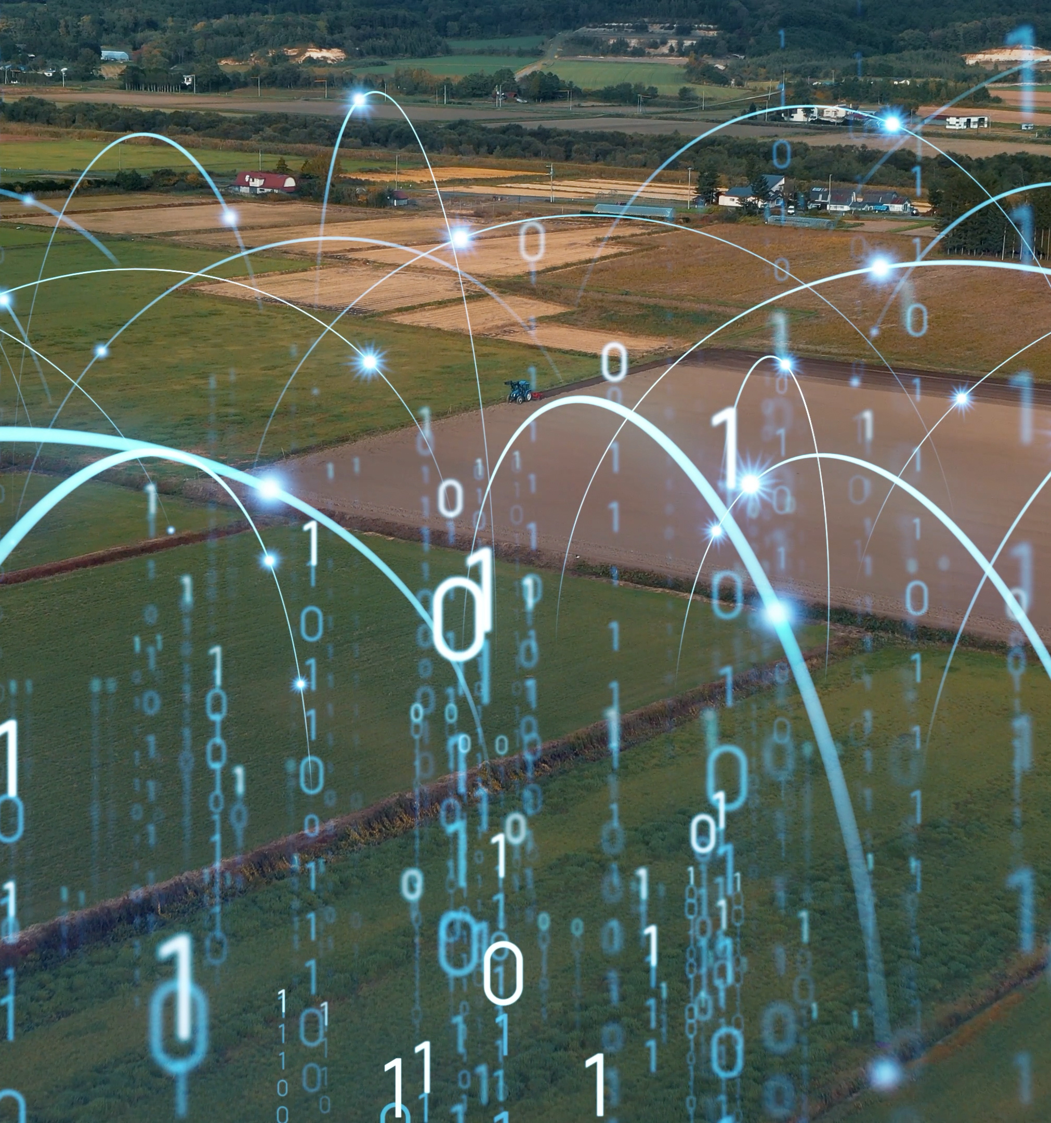
In the next Module 6, Overview of Blockchain in Agrifood, you will learn
‘
Blockchain as part of the digitalisation of the agrifood sector - a potential new solution to some of the most pressing issues in agrifood today (e.g. trust, sustainability, supply chain management)?​
Address questions about Blockchain and its uses in agriculture: what, how, and why? ​

Slide 49
https://blockchainforagrifood.eu/
Thank you
Any questions?

