Slide 1



Module 6
OVERVIEW OF BLOCKCHAIN IN AGRIFOOD
The European Commission support for the production of this publication does not constitute an endorsement of the contents which reflects the views only of the authors, and the Commission cannot be held responsible for any use which may be made of the information contained therein.
Blockchain for AgriFood Open Educational Resources © 2023/2024 by Blockchain for AgriFood Consortium is licensed under CC BY-SA 4.0

Slide 2
SECTION 01 INTRODUCTION TO BLOCKCHAIN IN THE AGRIFOOD CHAIN
SECTION 02 THE BUILDING BLOCKS OF BLOCKCHAIN
SECTION 03 HOW TO USE BLOCKCHAIN WITHIN THE AGRIFOOD SECTOR
SECTION 04 BLOCKCHAIN IN PRACTICE
SECTION 05 TRUSTWORTHY BLOCKCHAIN SOURCES - WHO TO TRUST?
SECTION 06 CONCLUSIONS
CONTENTS
The European Commission support for the production of this publication does not constitute an endorsement of the contents which reflects the views only of the authors, and the Commission cannot be held responsible for any use which may be made of the information contained therein.

Slide 3

MODULE DESCRIPTION
Topic: ‘Overview of Blockchain in Agrifood’
Significance: Blockchain as part of the digitalisation of the agrifood sector - a potential new solution to some of the most pressing issues in agrifood today (e.g. trust, sustainability, supply chain management)?
Growing topic in the academic literature
Address questions about Blockchain and its uses in agriculture: what, how, and why?
Real-world applications and case studies
Notes:
Explain concisely what the module is about and how the overall module will support student learning in the relevant discipline. In this part you can describe details of the background of the module and its overall aims and the prior knowledge the trainees should have. You can also include information on how the module relates to the other modules in the curriculum. The questions provided are intended as prompts and should be replaced upon completion.

Slide 4
LEARNING OUTCOMES
Demonstrate a clear understanding of the fundamentals of Blockchain technology, its basic components, mechanism, and functions
Analyse key trends and developments regarding the use of Blockchain in the agri-food sector, including real-world case studies
Assess the relative advantages and limitations of Blockchain’s uses in agri-food, its trustworthiness and its future potential
Synthesise topics contained in this module into a single ‘big picture’ overview of Blockchain in agrifood
Notes:
- Learning outcomes refer specifically to what students are expected to achieve or learn at the end of the course. You can use Bloom's taxonomy to identify verbs to describe student learning. Examples of learning outcomes verbs for library instruction include:
Knowledge/Remembering: define, list, recognize;
Comprehension/Understanding: characterise, describe, explain, identify, locate, recognize, sort;
Application/Applying: choose, demonstrate, implement, perform;
Analysis/Analysing: analyse, categorise, compare, differentiate;
Evaluation/Evaluating: assess, critique, evaluate, rank, rate;
Synthesis/Creating: construct, design, formulate, organise, synthesise.

Slide 5
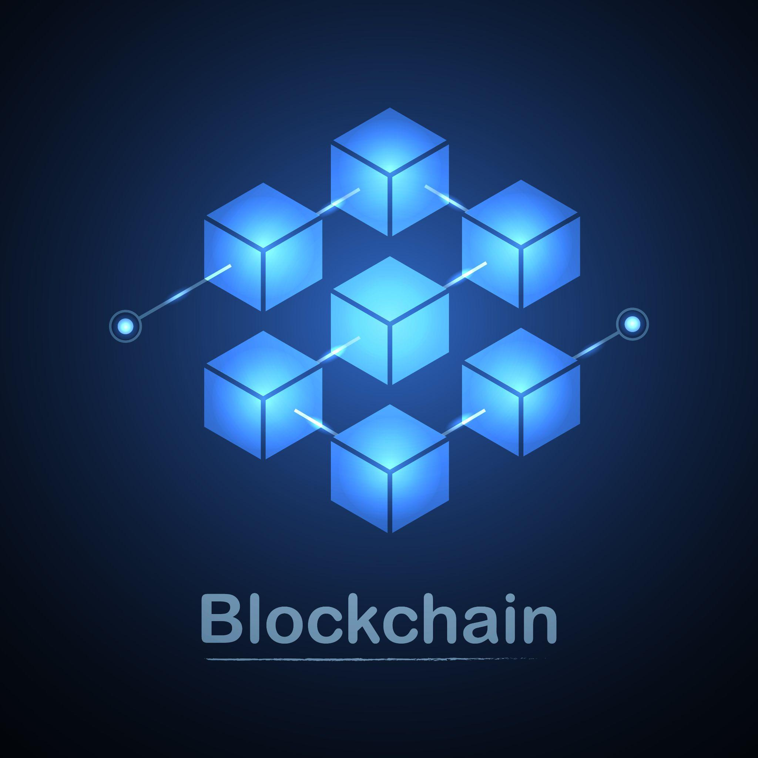
DEFINITION OF A BLOCKCHAIN
Also known as distributed ledger technology (DLT), the blockchain is a record that anyone can add to, that nobody can change, and that isn't controlled by any one person or entity.
The core concept is a public ledger with copies spread out among multiple locations called nodes, which usually refer to individual computers with copies of the ledger. ​
In other words, a blockchain is a distributed database shared among a computer network's nodes.​

Slide 6

WHAT IS BLOCKCHAIN TECHNOLOGY?
Best known for their crucial role in cryptocurrency systems for maintaining a secure and decentralized record of transactions​
Not limited to cryptocurrency uses​
Blockchains can be used to make data in any industry immutable—the term used to describe the inability to be altered.​
Very often referred as decentralized​

Slide 7
INDUSTRY USES OF BLOCKCHAIN
Blockchain is an emerging technology that is being adopted in innovative manner by various industries, including:
energy
finance
media & entertainment
retail
agriculture
In this module, we will focus on the role of Blockchain within the agrifood sector, and the opportunities and challenges associated with its use. Agriculture is one of the most important sectors where blockchain technology has the potential to tackle wide-ranging concerns with product stealing, traceability, price fraud, and customer distrust. ​
The development of a more reliable, sustainable, and secure agri-food system is possible with the use of blockchain technology.​

Slide 8
KEY TAKEAWAYS
Blockchain is a type of shared database that differs from a typical database in the way it stores information; Blockchains store data in blocks linked together via cryptography.​
Different types of information can be stored on a blockchain. ​
In many case, Blockchain is decentralized so that no single person or group has control—instead, all users collectively retain control.​
Decentralized Blockchains are immutable, which means that the data entered is irreversible.​

Slide 9
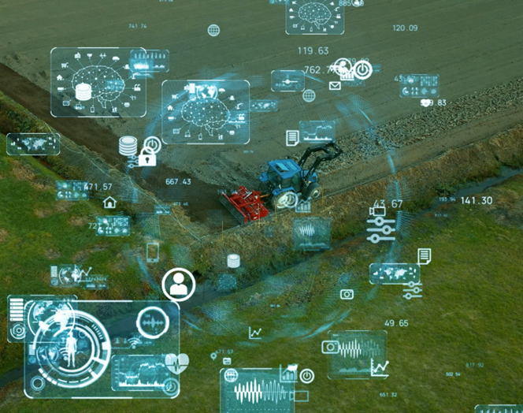
BLOCKCHAIN IN AGRIFOOD: OPPORTUNITIES
Supply Chain Transparency​
Provenance and Quality Assurance​
Efficient Traceability​
Smart Contracts​
Access to Financing​
Reducing Food Waste​
Sustainable Agriculture​
Market Access​

Slide 10
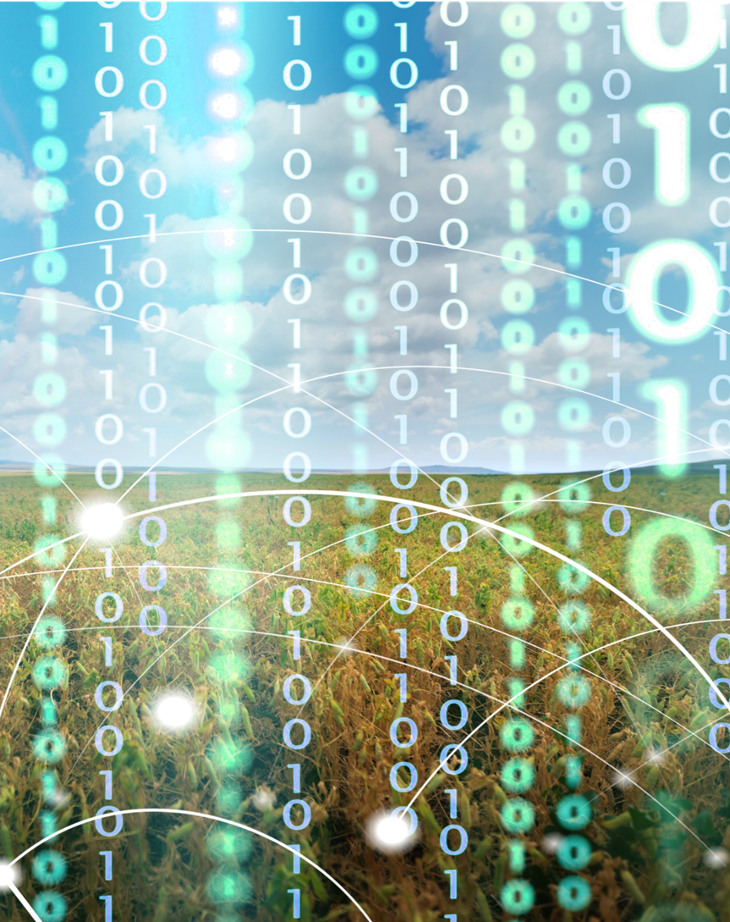
BLOCKCHAIN IN AGRIFOOD: CHALLENGES
Data Standardisation​
Data Privacy and Security​
Infrastructure and Connectivity​
Cost of Implementation​
Education and Training​
Interoperability​

Slide 11
CHALLENGE IN FOCUS: DATA STANDARDISATION
Data standardisation in agriculture refers to the process of creating uniform structures and formats for collecting, storing, and sharing agricultural data. It plays a pivotal role in enhancing efficiency, accuracy, and transparency within the industry. ​
Several factors underline the significance of data standardization in agriculture:​
Interoperability
Informed Decision-Making
Supply Chain Efficiency
Market Access
Research and Development
Collaboration among stakeholders, including governments, agricultural organizations, and technology providers, is crucial to overcoming these challenges and advancing the adoption of Blockchain in the agrifood sector.​

Slide 12
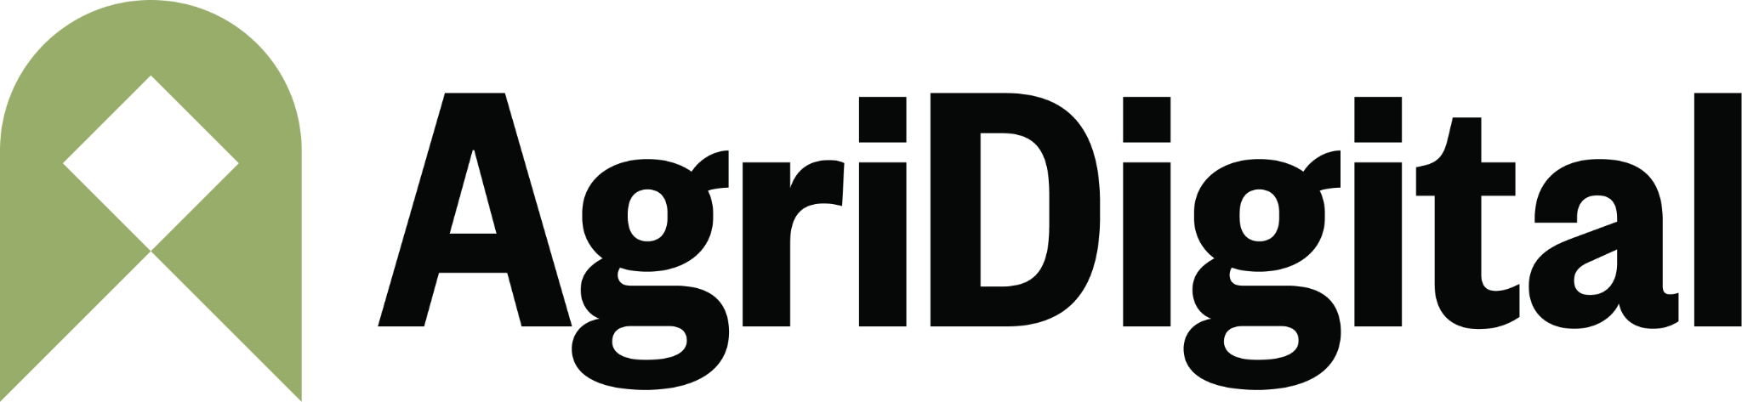
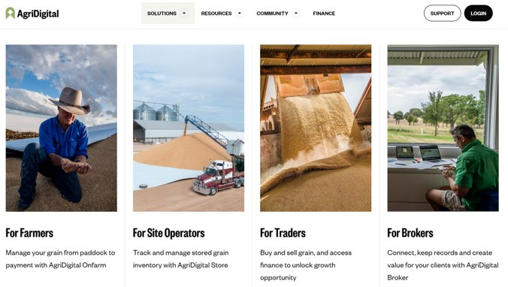
APPLICATIONS OF BLOCKCHAIN IN AGRIFOOD
Applications of Blockchain in agrifood can be grouped into four main categories:
1. Provenance of traceability and food authenticity
2​. Smart agricultural data management
3​. Trading finance in supply chain management​
4​. Other information management systems
Example: AgriDigital
AgriDigital, a leading independent digital grain firm, completed the world’s first settlement sale on a Blockchain in 2016 for 23.46 tons of grain
Since then, more than 1,300 customers have used the cloud-based system to process approximately 1.6 million tons of grain and $360 million in producer payments

Slide 13
THE BUILDING BLOCKS OF BLOCKCHAIN
AND THE BLOCKCHAIN MECHANISM
The European Commission support for the production of this publication does not constitute an endorsement of the contents which reflects the views only of the authors, and the Commission cannot be held responsible for any use which may be made of the information contained therein.

Slide 14
INTRODUCTION
The basic building blocks of blockchain are the following elements: ​
Blocks​ : each ‘block’ of data in the chain contains a list of transactions and a unique identifier (hash) from the previous block.
Distributed ledger : identical copies of the information recorded on the Blockchain are stored on thousands of computers (nodes) around the world.
Cryptography​: Cryptographic functions, known as hash functions, secure the information stored on the Blockchain. Each member of the Blockchain has a public and private key, which enable the verification and signing of transactions.
Consensus Mechanism​: Blockchain requires all nodes to reach consensus on valid transactions. This is usually achieved through various consensus algorithms such as Proof of Work (PoW) or Proof of Stake (PoS).​
Immutability​: Once data is stored in the blockchain, it cannot be easily changed.

Slide 15
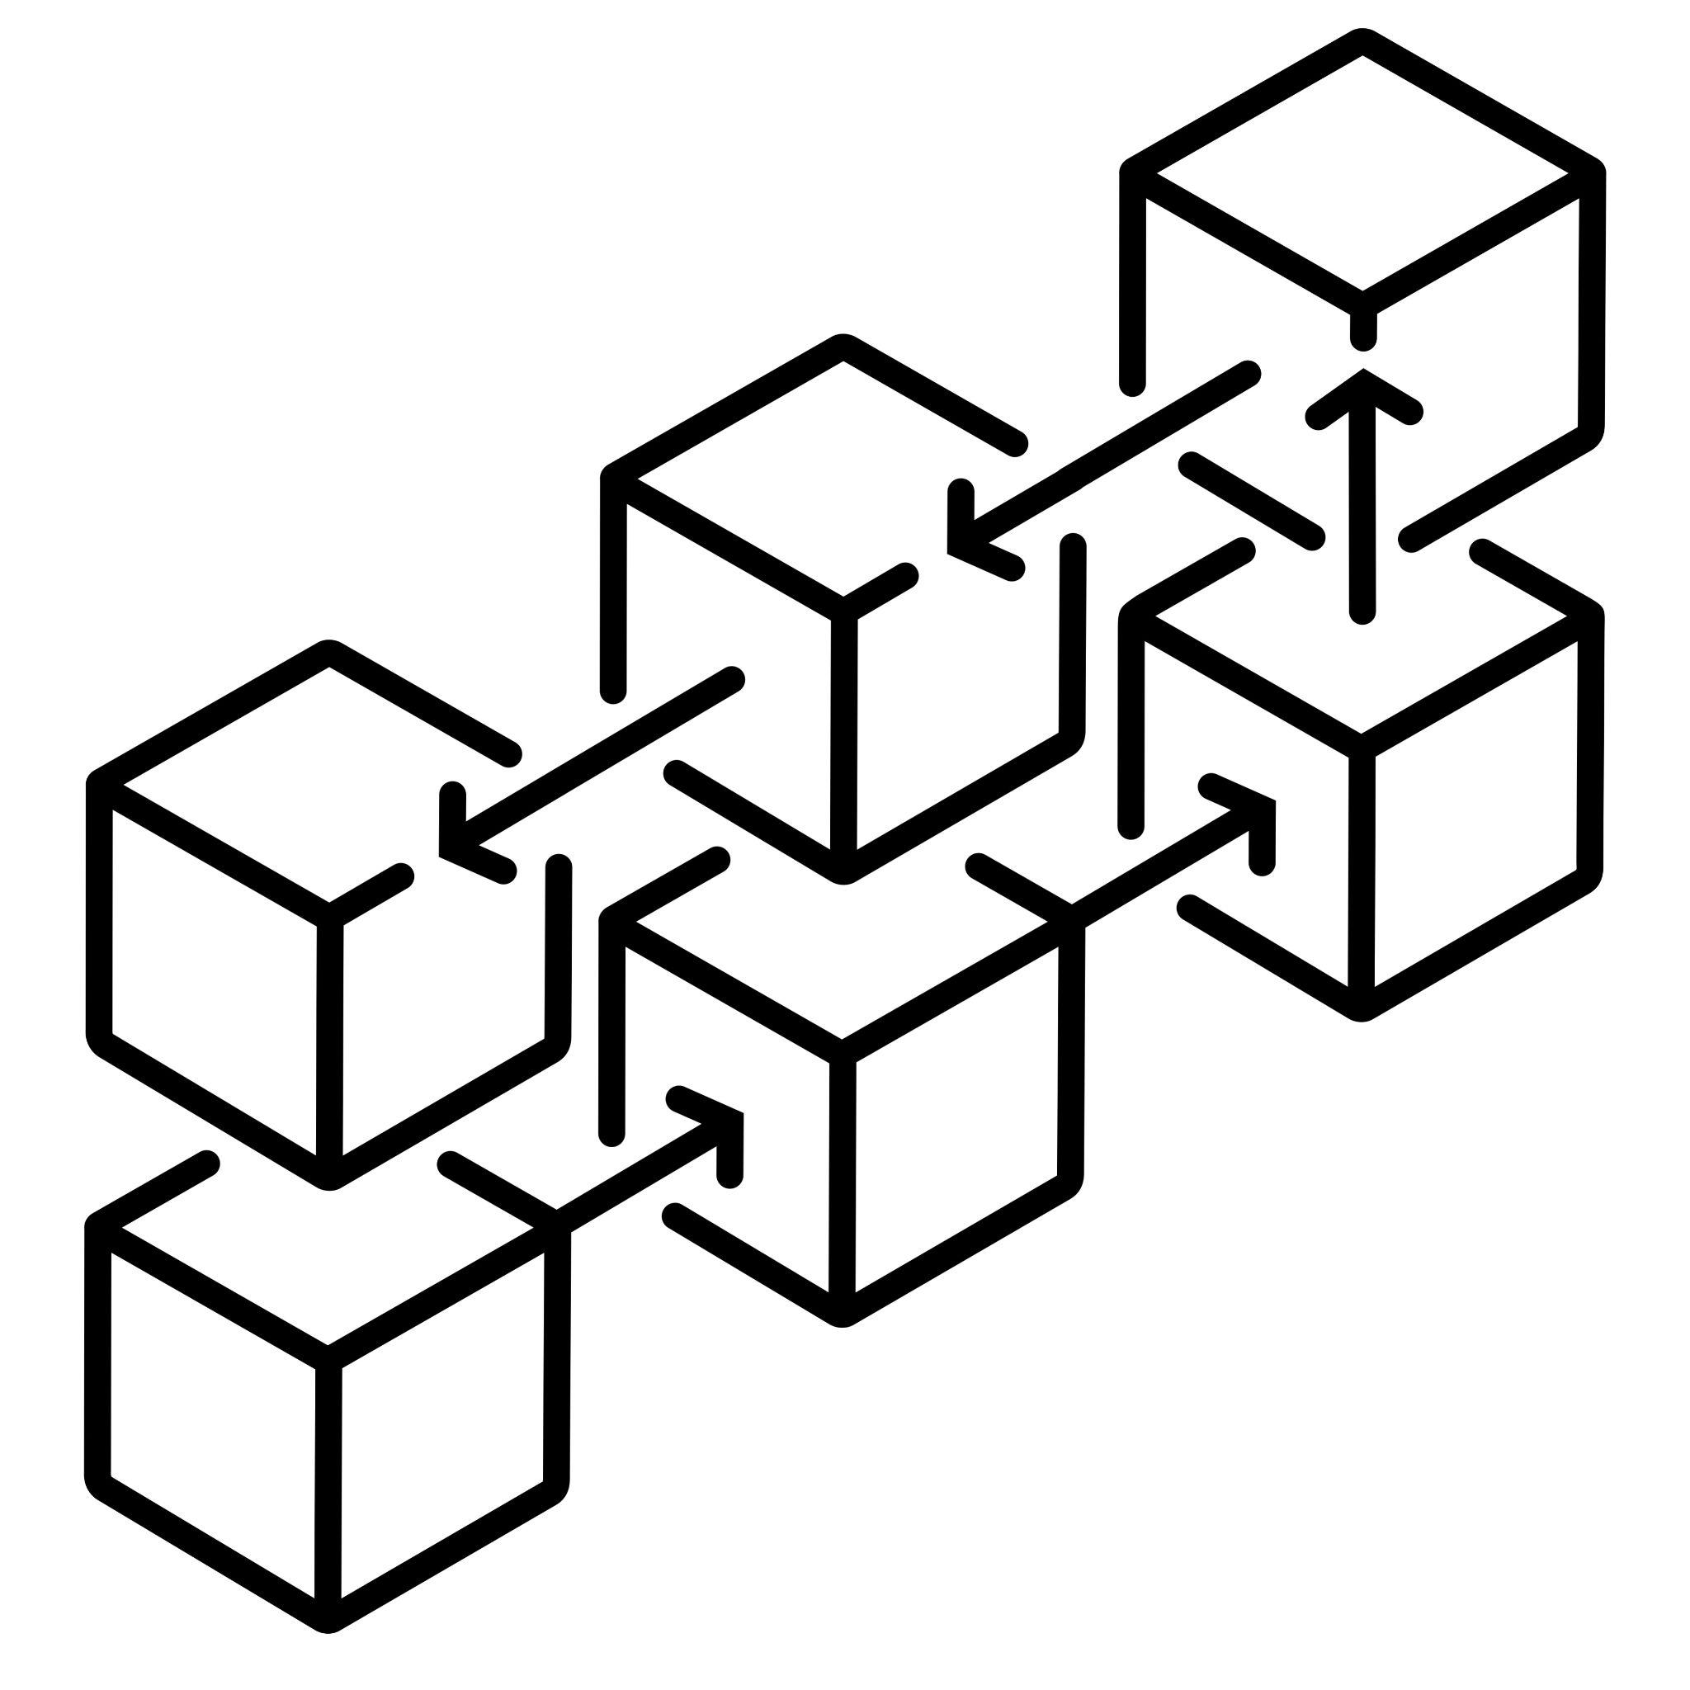
HOW DOES A BLOCKCHAIN WORK?
Each transaction or data entry, known as a "block", is securely linked to the previous one through cryptographic hashing, creating a continuous and tamper-resistant chain of information. ​
Because there is no way to change a block, the only trust needed is at the point where a user or program enters data. This aspect reduces the need for trusted third parties or intermediaries, such as auditors, that can create additional costs and/or increase the risk of human error. ​

Slide 16
BLOCKCHAIN ARCHITECTURE
Blockchain architecture has the following main components:​
A distributed ledger​
A shared database in the Blockchain network that stores the transactions. However, distributed ledger technologies have strict rules about who can edit and how to edit. Entries, once recorded, cannot be deleted.​
2. Smart contracts​
Smart contracts can be used to self-manage business contracts without the need for an assisting third party. They are programs stored on the blockchain system that run automatically when predetermined conditions are met. They run if-then checks so that transactions can be completed confidently.
3. Public key cryptography
​A security feature to uniquely identify participants in the blockchain network. This mechanism generates two sets of keys for network members. One key is a public key that is common to everyone in the network. The other is a private key that is unique to every member. The private and public keys work together to unlock the data in the ledger.

Slide 17
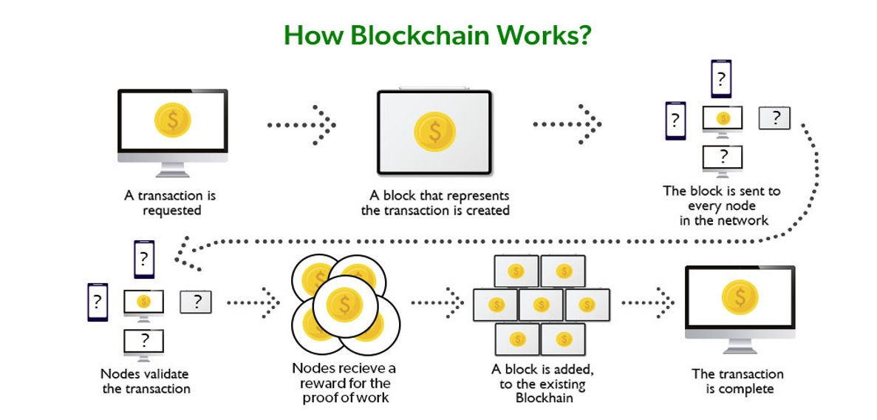
HOW DOES A BLOCKCHAIN WORK?
Source: geeksforgeeks.org

Slide 18
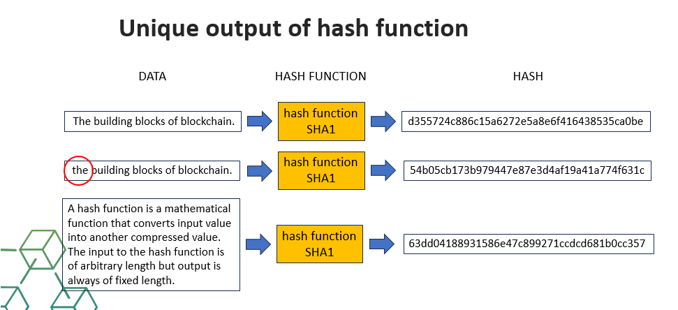
HASH FUNCTIONS
A hash function is a mathematical function that converts input value into another compressed value. The input to the hash function is of arbitrary length but output is always of fixed length
Hash functions are extremely useful and appear in almost all information security applications

Slide 19
COMPARISON TO A TRADITIONAL DATABASE
Blockchain is a special type of database management system that has more features than a regular database. We describe some significant differences between a traditional database and a blockchain in the following list:​
Blockchains decentralize control without damaging trust in the existing data. This is not possible in other database systems.​
Companies involved in a transaction cannot share their entire database. But in blockchain networks, each company has its copy of the ledger, and the system automatically maintains consistency between the two ledgers.​
Although in most database systems you can edit or delete data, in blockchain you can only insert data.
​

Slide 20
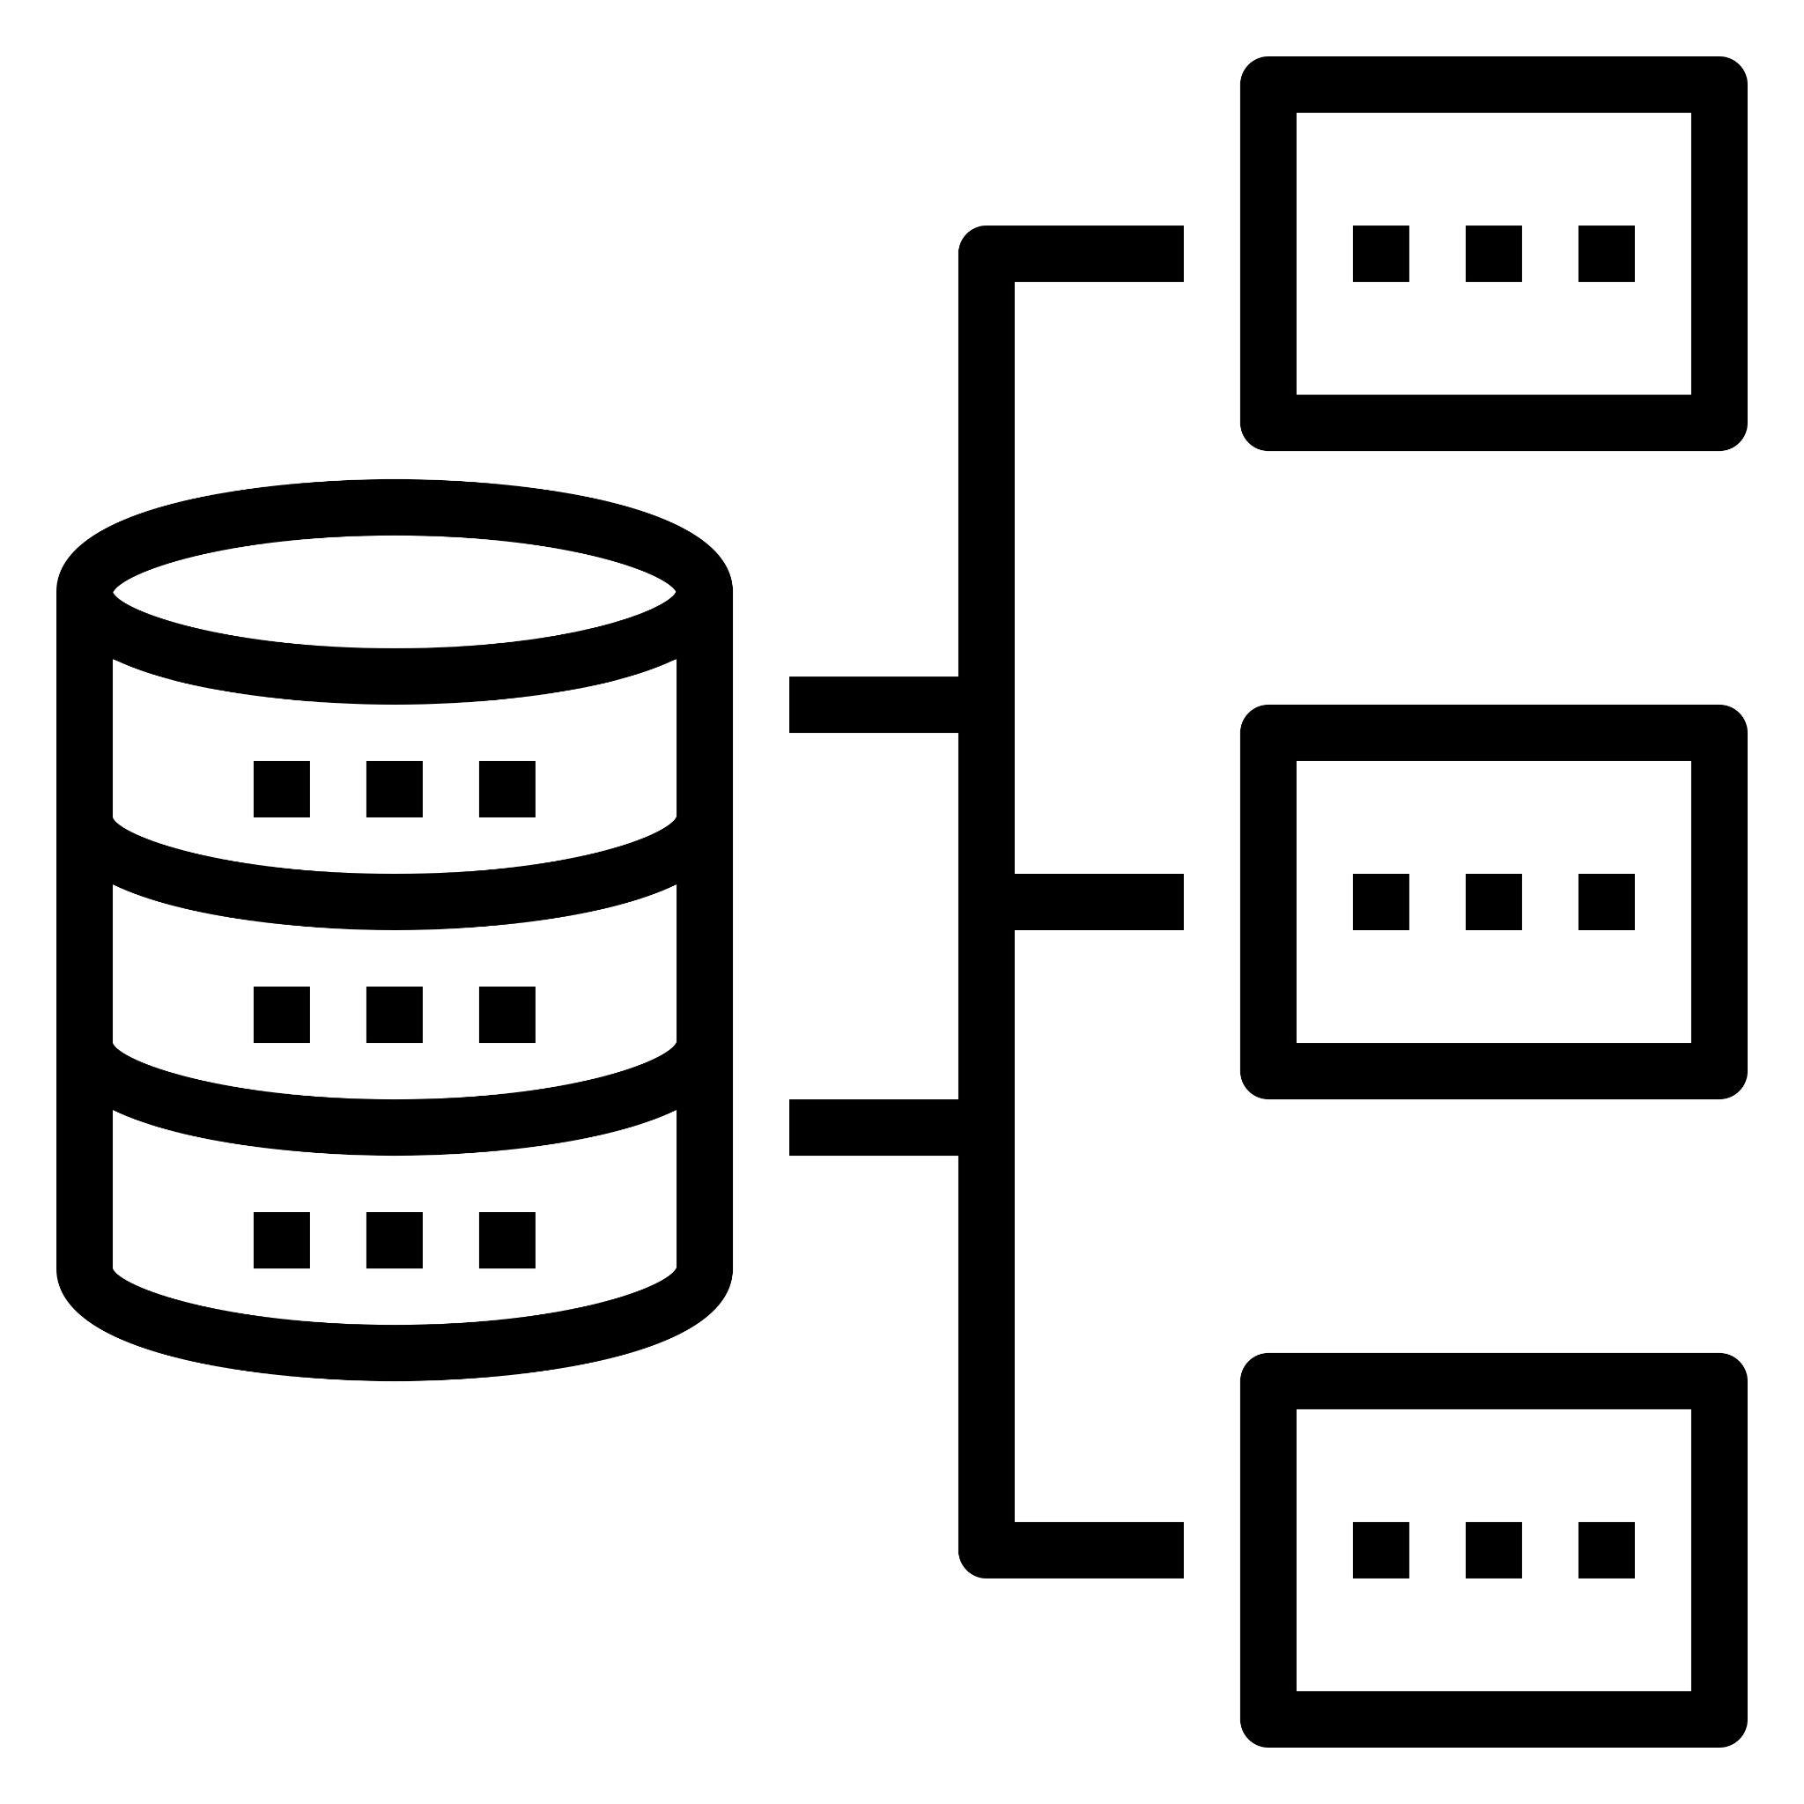
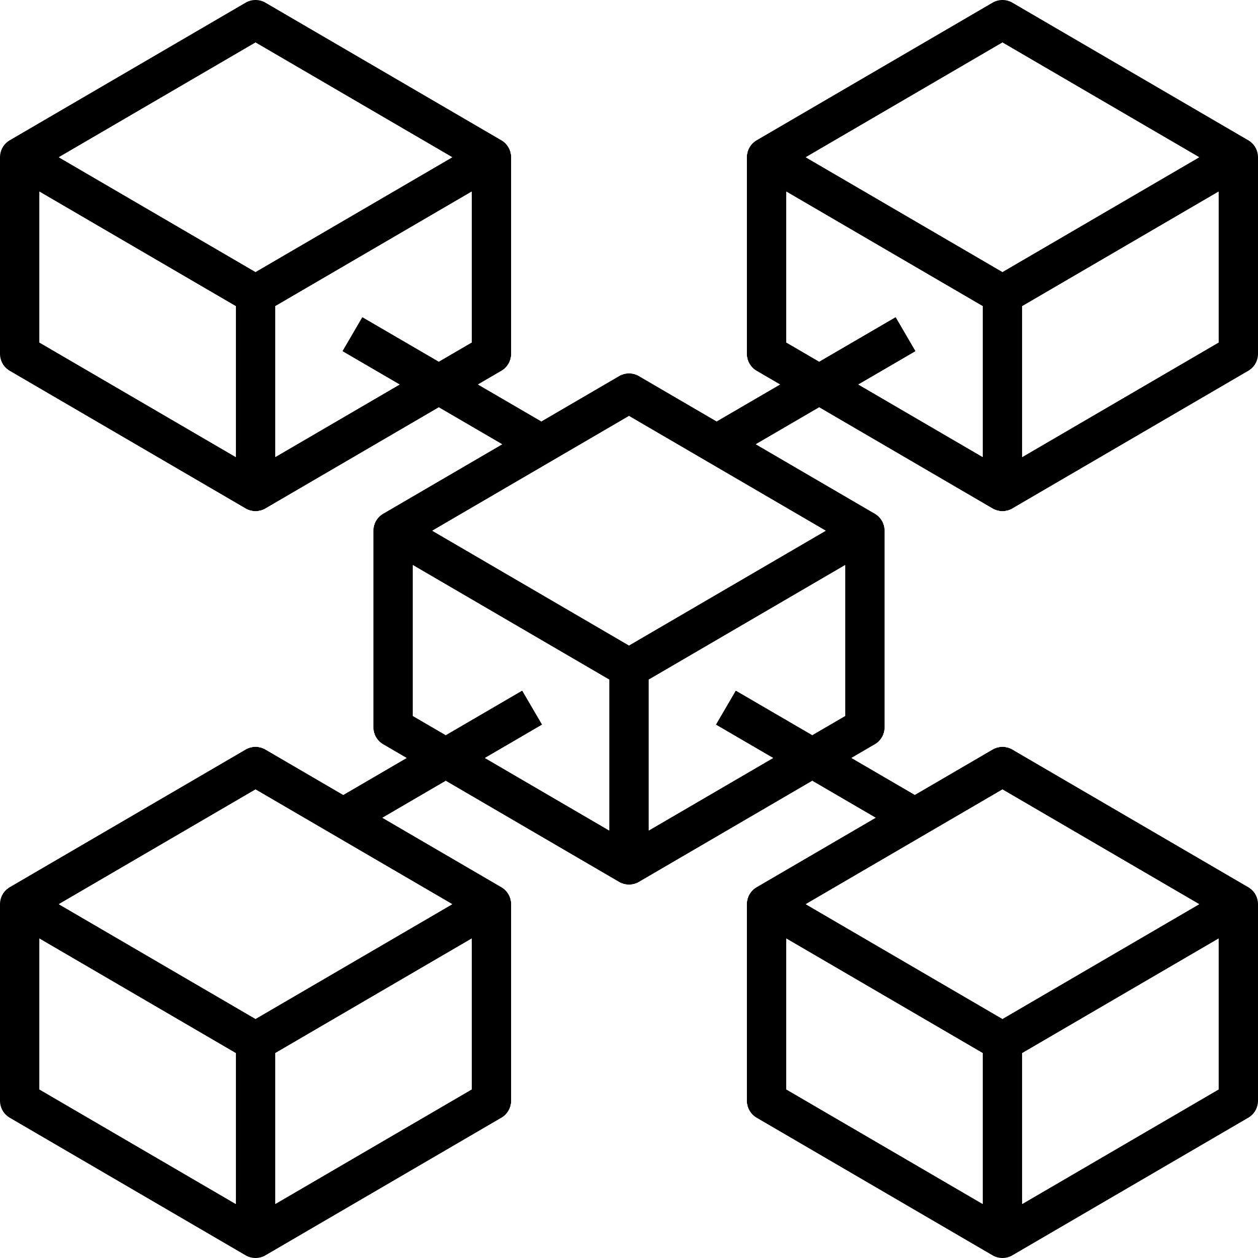
COMPARISON TO A TRADITIONAL DATABASE
Key difference: centralization vs. decentralization​
Traditional Databases: Traditional databases are centralized systems where a single entity (e.g., a company or organization) has control over the database. They rely on a central server or a cluster of servers to manage and store data. ​
Blockchain: Blockchains are decentralized networks where data is distributed across multiple nodes (computers) in a network. There is no central authority or single point of control, making them resistant to censorship and tampering. ​

Slide 21
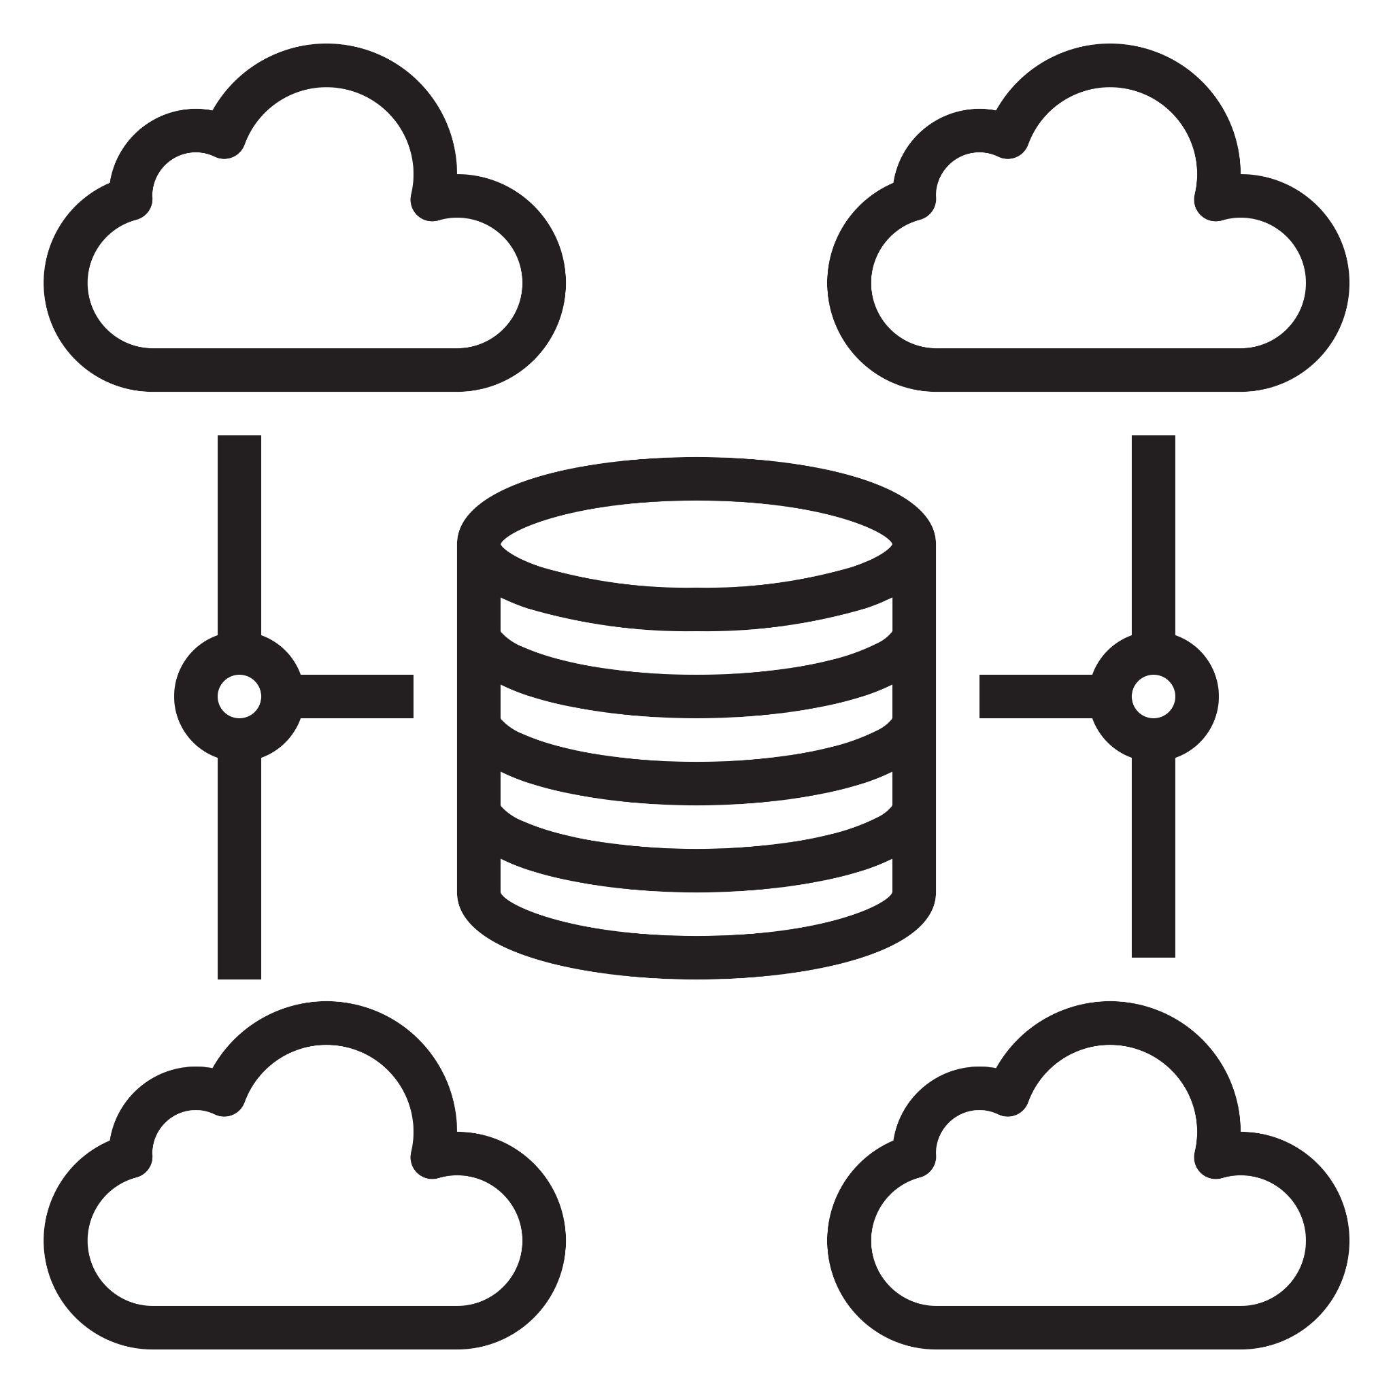
BLOCKCHAIN VS THE CLOUD & BLOCKCHAIN AS A SERVICE
How is Blockchain different from the cloud?
The term cloud refers to computing services that can be accessed online. You can access Software as a Service (SaaS), Product as a Service (PaaS), and Infrastructure as a Service (IaaS) from the cloud. ​
What is blockchain as a service?​
Blockchain as a Service (BaaS) is a managed blockchain service that a third party provides in the cloud. You can develop blockchain applications and digital services while the cloud provider supplies the infrastructure and blockchain building tools. ​

Slide 22
BENEFITS OF BLOCKCHAIN TECHNOLOGY
Blockchain technology brings many benefits to asset transaction management.
Advanced security​: Blockchain uses a combination of cryptography, decentralization, and consensus to create a highly secure underlying software system that is nearly impossible to tamper with. There is no single point of failure, and a single user cannot change the transaction records.​ Thus, Blockchain can enhance security and trust.
Improved efficiency​: Blockchain can speed up business-to-business transactions by providing transparency and promoting disintermediation.
Faster auditing:​ Blockchain records are chronologically immutable, which means that all records are always ordered by time. This data transparency makes audit processing much faster.

Slide 23
HOW TO USE BLOCKCHAIN TECHNOLOGY WITHIN THE AGRIFOOD SECTOR
The European Commission support for the production of this publication does not constitute an endorsement of the contents which reflects the views only of the authors, and the Commission cannot be held responsible for any use which may be made of the information contained therein.

Slide 24
AGRI-FOOD DIGITALISATION AND BLOCKCHAIN
Current challenges in the agri-food sector: rapid population growth; food waste; pollution and greenhouse gas emissions; financial losses associated with food waste and food fraud
Digitalisation of the agri-food sector as a potential solution to many of these problems
Increase productivity, efficiency, transparency in supply chains
More sustainable, equitable agricultural practices
Reduce waste
Data-driven decision making
Blockchain as a useful tool within the wider digitalisation of the agrifood sector; often most effective when used in conjunction with other advanced technologies (e.g. IoT, sensors, cloud computing, machine learning)
Key advantages of Blockchain in agri-food: transparency, traceability, trust

Slide 25
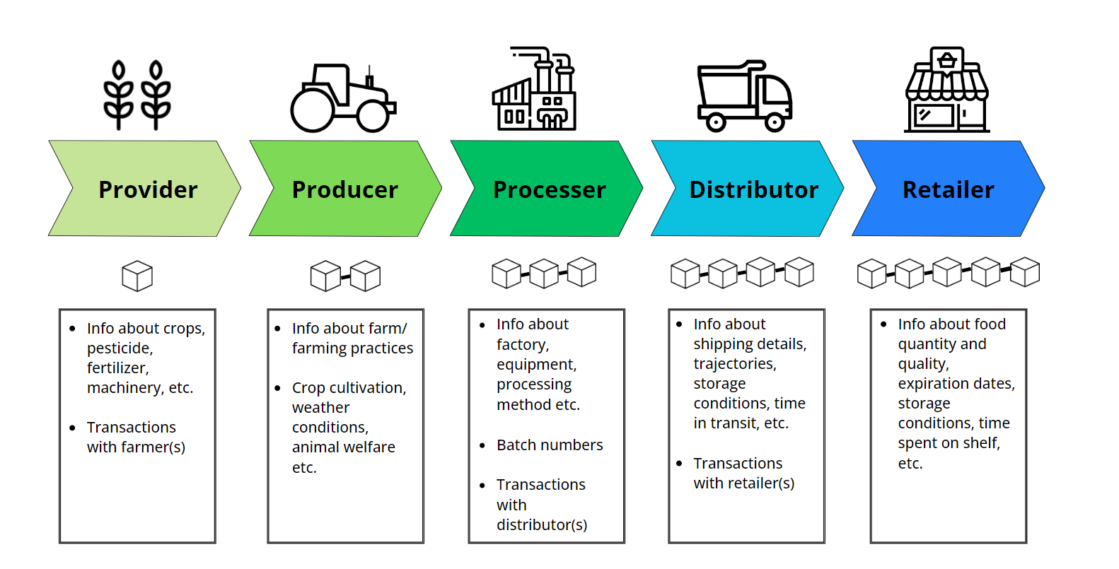
BLOCKCHAIN AND SUPPLY CHAIN MANAGEMENT
Challenges: globally distributed stakeholders; lack of shared information; low levels of trust; human error & fraud; costly inefficiencies
Blockchain solution/application: Blockchain as a distributed, decentralised ledger
Fig. 1: Digitalisation of supply chain using Blockchain

Slide 26
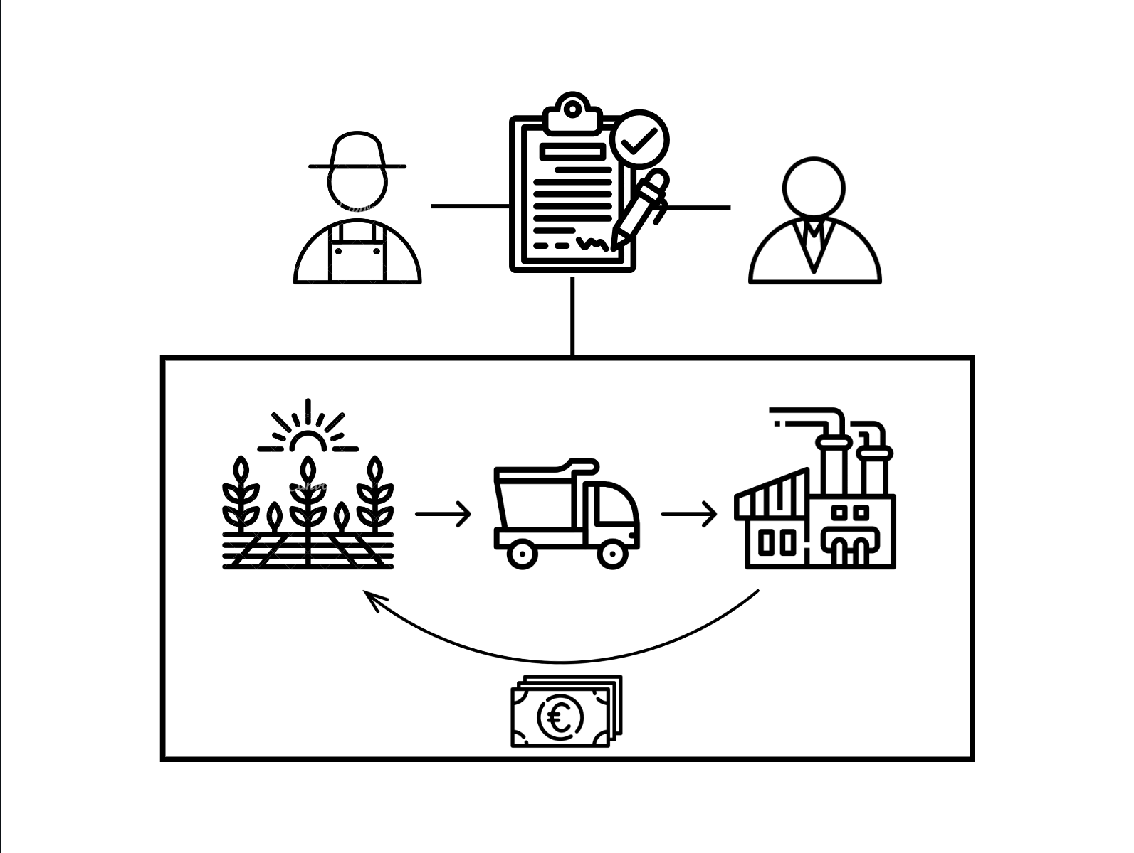
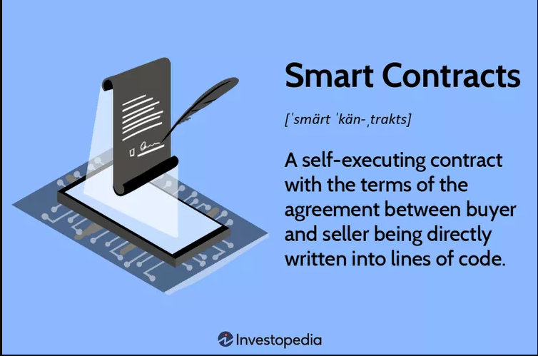
BLOCKCHAIN AND FARMER-CENTRIC SOLUTIONS
Challenges: Lack of information transparency creates costs which can exclude small-scale farmers from supply chains; lack of trust; delayed payment and breach of contract
Blockchain solution/application : Smart contracts (including smart crop insurance contracts)
Fig.2 : Definition of smart contracts
Fig. 3: Example of an agri-food smart contract between a farmer and producer

Slide 27
BLOCKCHAIN AND SUPPLY CHAIN MANAGEMENT
Advantages:
Quicker, more accurate flow of information between supply chain stakeholders
Reduce chances of contamination; swift and targeted recall in the event of contamination, improves food safety and reduces food waste
Disintermediation
Less room for human error, miscommunication or fraud
Increased transparency
Increased efficiency
Reduced costs
Limitations:
Adoption challenges - high upfront cost of digital infrastructure and stakeholder upskilling
Lack of interoperability between different Blockchain systems
Blockchain cannot verify whether the information initially inputted is accurate - still some room for fraud/error

Slide 28
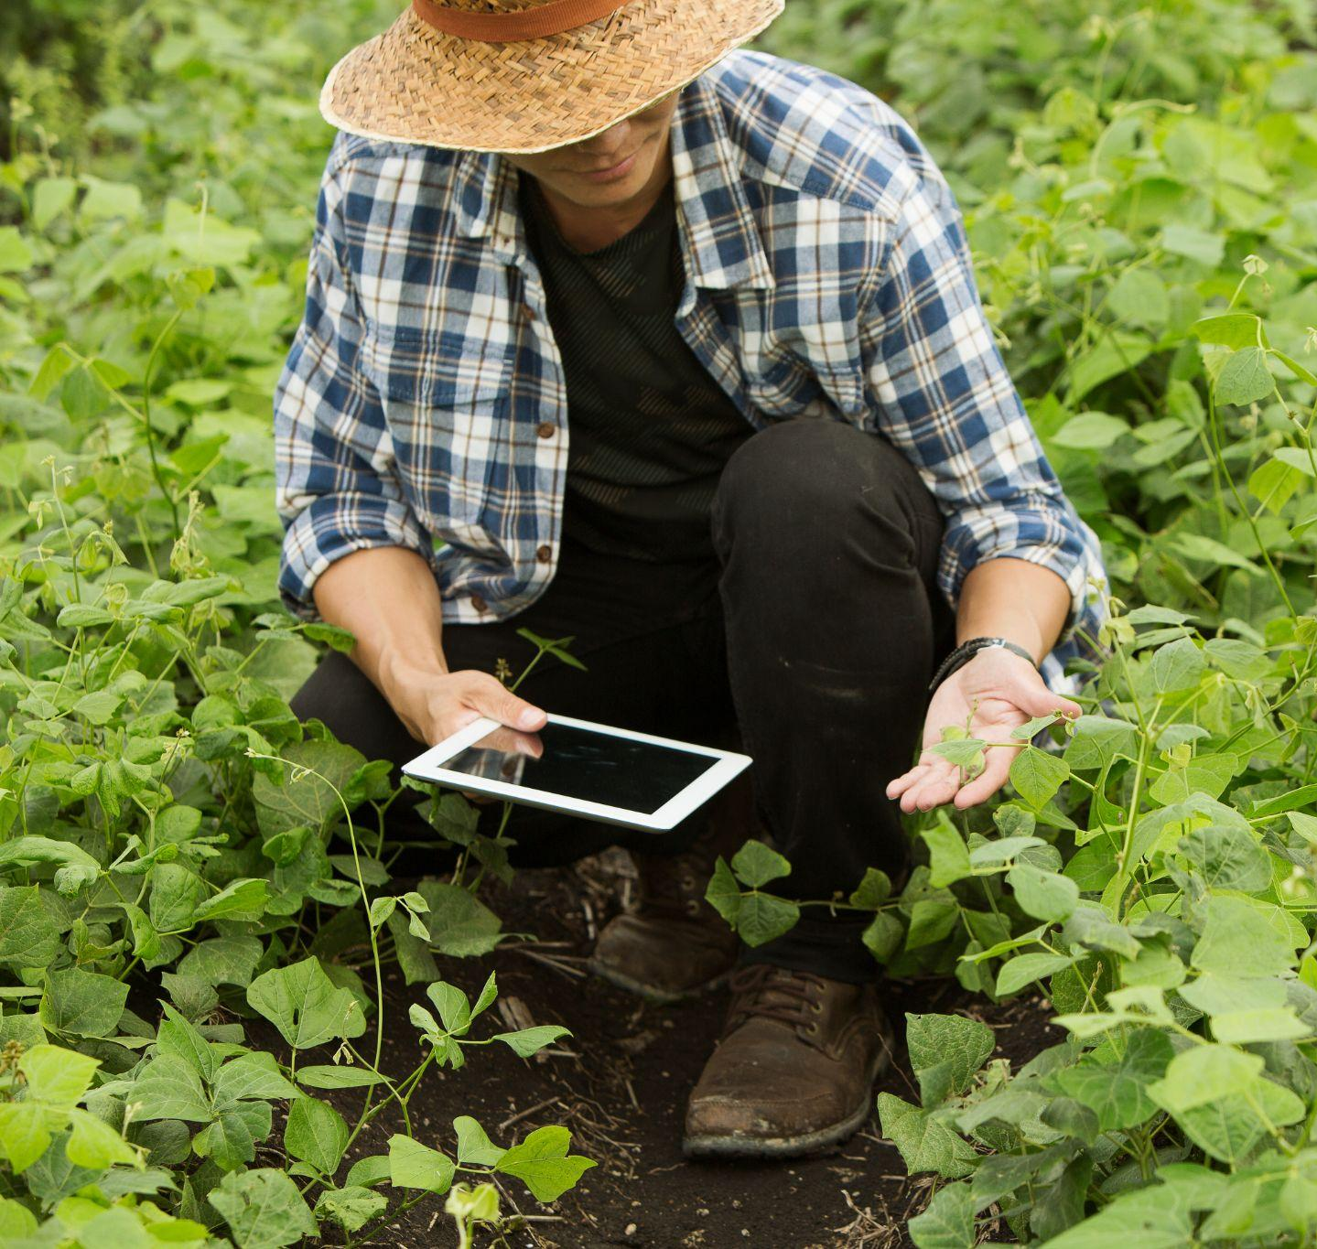
BLOCKCHAIN AND FARMER-CENTRIC SOLUTIONS
Advantages:
Prompt payment for services and insurance claims
Disintermediation & reduced costs → access new markets
Transparency and immutability promotes trust & collaboration
Reduced likelihood of breach of contract
Efficiency
Limitations:
Adoption challenges - low levels of digital skills/knowledge among farmers (especially in developing countries), high initial costs (infrastructure, upskilling)
Stand-alone smart contracts are not legally enforceable (most effective as ancillaries)
Smart contracts are inflexible

Slide 29
BLOCKCHAIN AND ENVIRONMENT-CENTRIC SOLUTIONS
Challenges: negative environmental impact of current agricultural practices; food waste; lack of accountability/measurable results for companies’ sustainability commitments - damaged reputation/credibility
Blockchain solution/application: smart food waste management systems; IoT/RFID food trackers with data stored on Blockchain; farm-to-fork tracking to promote sustainable practices
Advantages:
Reduce food waste
Hold companies accountable to their public commitments/sustainability pledges
Encourage more sustainable and ethical agricultural practices
Transparency, verifiable supply chains and trust
Limitations:
Selective information sharing
Lack of regulations in place to enforce measures
PoW and high energy consumption - question sustainability of Blockchain itself

Slide 30


ENVIRONMENTAL CASE STUDY: FISHING INDUSTRY
The fishing industry is often associated with unsustainable practices such as overfishing which pose a serious threat to marine conservation
Use of Blockchain technology to support more sustainable fishing practices
Example: Atea and IBM Food Trust
Example: World Wildlife Fund (WWF), 2018 pilot programme, blockchain in the Pacific Islands’ tuna industry
OpenSC online platform uses blockchain to verify sustainable production, track food along the supply chain
Video: Atea + IBM Food Trust

Slide 31
BLOCKCHAIN AND CONSUMER RELATIONS
Challenges: shifting consumer preferences ; ‘greenwashing’; reputational damage caused by product recalls; food fraud; exploitative labour practices (especially in developing countries) - lack of transparency and reduced customer confidence
Blockchain solution/application: QR codes on product packaging enabling consumers to access information about the product stored on the Blockchain (e.g. provenance, organic/fairtrade certification); IoT/RFID food trackers with data stored on Blockchain
Advantages:
Increase consumer confidence & attract new customers
Blockchain & transparency as a unique selling point
Swift, targeted product recall - minimize reputational damage
Informed, ethical consumer decision-making
Promote more sustainable & ethical practices in agri-food sector
Limitations:
Consumer demand alone may be insufficient as a driver for change
Lack of regulations/policy based motivations for change

Slide 32
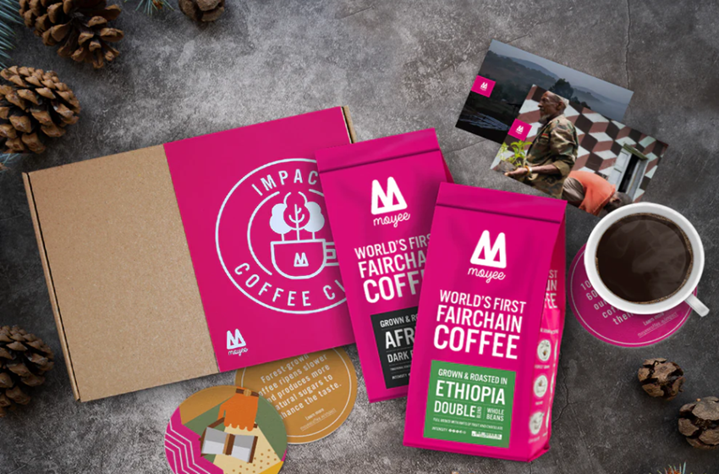
SUSTAINABILITY & CONSUMER RELATIONS
CASE STUDY: MOYEE COFFEE
Challenges in the coffee industry:
‘Big Coffee’, uneven distribution of profits - only 10% of coffee value remains in country of origin
Poverty - 90% of coffee farmers earn less than €2 a day
Environmental impact - habitat destruction and deforestation
Moyee’s approach: “Radically good coffee with a radical impact”
‘FairChain’ business model: share more of the value from coffee with coffee growing countries
Key: roasting, packaging and branding coffee in country of origin
Focus on social and environmental sustainability - helping coffee farmers earn a liveable wage and contribute to reforestation in coffee producing countries
Blockchain technology is central to Moyee’s business model and brand identity
Source: Moyee Coffee

Slide 33
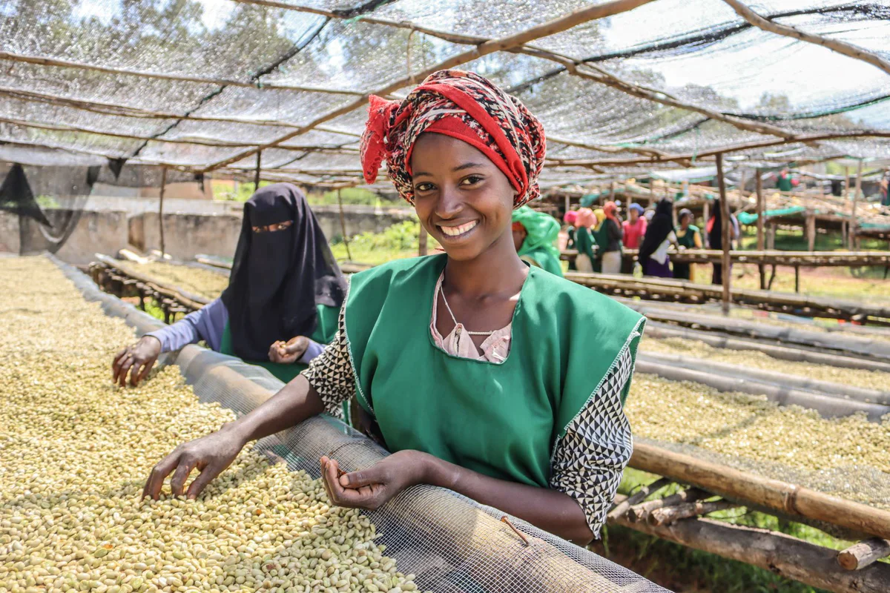
SUSTAINABILITY & CONSUMER RELATIONS
CASE STUDY: MOYEE COFFEE
Uses of Blockchain within Moyee Coffee:
End to end digitalised coffee value chain - 100% transparency
Moyee’s farmers are given mobile wallets, tap cards, unique ID numbers and barcodes - paid digitally
Geo-tagging farms and washing station to prove location
QR codes on the side coffee bags - consumers can scan with mobile phones and access information about the farmers and other supply chain actors, including who gets paid what
Consumers receive a digital token worth 50c upon purchasing Moyee Coffee, and can either:
Keep the token and get money back off their next purchase
Use the token to tip the farmer
Help fund social projects in coffee-growing communities
CASE STUDY: MOYEE COFFEE
Source: Moyee Coffee

Slide 34
HOW TO USE BLOCKCHAIN WITHIN THE AGRIFOOD SECTOR: CONCLUSIONS
Blockchain technology has many potential applications within the agrifood sector; major advantages include transparency, traceability and trust
Potential advantages to many actors in the supply chain, from farmers to producers to consumers
A relatively new technology only recently introduced in the agrifood sector - difficult to assess the full extent of its strengths and limitations, but initial results suggest great potential
However, Blockchain is also surrounded by ‘hype’, has limitations too - not a universal solution
Blockchain technology as a tool rather than a goal - achieving social and environmental sustainability requires a shift in attitude and outlook as well as the adoption of new technologies
Realising this potential will require increased overall levels of digitalisation and technical upskilling within the agrifood sector
A quickly developing technology - keep up to date with ongoing developments

Slide 35
BLOCKCHAIN IN PRACTICE:
CASE STUDIES
The European Commission support for the production of this publication does not constitute an endorsement of the contents which reflects the views only of the authors, and the Commission cannot be held responsible for any use which may be made of the information contained therein.

Slide 36
POWER OF CASE STUDIES
Case studies are a powerful educational tool. They provide the following benefits:
1. Real-world Context: Through case studies, theoretical knowledge finds practical grounding. We're not just discussing concepts; we're looking at how they play out in real scenarios.
2. Problem-Solving: Each case study presents a unique set of challenges. By diving into these situations, you're actively engaging in problem-solving, fostering critical thinking and analytical skills.
3. Relatable Learning: By seeing blockchain in action within familiar agrifood settings, the knowledge becomes more relatable and easier to grasp.
4. Diverse Perspectives: Case studies often showcase a variety of stakeholder viewpoints, from farmers to distributors, thus enriching our understanding of the topic.
Thus, the following case studies should help you understand the real-world application of blockchain within the agrifood sector.
Notes:
Provide introduction/overview of key concept(s), history/development to date, core problem/challenge as relevant.
Rename slide with relevant title
Make sure to incorporate images and visual aids to engage students.

Slide 37

CASE STUDY 1: CARREFOUR
Let’s meet Carrefour
The supermarket that launched Europe’s first food blockchain for its free-range Auvergne chicken
https://www.carrefour.com/en/group/food-transition/food-blockchain
Notes:
- This slide should list and define any key terms the students should know and may not be familiar with. Key terms should be written in bold.

Slide 38
CASE STUDY 1: CARREFOUR
In 2018, leading French-based retailer Carrefour has launched Europe’s first food blockchain through its free-range Auvergne chicken, one million of which were sold every year. The company has since extended the technology to many more animal and vegetable product lines, including eggs.
Traceability
Carrefour is using blockchain in the food sector so that each and every party along the length of the supply chain, including producers, processors and distributors, to provide traceability information about their particular role. For example, each batch – dates, places, farm buildings, distributed channels, potential treatments – can be traced and added to the database.
As a result, it can provide consumers a guarantee of complete product traceability, meets the growing desire for transparency from farm to fork.
Carrefour said it would be able to use it to share a secure database with all of its partners as well as guaranteeing higher levels of food safety for its customers
Notes:
- These slides should contain the main content of the module, broken into sub-sections for clarity. The content will vary depending on the module but should include topics such as trends in the industry/academic literature, pros and cons of this particular application of blockchain technology, practical/ethical dilemmas and considerations, thought-provoking questions etc.

Slide 39
CASE STUDY 1: CARREFOUR
QR code
So how does it work? In concrete terms, each product’s label features a QR code which consumers will be able to scan using their smartphones. This will provide them with information about the product and the journey it has taken – from where it was reared right up to when it was placed on the shelves: for example, for free-range Carrefour Quality Line Auvergne chicken, consumers were able to find out the following information:
Where the bird was reared
The name of the farmer
What feed was used (whether or not they were fed on French cereals and soya beans, on GMO products etc)
Any quality labels
Where the bird was slaughtered
Notes:
- These slides should contain the main content of the module, broken into sub-sections for clarity. The content will vary depending on the module but should include topics such as trends in the industry/academic literature, pros and cons of this particular application of blockchain technology, practical/ethical dilemmas and considerations, thought-provoking questions etc.

Slide 40
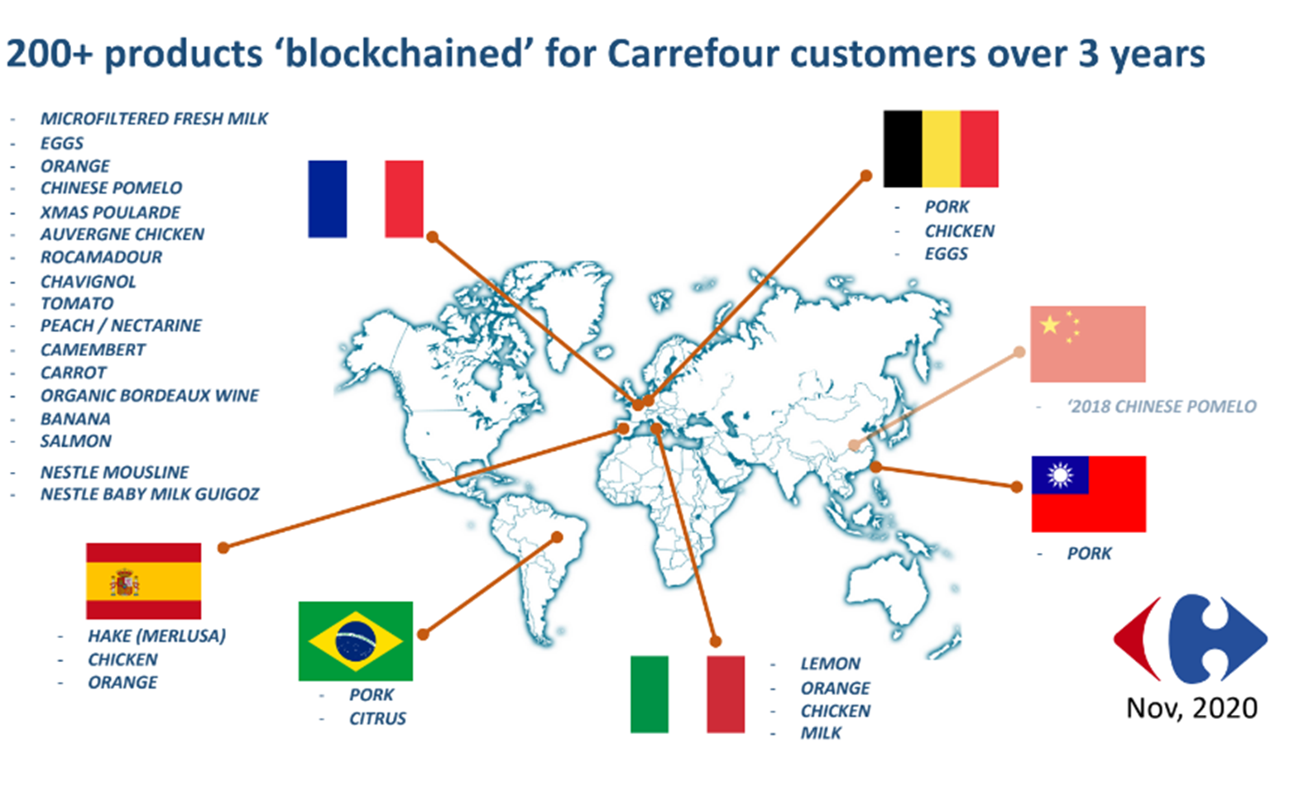
CASE STUDY 1: CARREFOUR
Read more: Carrefour uses blockchain to offer consumers greater supply chain transparency - RetailWire
Notes:
- These slides should contain the main content of the module, broken into sub-sections for clarity. The content will vary depending on the module but should include topics such as trends in the industry/academic literature, pros and cons of this particular application of blockchain technology, practical/ethical dilemmas and considerations, thought-provoking questions etc.

Slide 41
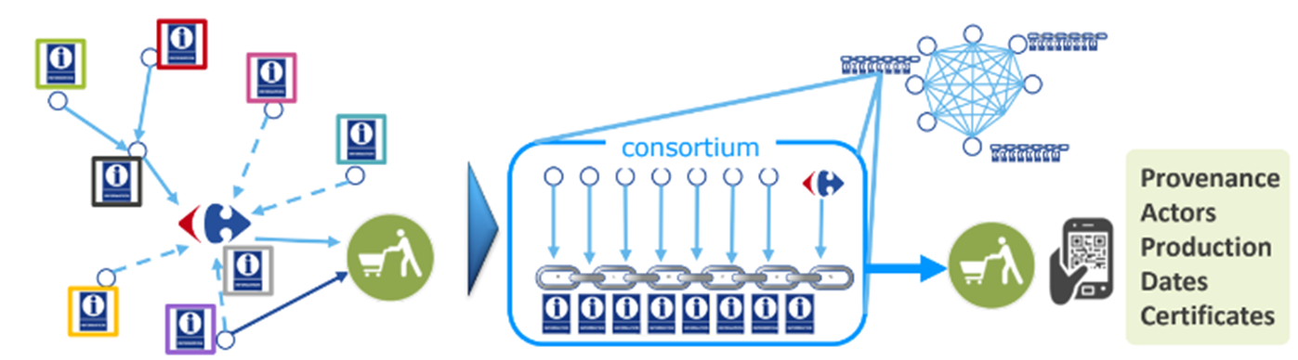
CASE STUDY 1: CARREFOUR
The trend for accurate and broader information is surging
73% of customers willing to pay for more quality / information
Labels and certification are numerous
Demand for local provenance
“Free from” segments rising
Customers are shifting from abundance to quality & trust
Carrefour’s blockchain organises community data into chains of blocks
Notes:
- These slides should contain the main content of the module, broken into sub-sections for clarity. The content will vary depending on the module but should include topics such as trends in the industry/academic literature, pros and cons of this particular application of blockchain technology, practical/ethical dilemmas and considerations, thought-provoking questions etc.

Slide 42
CASE STUDY 2: PROVENANCE
Let’s meet Provenance
The UK company revolutionizing transparency
https://www.provenance.org/
Notes:
- This slide should list and define any key terms the students should know and may not be familiar with. Key terms should be written in bold.

Slide 43
CASE STUDY 2: PROVENANCE
Founded in 2013 by Jessi Baker.
Mission: Empower brands to take steps toward greater transparency.
Tool: Blockchain-powered platform to trace products' origins.
Jessi Baker recognized the disconnect between products and their origins. With a a Master’s in Engineering (Cambridge University) and Design (Royal College of Art), she founded Provenance whilst doing a PhD in Computer Science (UCL).
Provenance is a digital platform enabling producers, manufacturers and retailers to track the journey of people, places and ingredients behind their products. They use blockchain and smart tagging technologies to revolutionise supply chain transparency. With Provenance, businesses can drastically reduce risk in their supply chain and foster a new form of consumer trust.
Notes:
- This slide should list and define any key terms the students should know and may not be familiar with. Key terms should be written in bold.

Slide 44
CASE STUDY 2: PROVENANCE
As a proud social enterprise and B Corp, they are committed to making business a force for good. The first to apply blockchain technology to supply chain in 2013, Provenance are now working with businesses in the UK and across global supply chains, including The Co-op supermarket, Sainsbury’s, Unilever, The World Bank, Greenpeace, organic certified farms across Europe and luxury brands in the food and fashion industry.
They are a member of the Ellen MacArthur foundation CE100 – pioneering open traceability systems for a circular economy and were featured in over 100 news titles in 2017.
Further reading:
TechCrunch – Provenance’s Story https://techcrunch.com/2015/09/21/provenance-aims-to-use-blockchain-technology-to-prove-authenticity/
Notes:
- It is recommended to include at least one visual aid (graph, diagram, chart, illustrative photo etc) per sub-section.

Slide 45
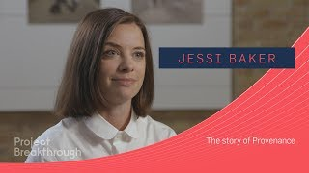
CASE STUDY 2: PROVENANCE
Video: The Story of Provenance - Interview with founder Jessi Baker
Notes:
- These short in-class exercises are intended to make the students stop, think and interact with the content so far. They also provide an opportunity for the teacher to see what the students have internalised or what they are struggling with. Responses could take the form of a menti poll, a word cloud, a mind map etc. Alternatively, this could be an opportunity for students to break out into small groups to discuss the topic together.

Slide 46
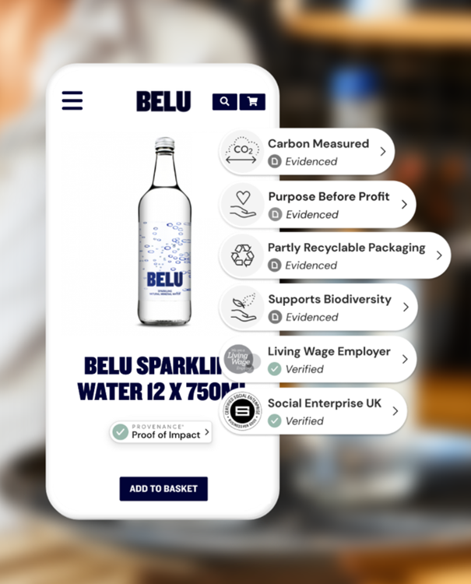
CASE STUDY 2: PROVENANCE
Example: Provenance-Belu Water Brand partnership
Launched in 2007, the Belu purpose is to change the way the world sees water. They invest profits into saving carbon emissions from entering the atmosphere, championing a circular economy and ending water poverty.
Since 2011, social enterprise Belu has committed to directing all of its net profit to WaterAid, a partnership that aims to bring clean water, decent toilets and good hygiene to everyone, everywhere. To date, they’ve sent over £5.5m. But BELU faced a challenge in translating its high-level brand purpose, and alignment with the UN’s Sustainable Development Goals, into tangible facts and claims that customers could easily understand and trust. It partnered with PROVENANCE.
Notes:
- These slides should contain the main content of the module, broken into sub-sections for clarity. The content will vary depending on the module but should include topics such as trends in the industry/academic literature, pros and cons of this particular application of blockchain technology, practical/ethical dilemmas and considerations, thought-provoking questions etc.

Slide 47
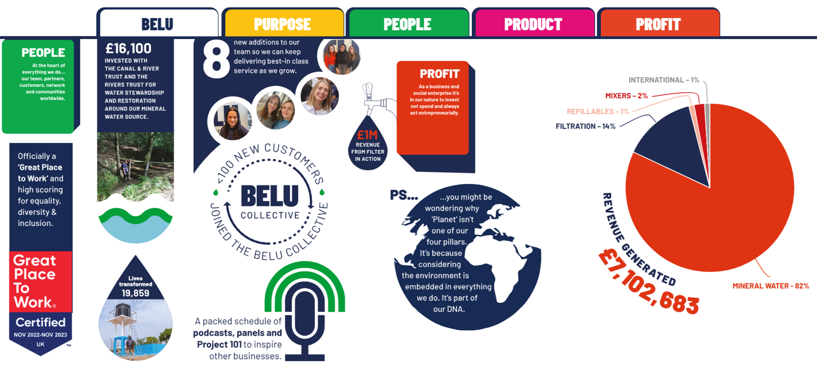
CASE STUDY 2: PROVENANCE
BELU publish a remarkable Impact Report, an easy overview of their impact initiatives allowing us to click through to see more information and proof.
Extract from the Belu 2022/2023 impact report
Notes:
- These slides should contain the main content of the module, broken into sub-sections for clarity. The content will vary depending on the module but should include topics such as trends in the industry/academic literature, pros and cons of this particular application of blockchain technology, practical/ethical dilemmas and considerations, thought-provoking questions etc.

Slide 48
SUBSTANTIVE CONTENT SUB-SECTION 2
Where they once articulated their brand purpose at a more abstract level, they are now communicating their impact in a way that their customers can easily pin down. BELU’s Proof Points also provide a useful asset in pitches to hospitality stockists, many of whom are increasingly focused on sustainable sourcing.
Read more about Provenance empowering Belu transparency
Provenance: BELU sustainability and transparency food & drink case study
Belu: Green credentials, not greenwash
Notes:
- These slides should contain the main content of the module, broken into sub-sections for clarity. The content will vary depending on the module but should include topics such as trends in the industry/academic literature, pros and cons of this particular application of blockchain technology, practical/ethical dilemmas and considerations, thought-provoking questions etc.

Slide 49
BLOCKCHAIN IN PRACTICE: CONCLUSIONS
Blockchain innovation in the agrifood sector is already a reality, and the potential uses and application of the technology are only likely to grow
Case studies demonstrate clear customer demand for increased transparency and traceability - Blockchain’s function as an immutable, decentralised ledger is well-suited to meet this need
Blockchain as a unique selling point, increase consumer confidence & brand loyalty
Links between Blockchain, traceability, and sustainability
Notes:
- These slides should contain the main content of the module, broken into sub-sections for clarity. The content will vary depending on the module but should include topics such as trends in the industry/academic literature, pros and cons of this particular application of blockchain technology, practical/ethical dilemmas and considerations, thought-provoking questions etc.

Slide 50
TRUSTWORTHY BLOCKCHAIN RESOURCES: WHO TO TRUST?
The European Commission support for the production of this publication does not constitute an endorsement of the contents which reflects the views only of the authors, and the Commission cannot be held responsible for any use which may be made of the information contained therein.

Slide 51

INTRODUCTION: TRUST
Trust has been widely examined from a psychological and organizational perspective. ​
Information systems (IS) research: the notion of a “human-to-technology trust relationship” was developed (Lankton, McKnight and Tripp, 2015, p. 882); describe trustworthiness of IT artifacts (Benbasat and Wang,2005)
Human treating computers as a social actor (Fussell et al., 2008)​
This kind of trust is also called human-like trust in technology (Lankton et al., 2015). ​
Notes:
- These slides should contain the main content of the module, broken into sub-sections for clarity. The content will vary depending on the module but should include topics such as trends in the industry/academic literature, pros and cons of this particular application of blockchain technology, practical/ethical dilemmas and considerations, thought-provoking questions etc.

Slide 52
BLOCKCHAIN & DIGITAL SECURITY
Trust in the blockchain can never be complete. Several elements have actually questioned this trust​
The ability to authenticate transactions while protecting digital identities:​
Blockchains provide privacy (e.g. through the use of pseudonyms) yet implement adapted security measures to guarantee that transactions are valid and that accounts are secure. This balance between identity protection and security management is a crucial factor in trusting the blockchain.​
Programming errors: Programmable blockchains imply a high risk of human programming errors, as happened with the 2016 attack on Ethereum. ​
In 4 weeks, the Decentralised Autonomous Organisation (the DAO), which enables its community to invest in venture capital, raised a spectacular amount of $150 million to fuel start-up projects wishing to build over Ethereum. ​
Notes:
- These slides should contain the main content of the module, broken into sub-sections for clarity. The content will vary depending on the module but should include topics such as trends in the industry/academic literature, pros and cons of this particular application of blockchain technology, practical/ethical dilemmas and considerations, thought-provoking questions etc.

Slide 53
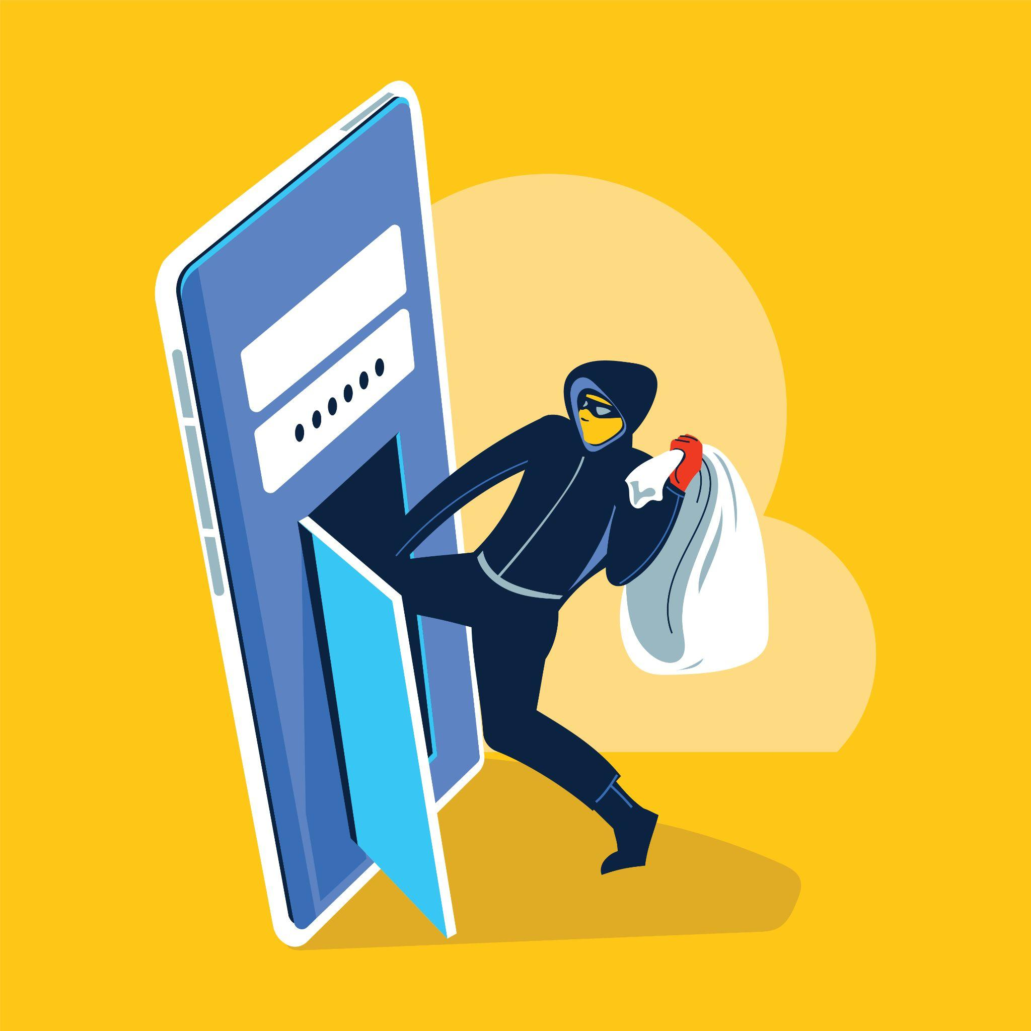

BLOCKCHAIN & DIGITAL SECURITY
The DAO was then robbed of $50 million by a group of hackers who exploited a vulnerability in the way smart contracts were implemented. ​
This error enabled the attackers to use the function designed to “cash out” an account several times. As Ethereum co-founder Vitalik Buterin wrote in a blog post, “This is an issue that affects the DAO specifically; Ethereum itself is perfectly safe.”​
In 2017, another attack on the wallet software Parity Wallet led to $30 million in ether being stolen.
Notes:
- It is recommended to include at least one visual aid (graph, diagram, chart, illustrative photo etc) per sub-section.

Slide 54
TRANSPARENCY & PRIVACY BREACHES IN THE BLOCKCHAIN
A blockchain relies on the pseudonymity of its participants, which means that once the real identity of an account holder is revealed, all of the transactions they made from their account can be revealed. As explained above, many techniques can protect users’ real identity, including owning multiple accounts (some only used once) and merging transactions, as is possible with Coinjoin.​
Once the​ real identity of an account holder is revealed, all of the transactions they made from their account can be revealed.​
Techniques for protecting a user’s real identity: owning multiple accounts (some only used once), merging transactions
Notes:
- These short in-class exercises are intended to make the students stop, think and interact with the content so far. They also provide an opportunity for the teacher to see what the students have internalised or what they are struggling with. Responses could take the form of a menti poll, a word cloud, a mind map etc. Alternatively, this could be an opportunity for students to break out into small groups to discuss the topic together.

Slide 55

STRUCTURAL LIMITS OF BLOCKCHAIN
Blockchain technologies have structural limits ​
They cannot be considered as a basis for complete trust and confidence. Indeed, organisational issues relating to power dynamics between actors and user appropriation as well as technical factors make studying the actual scope of this technology very complex. However, they indicate once more that mere transparency does not necessarily come with complete trust and an adequate protection of personal data​
Notes:
- These slides should contain the main content of the module, broken into sub-sections for clarity. The content will vary depending on the module but should include topics such as trends in the industry/academic literature, pros and cons of this particular application of blockchain technology, practical/ethical dilemmas and considerations, thought-provoking questions etc.

Slide 56
MODULE 6: OVERALL CONCLUSIONS
Blockchain is a complex new technology that holds much potential for the agrifood sector
Key advantages: efficiency, trust, transparency, traceability
However, Blockchain also has notable limitations and flaws which must also be considered
A relatively new technology - surrounding ‘hype’, still developing - too soon to definitively assess yet?
Applications of Blockchain in agrifood likely to increase in coming years - keep up to date with new developments
Notes:
- These slides should contain the main content of the module, broken into sub-sections for clarity. The content will vary depending on the module but should include topics such as trends in the industry/academic literature, pros and cons of this particular application of blockchain technology, practical/ethical dilemmas and considerations, thought-provoking questions etc.

Slide 57
LINKS TO FURTHER MATERIALS
Introduction to Blockchain in the agrifood chain:
https://doi.org/10.1155/2022/8011525
https://doi.org/10.3390/agriculture12091333
https://doi.org/10.3390/bdcc7020086
https://www.pcmag.com/how-to/what-is-the-blockchain-and-whats-it-used-for
https://www.agmatix.com/blog/importance-of-data-standardization-and-harmonization-in-agriculture/ ​
https://www.scnsoft.com/blockchain/food-supply-chain
https://www.pcmag.com/how-to/what-is-the-blockchain-and-whats-it-used-for ​
The building blocks of Blockchain and the Blockchain mechanism:
https://101blockchains.com/permissioned-vs-permissionless-blockchains/
https://www.sciencedirect.com/science/article/pii/S0360835221000346?via%3Dihub
https://www.bcg.com/capabilities/digital-technology-data/blockchain
https://www.techtarget.com/searchcio/feature/Top-9-blockchain-platforms-to-consider
Notes:
- These slides should contain the main content of the module, broken into sub-sections for clarity. The content will vary depending on the module but should include topics such as trends in the industry/academic literature, pros and cons of this particular application of blockchain technology, practical/ethical dilemmas and considerations, thought-provoking questions etc.

Slide 58
LINKS TO FURTHER MATERIALS
How to use Blockchain technology within the agrifood sector:
https://www.undp.org/sites/g/files/zskgke326/files/2021-11/UNDP-Blockchain-for-Agri-Food-Traceability.pdf​
https://www.sciencedirect.com/science/article/abs/pii/S0959652620347752​
https://www.sciencedirect.com/science/article/pii/S2772390922000609​
https://www.nature.com/articles/s41599-023-01658-2.pdf​
https://www.researchgate.net/publication/343090613
https://papers.ssrn.com/sol3/papers.cfm?abstract_id=3028164​
Blockchain in practice: case studies:
https://www.carrefour.com/en/group/food-transition/food-blockchain
https://retailwire.com/discussion/carrefour-uses-blockchain-to-offer-consumers-greater-supply-chain-transparency/
https://www.provenance.org/
https://techcrunch.com/2015/09/21/provenance-aims-to-use-blockchain-technology-to-prove-authenticity/
https://belu.org/green-credentials-not-greenwash/
https://www.provenance.org/case-studies/belu
Notes:
- These slides should contain the main content of the module, broken into sub-sections for clarity. The content will vary depending on the module but should include topics such as trends in the industry/academic literature, pros and cons of this particular application of blockchain technology, practical/ethical dilemmas and considerations, thought-provoking questions etc.

Slide 59
LINKS TO FURTHER MATERIALS
Trustworthy Blockchain resources: who to trust?:
https://aisel.aisnet.org/jais/vol16/iss10/1/
https://www.researchgate.net/publication/220580421_Trust_In_and_Adoption_of_Online_Recommendation_Agents
https://dl.acm.org/doi/10.1145/1349822.1349842
https://ift.onlinelibrary.wiley.com/doi/full/10.1111/1750-3841.15477
https://www.sciencedirect.com/science/article/pii/S2096248723000279
https://www.mdpi.com/2673-4591/40/1/7
Notes:
- These slides should contain the main content of the module, broken into sub-sections for clarity. The content will vary depending on the module but should include topics such as trends in the industry/academic literature, pros and cons of this particular application of blockchain technology, practical/ethical dilemmas and considerations, thought-provoking questions etc.

Slide 60
SELF-TEST QUIZ
What is blockchain?
  A decentralized, distributed ledger technology used to record transactions across multiple computers.
  A centralized database controlled by a single entity to store transaction records.
  A type of cryptocurrency used for online purchases and investments.
  A software application used for creating digital artwork.

Slide 61
SELF-TEST QUIZ
What are some opportunities presented by blockchain technology?
  Increased transparency, efficiency, and security in various industries such as finance, supply chain, and healthcare.
  Enhanced privacy through centralized control of data.
  Reduction in transaction costs by eliminating the need for intermediaries.
  Limited applicability only to the cryptocurrency market.

Slide 62
SELF-TEST QUIZ
What role do cryptography functions serve in blockchain technology?
  Securing transactions and ensuring data integrity through encryption and digital signatures.
  Providing real-time analytics and data visualization.
  Regulating the supply of digital assets within the blockchain network.
  Facilitating communication between different nodes in the network.

Slide 63
SELF-TEST QUIZ
How does blockchain technology differ from traditional databases?
  Blockchain offers decentralized, immutable, and transparent record-keeping, while traditional databases are typically centralized and mutable.
  Traditional databases provide better scalability and performance compared to blockchain.
  Blockchain relies on a single central authority for data management, unlike traditional databases.
  Traditional databases are more resistant to cyber attacks compared to blockchain.

Slide 64
SELF-TEST QUIZ
How is blockchain different from the cloud?
  Blockchain is a decentralized and distributed ledger technology, whereas the cloud is a centralized network of servers for storage and computing.
  Blockchain provides unlimited storage capacity, while the cloud has limited storage capabilities.
  The cloud relies on cryptographic algorithms for security, whereas blockchain uses traditional encryption methods.
  Blockchain offers faster data access and retrieval compared to the cloud.

Slide 65
SELF-TEST QUIZ
Is blockchain usable in the agri-food sector?
  Yes, blockchain can improve transparency, traceability, and efficiency in the agri-food supply chain, helping to enhance food safety and quality assurance.
  No, blockchain technology is not compatible with the diverse operations and stakeholders involved in the agri-food sector.
  Yes, but only for large-scale agri-food companies; small and medium-sized enterprises cannot benefit from blockchain.
  No, because the agri-food sector does not require transparency or traceability in its operations.

Slide 66
SELF-TEST QUIZ
What are some key advantages of blockchain technology?
  Efficiency, trust, transparency, and traceability.
  Cost-effectiveness, centralized control, rapid scalability, and anonymity.
  Complexity, limited accessibility, high energy consumption, and susceptibility to hacking.
  Data fragmentation, reliance on intermediaries, slow transaction speed, and lack of security.

Slide 67
SELF-TEST QUIZ
What are the defining characteristics of a "block" and a "chain" in blockchain technology?
  Efficiency in data storage and processing, and the sequential linking of blocks to ensure trust, transparency, and traceability.
  The encryption of data within each block and the decentralization of control across multiple nodes.
  The use of cryptographic hashing algorithms and the implementation of smart contracts.
  The creation of a digital ledger and the distribution of digital assets.

Slide 68
The European Commission support for the production of this publication does not constitute an endorsement of the contents which reflects the views only of the authors, and the Commission cannot be held responsible for any use which may be made of the information contained therein.

